Slide 1

Revision of the NHP & Development of the IAP
Overview of the draft NHP & Implementation Action Plan
Dr. Thomas Chiramba
Nambia University of Science and Technology

Slide 2

NAMIBIA UNIVERSITY
OF SCIENCE AND TECHNOLOGY
1. Status & the formulation process
Status
Draft NHP setting the scene & defining Goal/s; Objectives; Strategies; Some activities and some outputs.
Draft of IAP with strategies, outputs, indicators & actors
Consultations
Four consultations: 2 regional { Otjiwarongo & Oshakati}, two National in Windhoek
Focus of consultations on main elements of NHP; IAP - activities, outputs, key indicators, actors/responsible institutions i.e. what & who?
Several Meetings with both NPC and MOF

Slide 3
NAMIBIA UNIVERSITY
OF SCIENCE AND TECHNOLOGY
2. Goal of Revised NHP
The overarching policy goal is to enable broad access to housing opportunities to progressively improve living and socio-economic conditions for urban and rural residents through a committed partnership between stakeholders in government, civil society, the private sector, residents and international development partners

Slide 4
NAMIBIA UNIVERSITY
OF SCIENCE AND TECHNOLOGY
3. The Contents of the draft NHP and IAP
NHP Scope
Executive Summary
Introduction
Background
Rationale
Alignment
Guiding Principles
Policy Principles
Policy Direction
Implementation Action Plan
Conclusion
Appendices
Notes

Slide 5
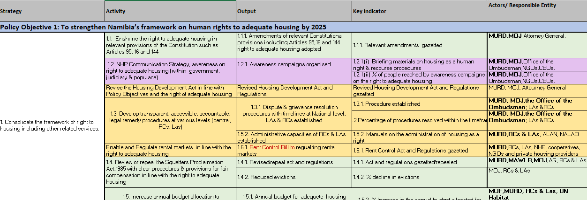
NAMIBIA UNIVERSITY
OF SCIENCE AND TECHNOLOGY
3. The Contents of the draft NHP and IAP
Matrix IAP

Slide 6
NAMIBIA UNIVERSITY
OF SCIENCE AND TECHNOLOGY
The Policy Objectives , Selected Strategies and Activities
Policy Objective 1: To strengthen Namibia’s framework on human rights to adequate housing by 2025
Amend Constitution Articles 95, 16 and 144 to ‘include right to adequate housing’
Review the Squatters Proclamation 1985
Increase national budget allocation for land and housing delivery
Policy Objective 2: To unlock housing opportunities at scale for urban and rural residents/neighborhoods at all socio-economic levels by 2030
Consolidate NHIS
Develop and implement Local Housing Action Plans

Slide 7
NAMIBIA UNIVERSITY
OF SCIENCE AND TECHNOLOGY
Policy Objective 3: To re-align state-supported housing initiatives proportionally to demographic distribution by 2025
Revitalize and increase funding DBTP
Increase funding to community revolving
Policy Objective 4: Capacitate OMAs and non-state implementers to accelerate and enhance implementation of government funded housing programs
Strengthen the coordination and management capacity
Build technical capacities of OMAs and non state implementers

Slide 8
NAMIBIA UNIVERSITY
OF SCIENCE AND TECHNOLOGY
Policy Objective 5: To focus public expenditure proportionally on priority target groups
Define Subsidy types
Build capacity across board to apply subsidies
Policy Objective 6: To increase private sector and international investment in the provision of adequate housing
Define incentives to attract private sector contribution to land and housing
Define and place obligations on private sector for land and housing development.

Slide 9
NAMIBIA UNIVERSITY
OF SCIENCE AND TECHNOLOGY
Policy Objective 7: To improve environmental, social, and spatial sustainability of neighborhoods and housing units in line with Sustainable Development Goals
Promote mixed land use and public open spaces in low income neighborhoods for economic opportunities
Promote inclusive housing through densification
Policy Objective 8: To encourage applied research, innovation and collective learning to improve affordability , increase funding & enhance delivery of housing for priority target groups
Upscale research and innovation in land and housing delivery
Promote uptake of research results and innovation in land and housing

Slide 10
NAMIBIA UNIVERSITY
OF SCIENCE AND TECHNOLOGY
4. Summary - key policy shifts & focus
Focus on informal settlement upgrading along side accelerated sustainable greenfield development
Introduces and differentiates housing opportunities (land) and housing provision within the context of incremental development
Places emphasis on a human rights-based approach (right to adequate housing) and remedy mechanisms

Slide 11
NAMIBIA UNIVERSITY
OF SCIENCE AND TECHNOLOGY
Summary - Key policy shifts & focus continues…
Clearly identifies priority target groups (ultra-low and low-income = 88% of population)
Clarifies the system of subsidies for housing opportunities
Highlights and prioritizes support for rural housing
Advocates for development of context specific, needs based and sustainable services – including renewable energy, decentralized water and sanitation

Slide 12
NAMIBIA UNIVERSITY
OF SCIENCE AND TECHNOLOGY
Summary -Key policy shifts & continues…
Strong alignment of goal, objectives, and strategies guided by NPC guidelines
Includes a comprehensive Implementation Action Plan
Based on a partnership approach and expanded private sector, civil society and community contribution

Slide 13
NAMIBIA UNIVERSITY
OF SCIENCE AND TECHNOLOGY
5. Way Forward
Currently finalizing IAP
Baseline data, timeframes, targets, budget/resources estimations - i.e. when, how and with what means?
Expected date of Completion- Mid March 2023

Slide 14
NAMIBIA UNIVERSITY
OF SCIENCE AND TECHNOLOGY
Thank You!

