Slide 1
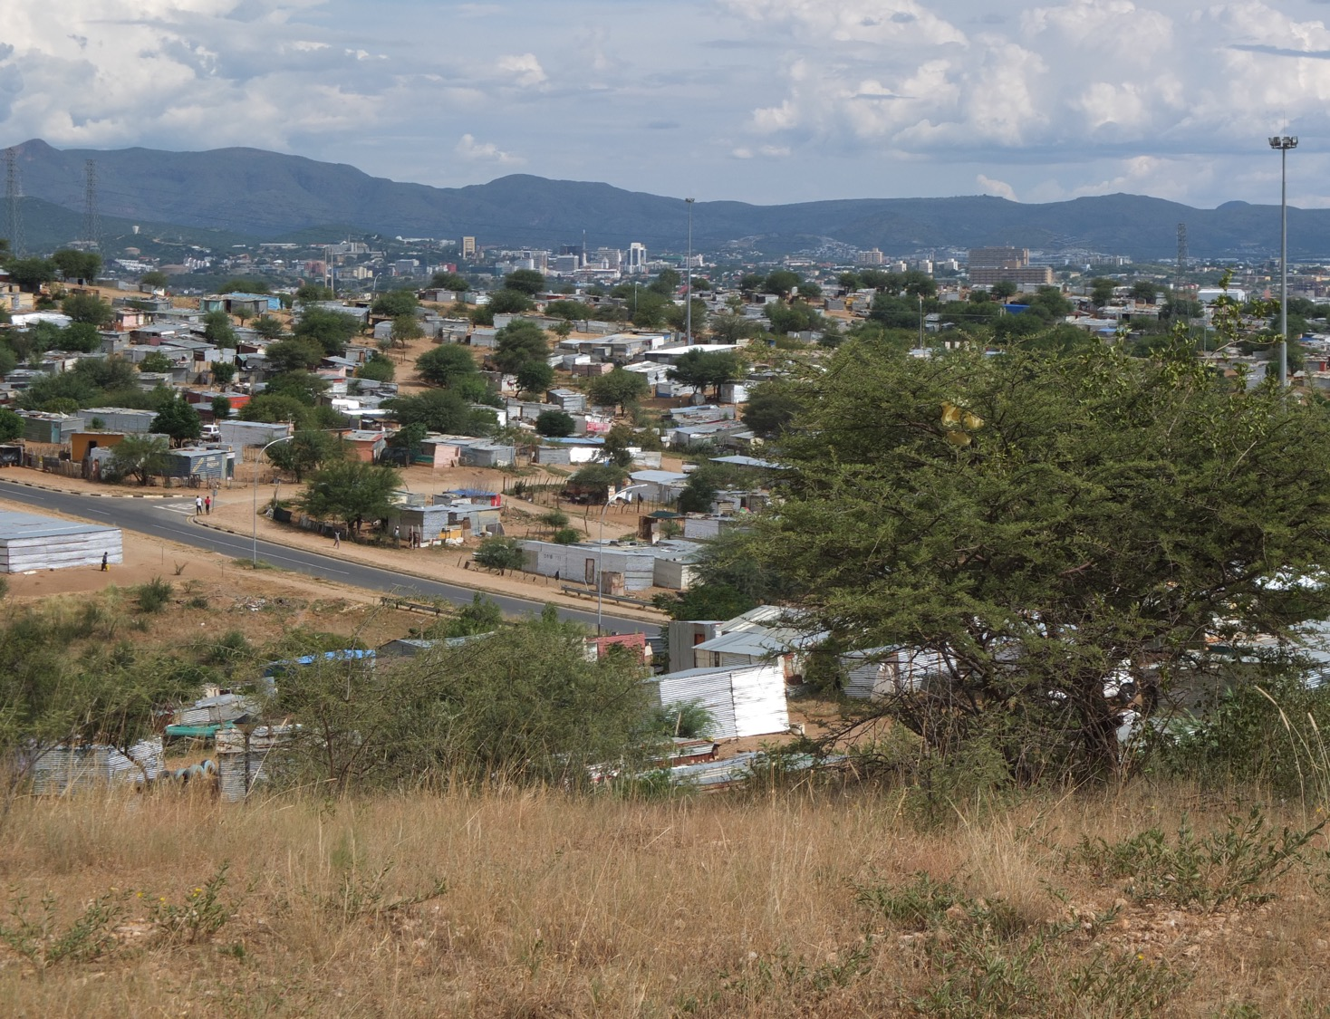

Challenges/opportunities: land and housing in Namibia
Dr Guillermo Delgado Acting director Institute for Land, Livelihoods and Housing
22 February 2023

Slide 2
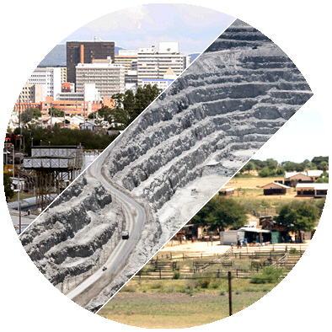
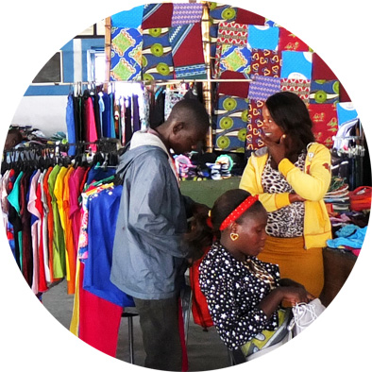
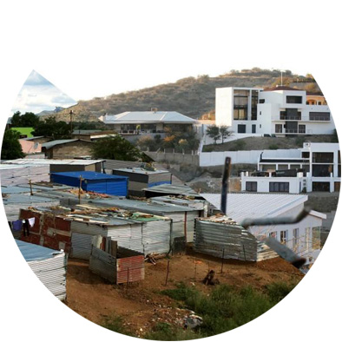
LAND
LIVELIHOODS
HOUSING
Research
Outreach
Projects
Education*

Slide 3
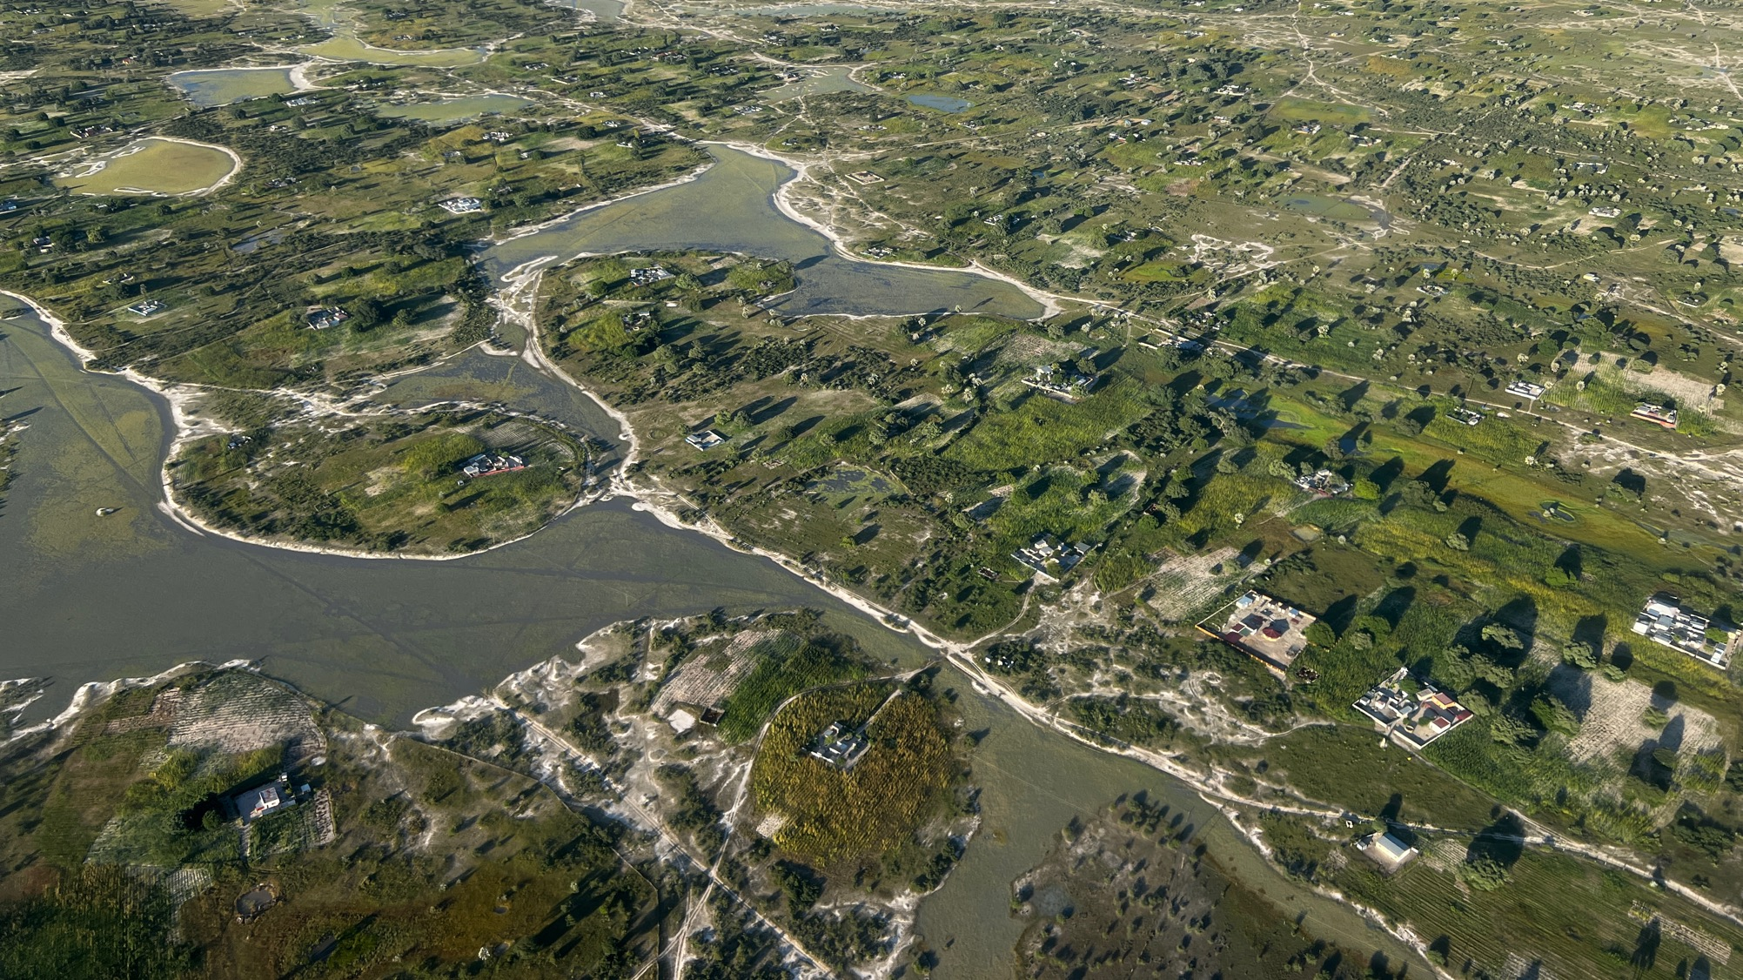
Beyond urban/rural:
a territorial approach

Slide 4
Most inhabitants in Namibia are within the ultra & low-income groups: There is a need to define affordability > addressed through NHP
INCOME GROUP DESIGNATION | 2009/10 Namibian Household Income and Expenditure Survey (NHIES) |  |  |  |  | 2015/16 NHIES
 | Income Deciles | % of overall Population |  | Average Household Size | Average Monthly Household Income (N$) | Average Monthly Household Income (N$) | Housing Affordability (max. 30% of income) (N$) | Affordable Loan (7.5% interest over 20 years) (N$)
ULTRA-LOW (Monthly household income range up to N$ 5,000) | 1-10 | 15.9 | 62.4 | 7.5 | 1,308 | 1,543 | 463 | 57,470
 | 11-20 | 13.5 |  | 6.4 | 1,811 | 2,565 | 770 | 95,580
 | 21-30 | 12.3 |  | 5.8 | 2,167 | 3,222 | 967 | 120,040
 | 31-40 | 11 |  | 5.2 | 2,520 | 4,004 | 1,201 | 149,080
 | 41-50 | 9.7 |  | 4.6 | 2,873 | 4,518 | 1,356 | 168,320
LOW (Monthly household income range N$ 5,000-10,000) | 51-60 | 8.8 | 25.1 | 4.2 | 3,434 | 5,441 | 1,632 | 202,580
 | 61-70 | 8.3 |  | 3.9 | 4,276 | 6,857 | 2,057 | 255,340
 | 71-80 | 8 |  | 3.8 | 6,063 | 8,250 | 2,475 | 307,230
MIDDLE (Monthly household income range N$ 10,000-20,000) | 81-90 | 6.6 | 9.8 | 3.1 | 8,473 | 11,936 | 3,581 | 444,520
 | 91-95 | 3.2 |  | 3 | 14,832 | 17,882 | 5,365 | 665,970
HIGH (Monthly household income range N$ 20,000-40,000) | 96-98 | 1.7 |  | 2.7 | 24,756 | 29,589 | 8,877 | 1,101,920
ULTRA HIGH (Monthly household income above N$ 40,000) | 99-100 | 1.1 |  | 2.5 | 47,758 | 67,337 | 20,201 | 2,507,590

Slide 5
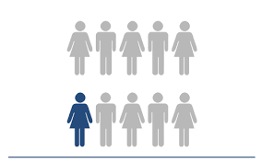
Only 1 out of every 10 people in Namibia can access “the formal”

Slide 6
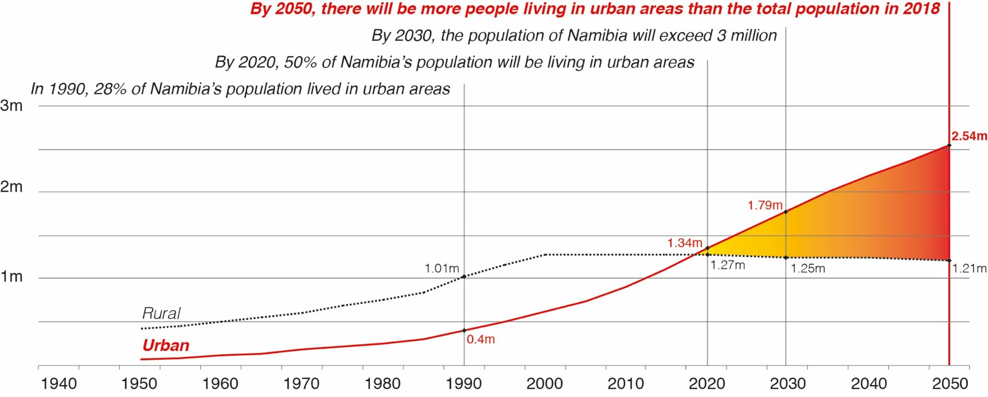
Namibia’s future is urban
Source: Lühl, P., & Delgado, G. (2018). Urban Land Reform in Namibia: Getting Ready for Namibia’s Urban Future. Presented at the Second National Land Conference, Windhoek. Retrieved from http://dna.nust.na/landconference/submissions_2018/policy-paper-urban-land-reform-2018-final.pdf with data from UNDESA. (2018). World Urbanization Prospects: The 2018 Revision. United Nations Population Division, Department of Economic and Social Affairs. https://esa.un.org/unpd/wup/
Notes:
Informal settlements / rural areas won’t disappear / the biggest challenges are yet to come

Slide 7
Land and housing-wise,
what works for the 90% of the population?

Slide 8
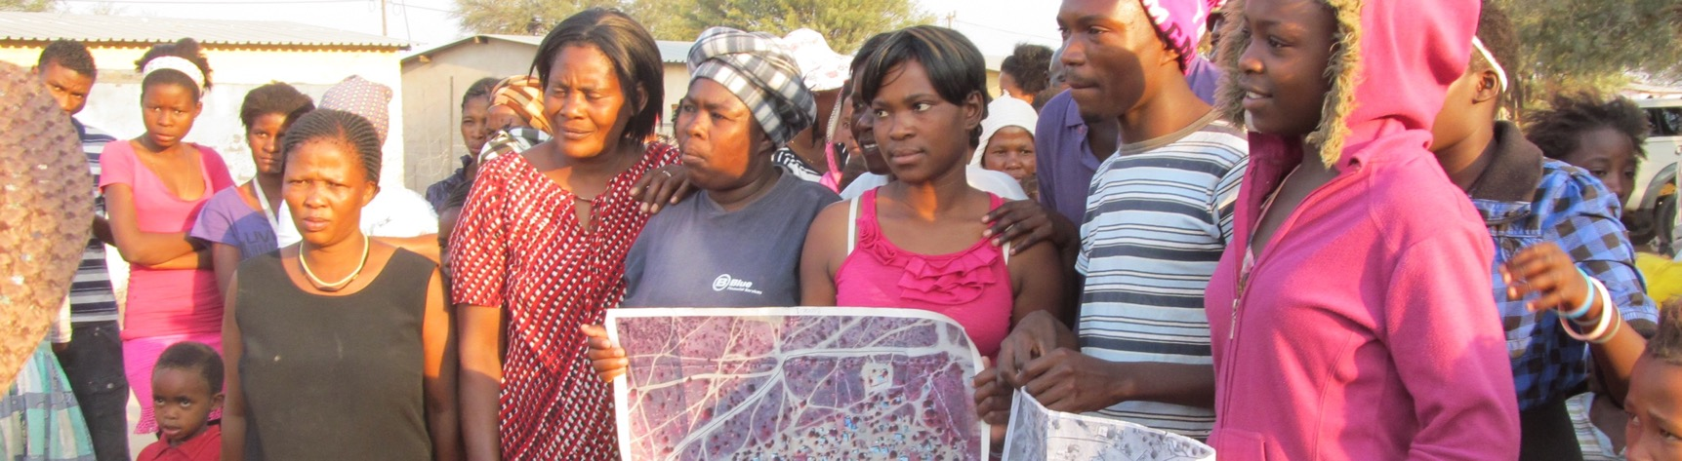
Land and housing-wise,
what works for the 90% of the population?
GRN: “Build Together”
NGO/CBO’s: SDFN/NHAG
LA “housing schemes” (?)
“land delivery plans” (?)

Slide 9
What do we know about urban areas in Namibia…?
…if we know that urban development innovation happens mainly at the local level*?
*Source: UN. (2017). New Urban Agenda. United Nations. http://habitat3.org/the-new-urban-agenda

Slide 10
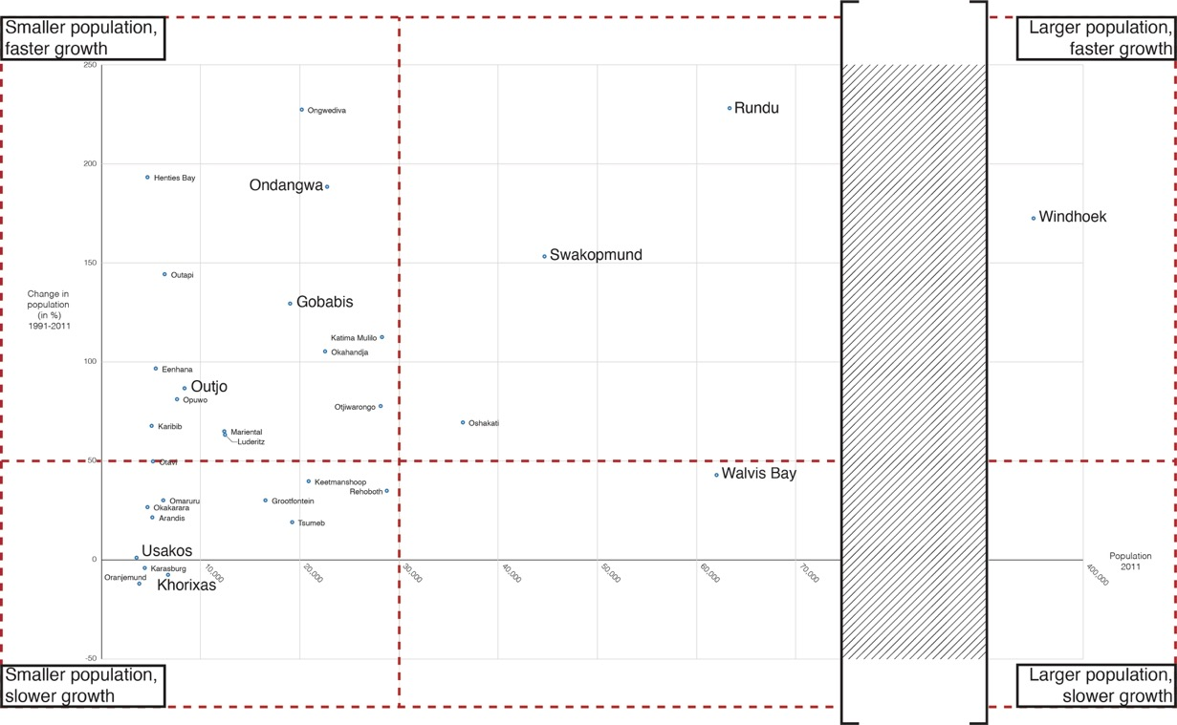
Urban areas are different; however, differentiated approaches remain lacking
Small population + growing fast
Large population + growing fast
Change in population
1991-2011
(%)
Population
2011
Small population + growing slow
Large population + growing slow
Source: Delgado, G., & Mendelsohn, M. (forthcoming). Urban areas in Namibia, implications of their growth rate and size (Document Note No. 5/2029). Integrated Land Management Institute.
Notes:
Budgets, migration, geology/climate

Slide 11
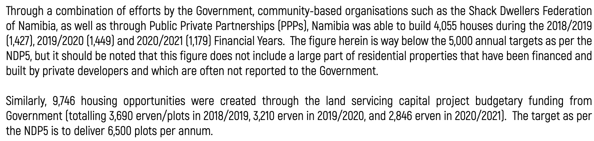
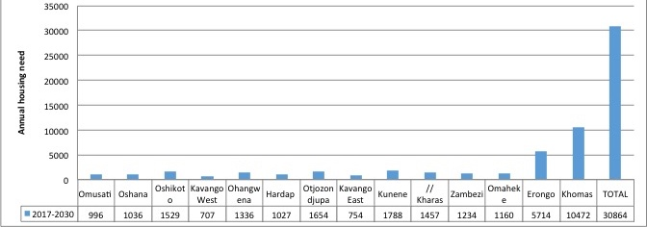
Scale of the challenge
LAND / HOUSING DELIVERED
Source: Republic of Namibia. (2021). Namibia’s Second Voluntary National Review Report on the Implementation of the Sustainable Development Goals Towards Agenda 2030. National Planning Commission. https://sustainabledevelopment.un.org/content/documents/279462021_VNR_Report_Namibia.pdf
SCALE OF THE NEED
Source: Asino, K., & Christensen, Å. (2018). Assessment of Housing Needs in Namibia (ILMI Working Paper No. 8). Integrated Land Management Institute. http://ir.nust.na:80/xmlui/handle/10628/608

Slide 12
Scale of the challenge
LAND / HOUSING DELIVERED
Source: Republic of Namibia. (2021). Namibia’s Second Voluntary National Review Report on the Implementation of the Sustainable Development Goals Towards Agenda 2030. National Planning Commission. https://sustainabledevelopment.un.org/content/documents/279462021_VNR_Report_Namibia.pdf
LAND: 3,248 / year
HOUSING: 1,351 / year
TOTAL: 4,600 / year
SCALE OF THE NEED
Source: Asino, K., & Christensen, Å. (2018). Assessment of Housing Needs in Namibia (ILMI Working Paper No. 8). Integrated Land Management Institute. http://ir.nust.na:80/xmlui/handle/10628/608
LAND & HOUSING:
TOTAL: 30,000 / year

Slide 13
Scale of the challenge
LAND / HOUSING DELIVERED
TOTAL: 4,600 / year
SCALE OF THE NEED
TOTAL: 30,000 / year

Slide 14
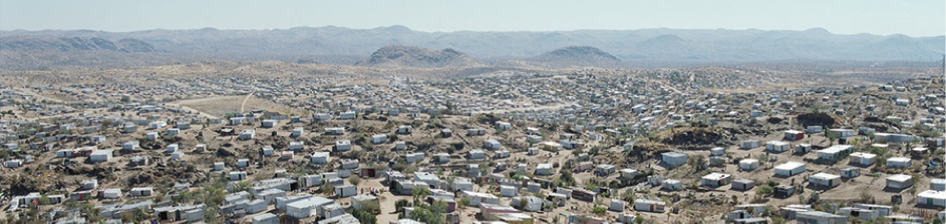
Informal settlements: a challenge or an opportunity? What are the realities?
Can we plan for informal settlements?
Can we upgrade with inhabitants living informal settlements?

Slide 15
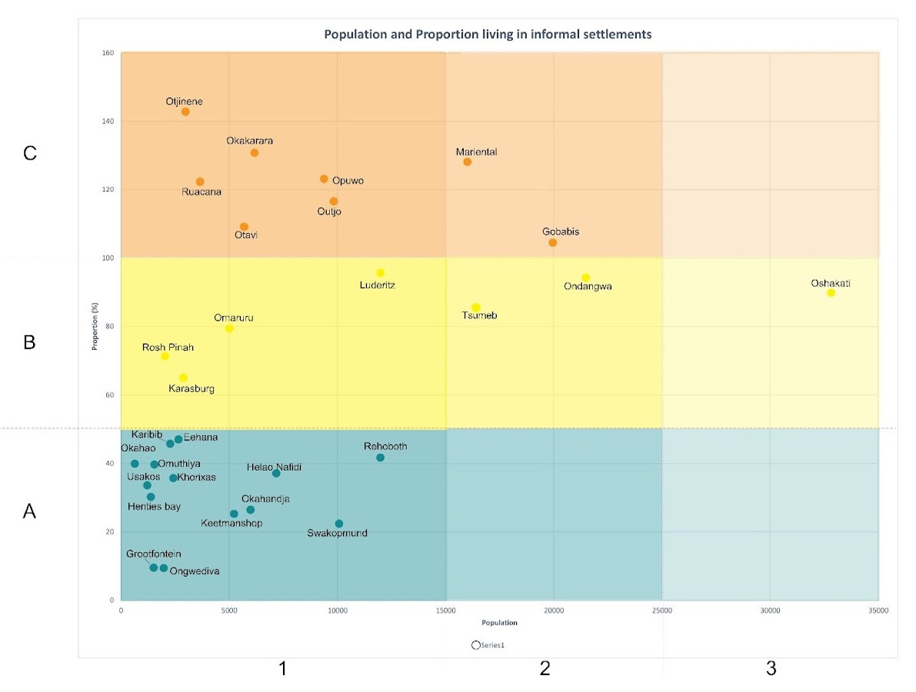
How many informal settlements do LAs in Namibia have?
NOTE: Windhoek, Rundu excluded from graph
Source: Draft National Strategy for Informal Settlement Upgrading

Slide 16
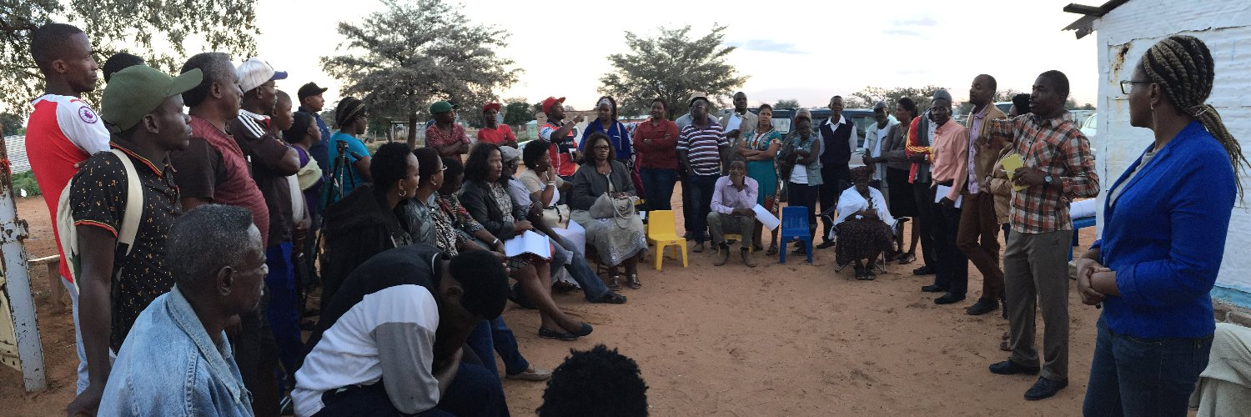
PARTNERSHIP APPROACH
Learning exchanges
Localised strategies

Slide 17
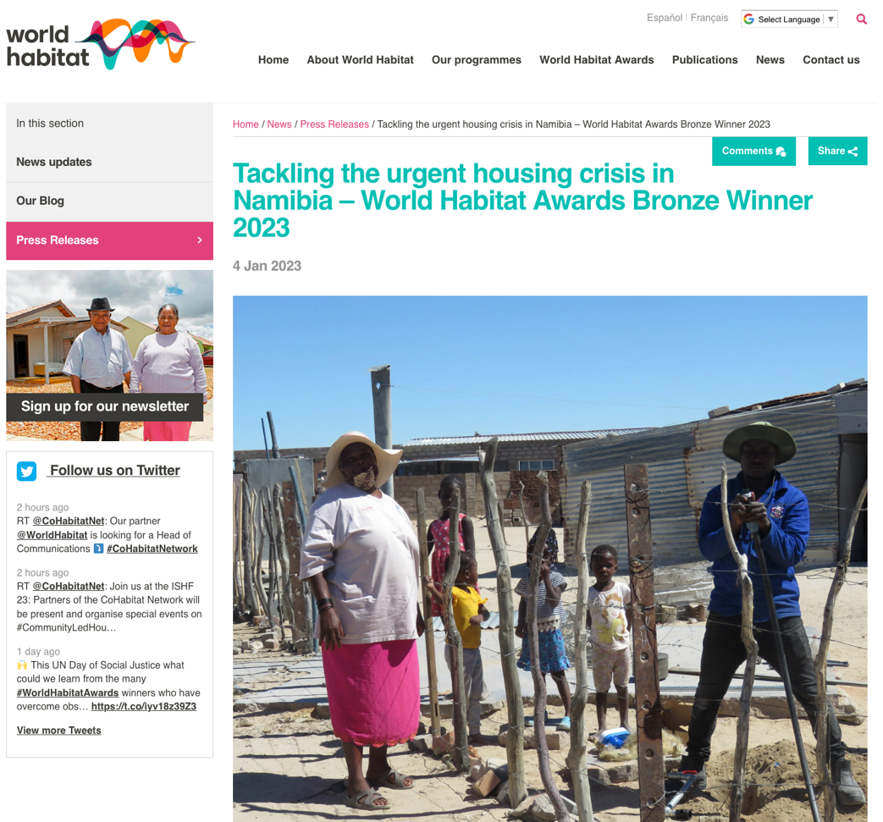
STRATEGY

Slide 18




About the Alliance
https://nationalalliance.nust.na/
A partnership approach to scaling up security of tenure
and housing opportunities through co-production between organised communities, local and regional authorities, central government, and universities.
The Alliance partners are the Namibia Housing Action Group (NHAG) / Shack Dwellers Federation of Namibia (SDFN); the Namibia Association of Local Authority Officials (NALAO) and the Association of Local Authorities in Namibia (ALAN); the Civil Society Organisations Working Group on Land Reform (CSO-WGLR); and the Namibia University of Science and Technology (NUST). The partners are working in partnership with the Ministry of Urban and Rural Development (MURD).
In partnership
With:

Slide 19
What can NUST do?
New Post-Graduate Programme on Informal Settlement Upgrading
Opening 2024
Semester 1
Principles and Practices of Settlement Upgrading.
Participatory Design and Communication Skills
Land Administration for Tenure Security
Semester 2 courses
Popular Urban Economies and Sustainable Livelihoods
Environment and Incremental Service Engineering
Financing and Management of Settlement Upgrading
Semester 3 + 4 Applied Participatory Settlement Upgrading Studio

Slide 20
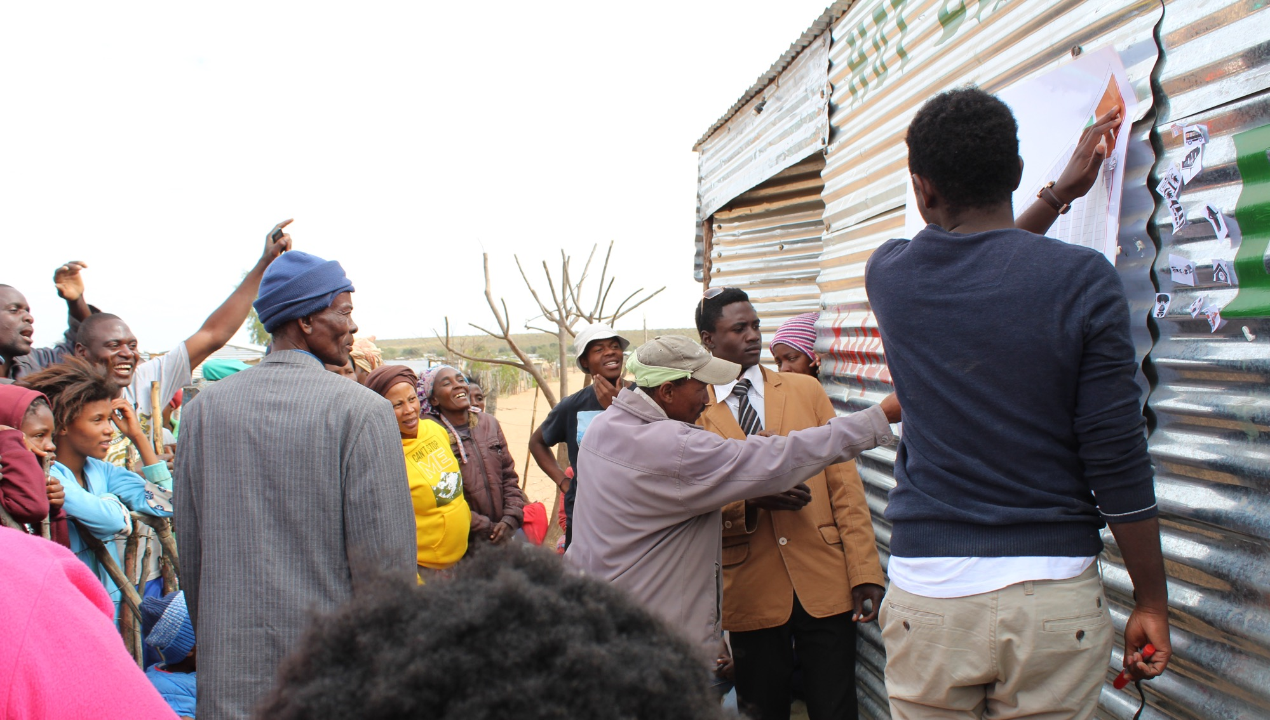
Local Housing Action Plans (NHP revision)
housing@nust.na
Participatory informal settlement upgrading with NUST students, Gobabis Municipality and community members, Gobabis. Photo: Taleni Iyambo
Notes:
Co-produced: produced together, as a team; not client/service provider authority/subject // Prizes & best practices

Slide 21
Missing themes (suggestions for further discussions)

Slide 22
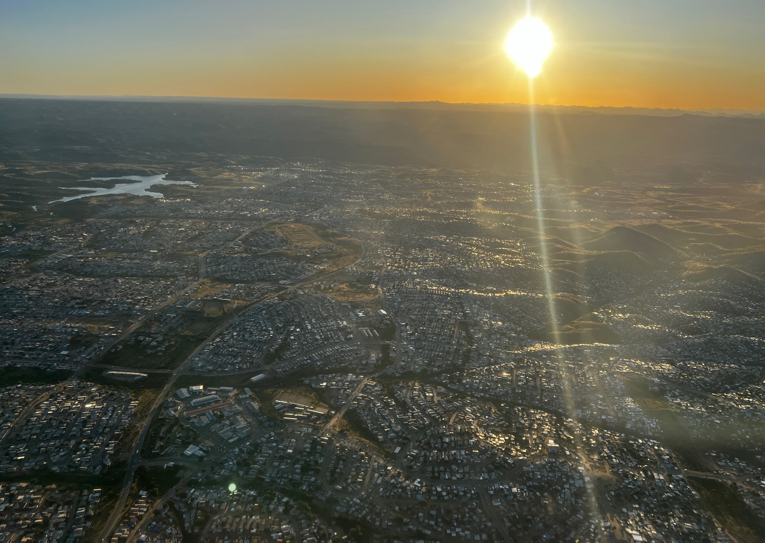
For Namibia to get development right, it needs to get urban development right
A house is the most important asset for the urban poor
Source: Moser, C. (Ed.). (2007). Reducing Global Poverty: The Case for Asset Accumulation. The Brookings Institution.

Slide 23
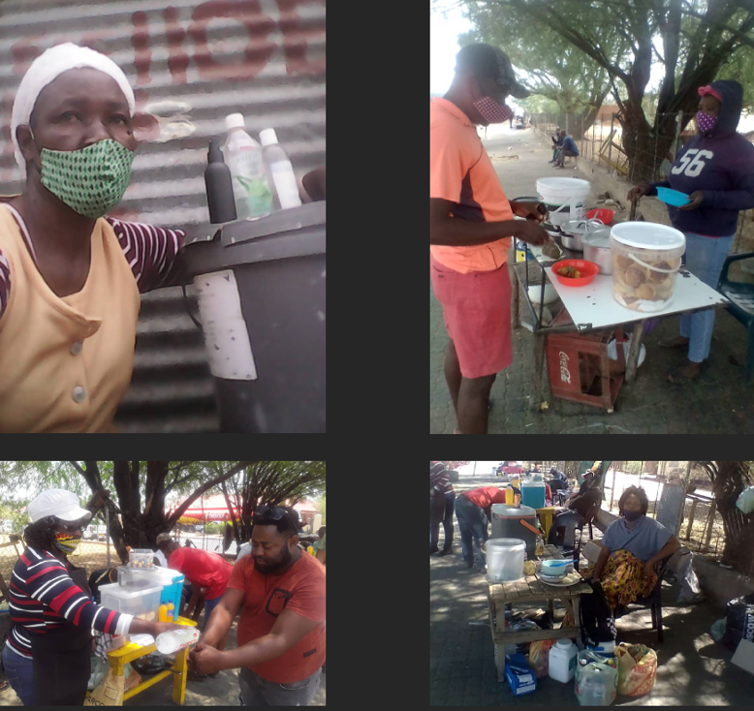
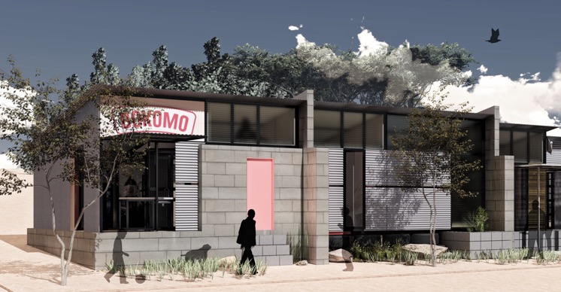
Informal trade 1. street trade 2. home-based businesses

Slide 24
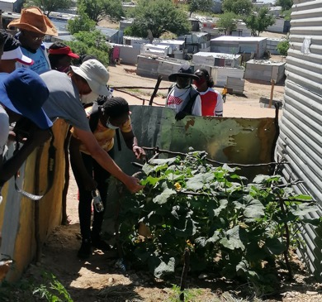
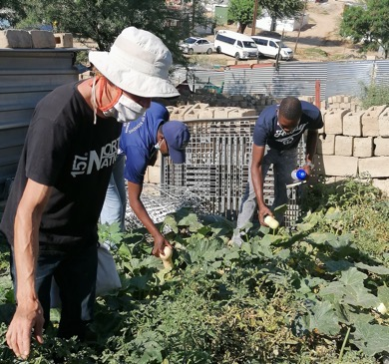
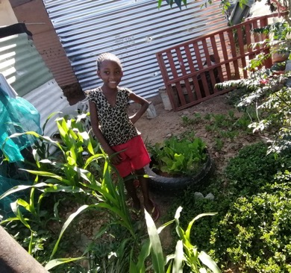
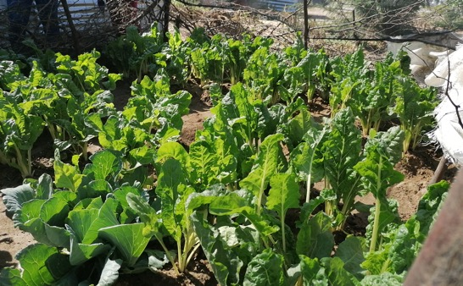
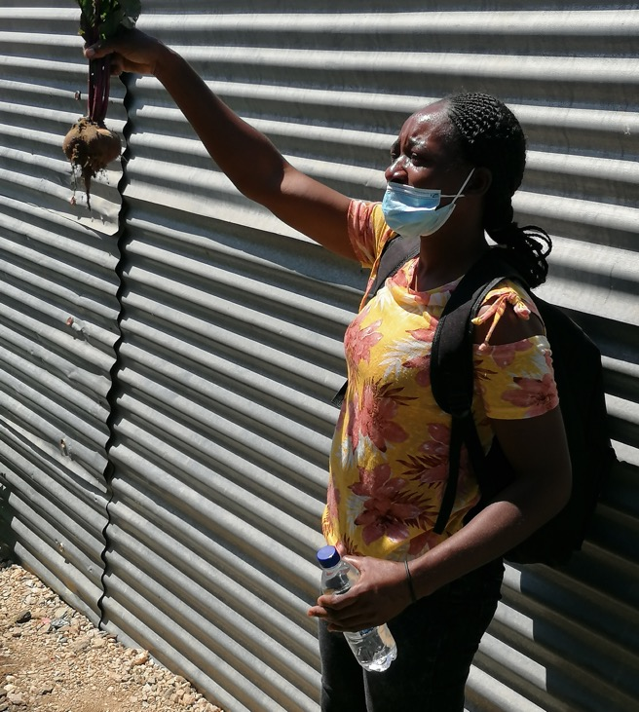
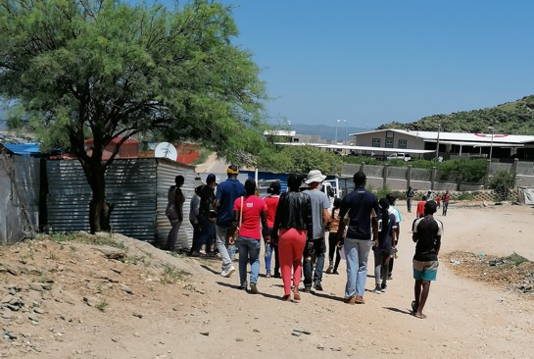
Food systems, climate adaptation/ mitigation

Slide 25
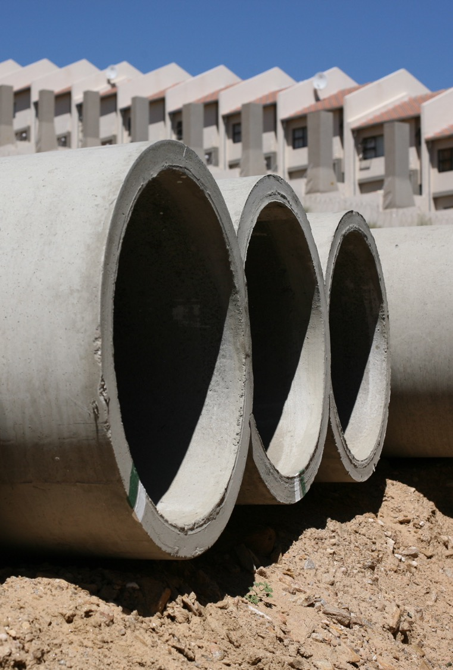
The infrastructure question
Sustainability
Finance
Urban development model (density, urban-rural towns)

Slide 26
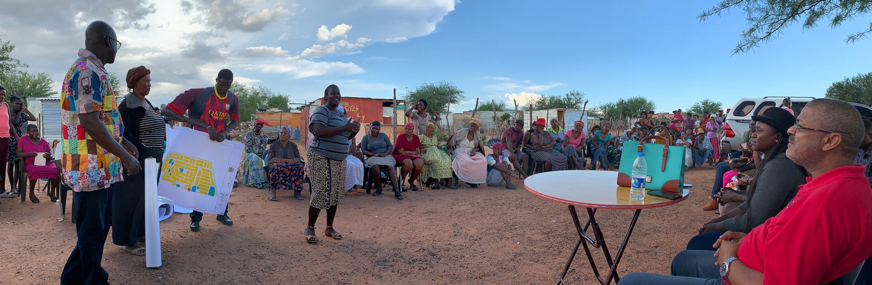
The Local Government Reform question
Governance of urban areas
Central-local government jurisdiction
Local government funding
How to confront the previous dispensation

Slide 27
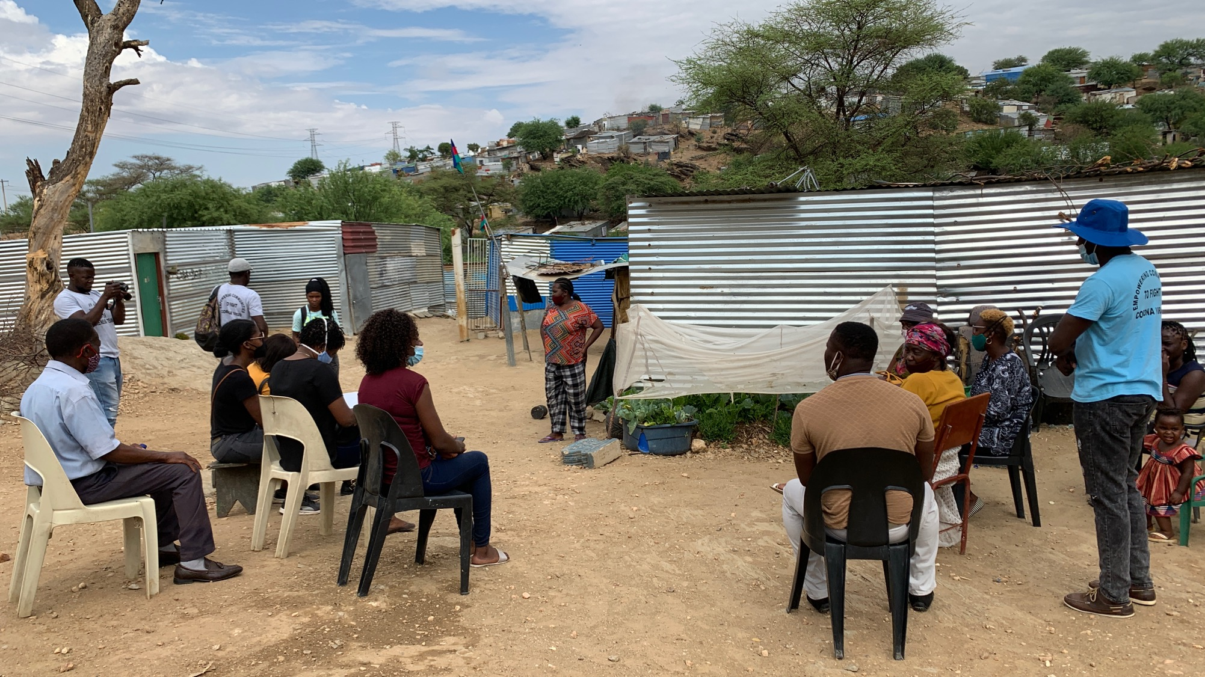
Namibia is at an advantage: we are already talking to each other

Slide 28



INSTITUTE FOR LAND, LIVELIHOODS AND HOUSING
Thank you
Guillermo Delgado gdelgado@nust.na http://illh.nust.na
W illh.nust.na
ILLH-Namibia
ILLH Namibia
ILLH Namibia

