Slide 1

Flexible land tenure
and
Pre-allocation:
Implementation of the FLTS
In Windhoek
ONYIKA INFORMAL SETTLEMENT
22 February 2023
Walvis Bay

Slide 2
Presentation
Flexible Land Tenure Implementation
Introduction
Objectives of the act
Implementation-Pilot Project
Progress update
Incorporation of Affordable Housing
Pre Allocation and Lease with an Option to Buy
Challenges
Conclusion

Slide 3
Objectives of the flexible land tenure act
Create alternative forms of land title that are simpler and cheaper to administer than existing forms of land title.
Provide security of title for persons who live in informal settlements or who are provided with low income housing.
To empower the person concerned economically by means of these rights.

Slide 4
Introduction
The Flexible Land Tenure Act is a well known piece of legislation.
The act seeks to facilitate affordable and speedy registration of ownership.
Windhoek was identified as one of the towns for piloting the FLTS implementation.
Windhoek identified three (3) areas for piloting implementation namely Onyika, Freedom Land A and Greenwell Matongo C.
Onyika was chosen as the first pilot project with others to follow.

Slide 5
Implementation of the Flexible Land Tenure System (FLTS)
In Windhoek
ONYIKA INFORMAL SETTLEMENT
Okuryangava

Slide 6
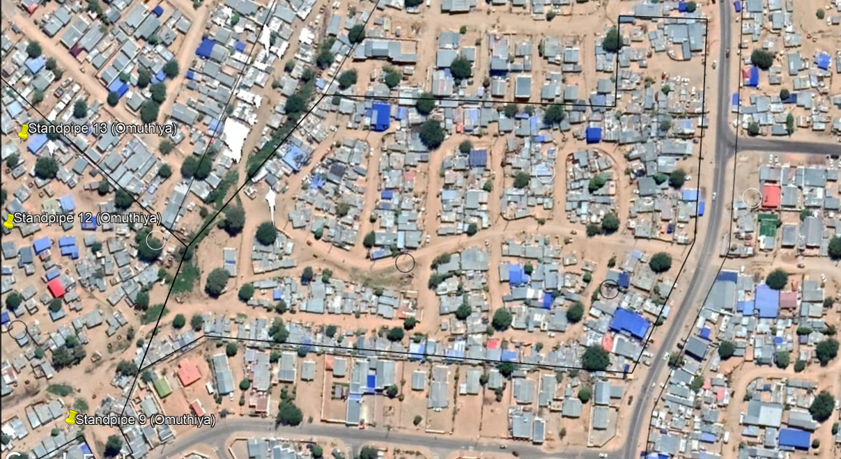
The pilot project
Council via Resolution 27/02/2020 approved the establishment of (1) Starter Title Scheme on Erf 2330, Okuryangava and Five (5) Land Hold Title Schemes on Erf 4032, 4033, 4034, 4047, 4048, Okuryangava with 138 rights holders as potential beneficiaries.
Statutory approval was granted on the 11th of February 2020
Council was informed by way of letter by 02 March 2020.
Surveying of the land parcel started immediately but stopped due COVID-19.
Associations were formed on all the six (6) schemes but was pending Council approval.

Slide 7
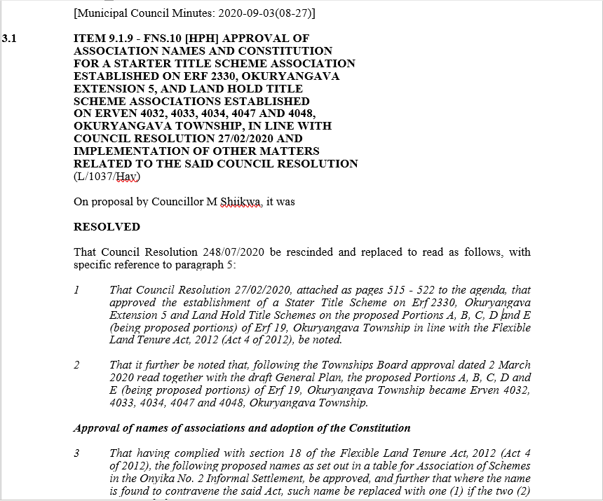
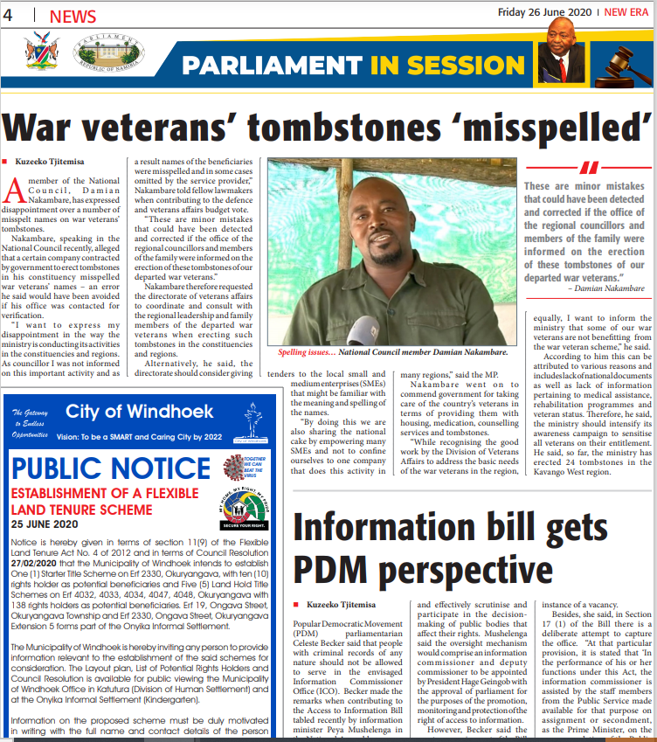
Progress update | planning
On Friday, 26 June 2020 a public notice for the establishment of a Flexible Land Tenure Schemes was placed in the New Era Newspaper. No objections or information was obtained.

Slide 8
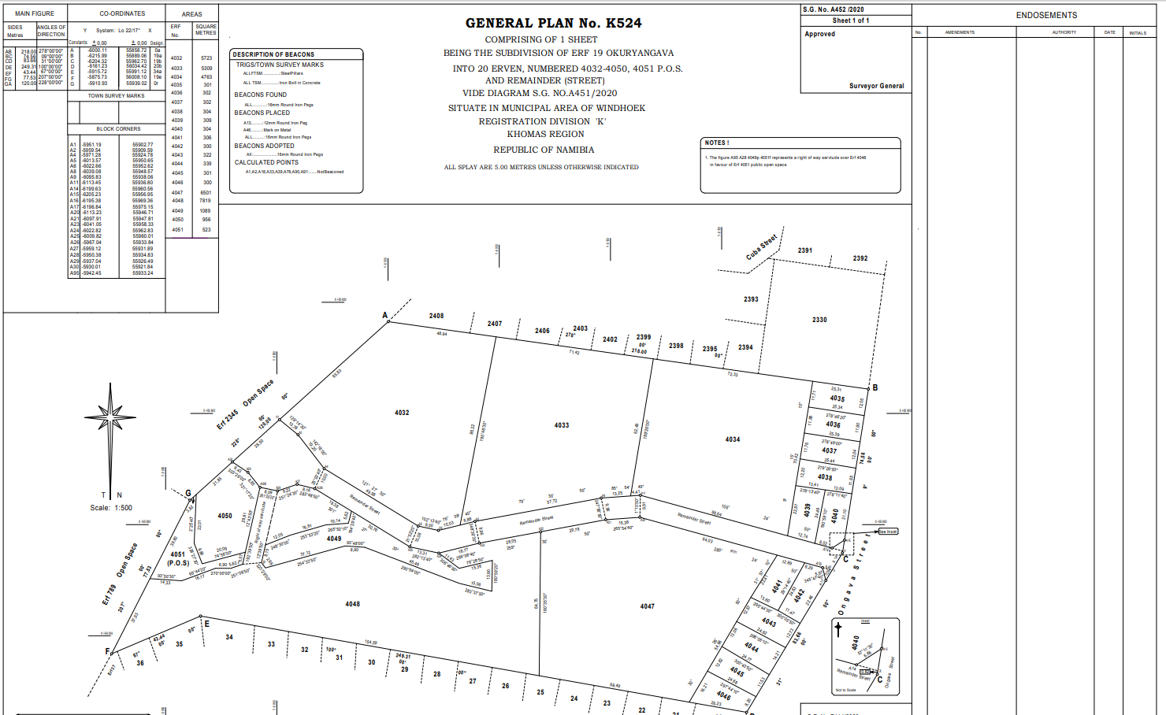
Progress update |
Surveying
Council in August via Resolution 260/09/2020 approved association names and constitution for the six (6) schemes in Onyika Informal Settlement.
The General Plan for Onyika was submitted to the Surveyor General for consideration and approved on the 20th of July 2020.
Surveyor General framed from the General Plan five (5) block erven diagrams to aid the registration process this is in addition to one (1) block erf diagram framed earlier.

Slide 9
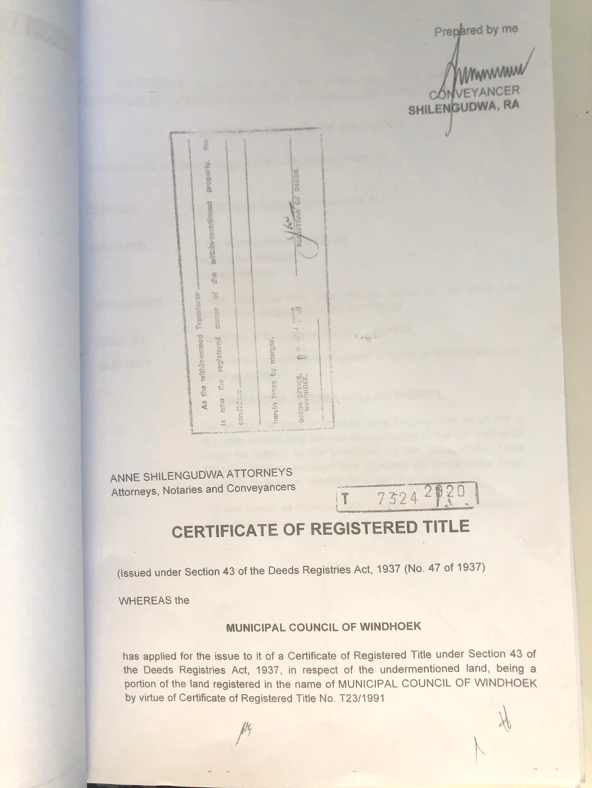
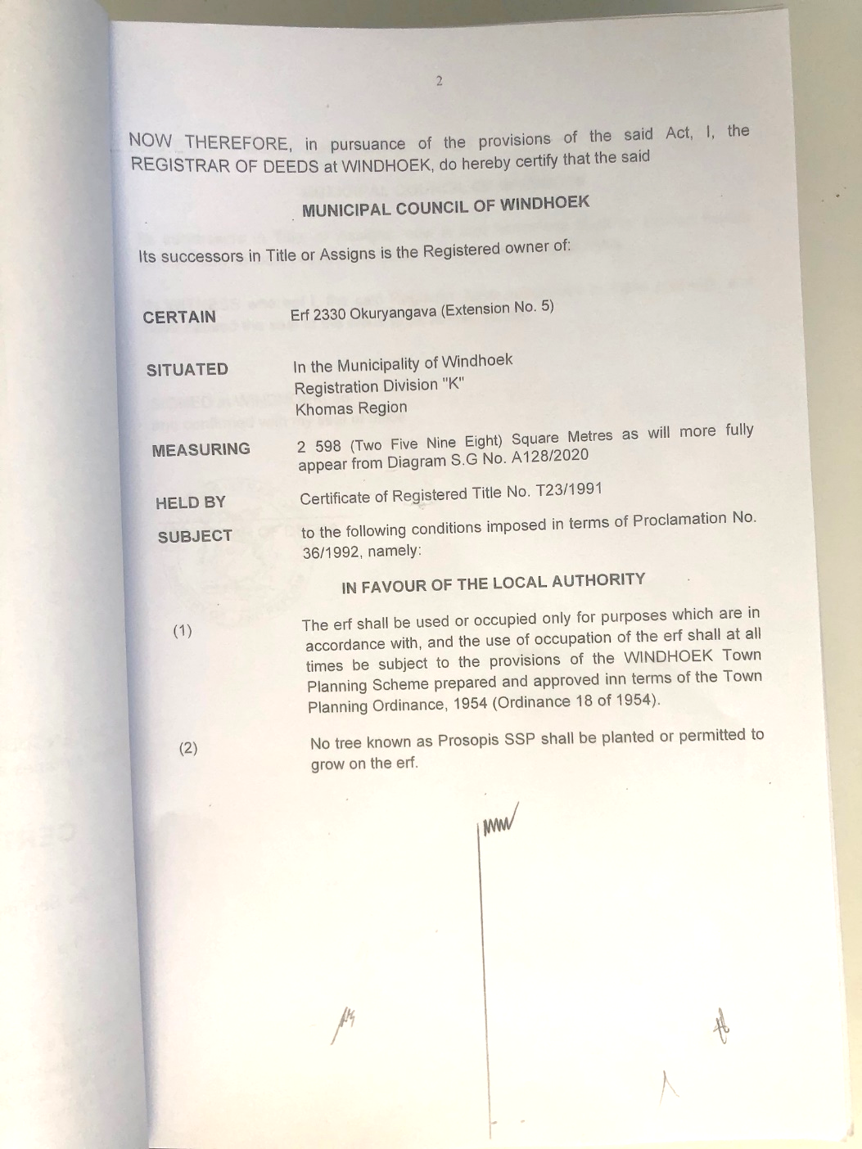
Progress update |
Registration
After a protracted conveyancing process, Certificates of Registered Title (CRT) were registered at the Deeds Office on the 9th of November 2020 followed immediately with signing of contracts and compilation of a notice to the Registrar of the Deeds and the Registrar of the Land Rights Office.

Slide 10
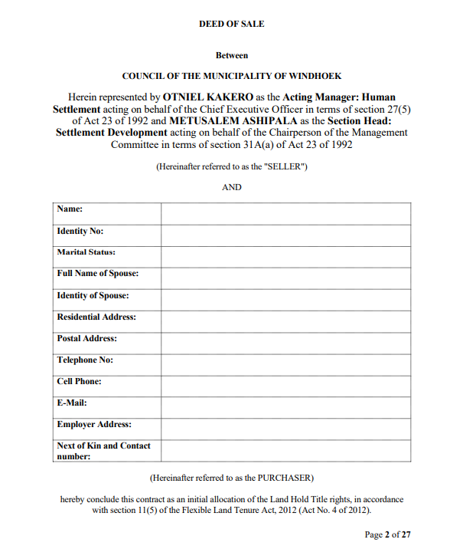
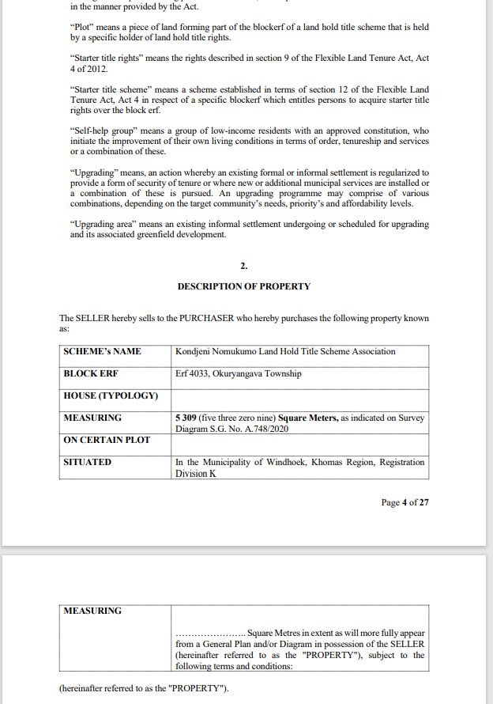
Progress update |
Deed of sale and loan agreement

Slide 11
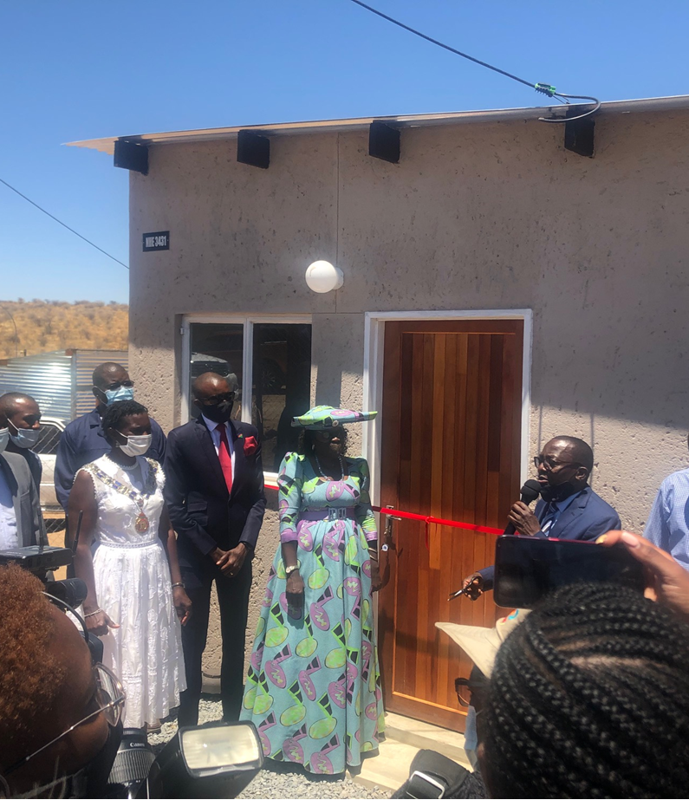
Incorporation of affordable housing
In addition to providing alternative forms of tenure that are simpler and cheaper to administer, the objects of the FLTS Act includes:
  Providing security of title for persons who live in informal settlements or who are provided with low-income housing;
In view of the above,
In June 2020, the Ministry of Urban and Rural Development (MURD), the Khomas Regional Council (KRC), the Windhoek Municipality (CoW) and the National Housing Enterprise (NHE) entered an MOU for the Implementation of the Informal Settlement Upgrading Affordable Housing Pilot Project and committed to build 1,200 low-cost houses in Windhoek at a cost of N$ 220,100,000.00 in two (2) years.
60% Opted for houses in Onyika Informal Settlement as part of affordable housing project.

Slide 12
Pre-allocation of land in the low income area

Slide 13
Pre-allocation and lease with an option to buy
Council per Resolution 31/02/2021 resolved that, in order to accelerate access to land in the informal settlements areas and associated Greenfields, land that has undergone initial planning stages (layout - supported by Council and cleared by the Environmental Commissioner), be pre-allocated to prospective purchasers, tenants or members of a saving group in line with the Development and Upgrading Policy.
The target is to pre-allocate 5000 sites in in three (3) years.
In addition to pre-allocation, Council resolved further that all leases in informal settlements that have undergone an upgrading intervention be kept up-to-date and the remaining statutory town planning process finalised to pave way for entry with project beneficiaries into lease with an option to buy or a Sales Agreement
Lease with an option to buy carry same benefit as the pre-allocation.

Slide 14
Pre-allocation and lease with an option to buy
Create New erven and allocate to residents prior to servicing
Allocated plots are to be leased from Council
Lease amounts paid are deductible from sale price of such erven
Already Existing Initiatives
Development and Upgrading Initiatives
Formalisation program goes hand in hand with the above approaches-
Areas are identified,
Socio economic survey is conducted,
Surplus people are allocated land elsewhere
Certificate of Acknowledgement of Occupation –
New way of trying to control illegal occupation
Over 25 000 certificates issued

Slide 15
challenges
Rapid Urbanization
Legislations
Title ownership – understanding the concept of group ownership
Inability to benefit from the FNB N$ 50 000.00 initiative
Misunderstandings of concepts -

Slide 16
conclusion
Challenge is huge and requires serious commitment
Implementation of the FLTS needs to be tweaked/adapted by each & every LA to fit its conditions and realities
The ultimate goal must be a multitude of options
There is a need to strengthen the rental option-Social Housing

Slide 17
Thank You!

