Slide 1

MINISTY OF INDUSTRIALISATION and TRADE
Republic of Namibia
Afcfta
WHAT ROLES DOES LA PLAY IN AFCFTA?
HOW WILL LA POSITION THEMSELVES FOR AFCFTA?
By: TILEINGE PEYEPENDA NGHAAMWA
DGS – “Director: General Services’’
E-mail: Peyependa.Nghaamwa@Mit.gov. na

Slide 2





Ministry of industrialisation and trade:
Republic of Namibia
“A leading organisation spearheading
economic structural transformation of Namibia”
VISION
STRATEGIC PILLARS & OBJECTIVES
Industrialisation and
Enterprise Development
Investment and
Trade Enhancement
Operational Excellence
● Improve the
manufacturing base to
realise industrialization
•Promote and secure
market access for
Namibian products.
•Enhance
Organisational
Performance
•Promote
entrepreneurship culture
to develop enterprises
• Create a conducive and
competitive environment for
business growth
•Promote, attract and retain
investment
To create and sustain a conducive business environment through value addition, market access, enterprise development and investment promotion for the benefit of all
MISSION
To develop and manage Namibia’s economic regulatory framework, promote economic growth and development through the formulation and implementation of appropriate policies with the view to attract investment, increase trade, develop and expand the country’s industrial base
….
Well-being of children
MANDATE
CORE VALUES

Slide 3
High-level agendas and goal:
SOURCE DOC | PAGE No: | PLAGIARISM REFERENCE QUOTES | DEPARTMENT
THE CONSTITUTION OF THE REPUBLIC OF NAMIBIA | 51 52 53 | Chapter 11 – Principle of State Policy Article 98 – Principles of Economic Order The economic order of Namibia shall be based on the principle of a mixed economy with the objective of securing economic growth, prosperity and a life of human dignity for all Namibians. (2) The Namibian economy shall be based, inter alia, on the following forms of ownership: (a) Public; (b) Private, (c) Joint-Venture; (d) Co-operatives; (e) Co-Ownership; (f) Small-Scale family Article 99 – Foreign Investments “…Foreign investment shall be encouraged within Namibia subject to the provisions of an Investment Code to be adopted by Parliament…” | Minister’s Office
AFICAN AGENDA 2063 | 13 15 | Aspiration No.1 : A prosperous Africa based on inclusive growth and sustainable development Goals – Transformed Economies Priority Areas: Sustainable and inclusive economic growth; STI driven manufacturing; industrialisation and value addition; Economic diversification and resilience; Aspiration No.2 : An integrated continent, politically united, based on the ideals of Pan Africanism and the vision of Africa’s Renaissance Goals – Transformed Economies Priority Areas: Intergration for sustained growth; trade., exchange of goods and services Fast tracking of the CFTA; | Industrial Development International Trade and Commerce

Slide 4


Passionate about Growth@Home to industrialialise this country, called Namibia, “Our Motherland”

Slide 5





Current
Current
1.3+ bil
$3.4+ tril
55
1
2050
2050
2.5 bil
$29+ tril

Slide 6
Objectives:
● Create a single trade market in Africa;
● to accelerate intra-Africa trade;
● Harmonize and coordinate trade liberalization and facilitation;
● Enhance competitiveness at the industry and enterprise level through scale of production,
particularly trade in value-added production;
● The overarching objectives is the Elimination and reduction of tarrifs and non-tariffs
barriers amgonst African member states.
Current
Current
1.3+ bil
$3.4+ tril
55
1
2050
2050
2.5 bil
$29+ tril
CSF
Qs
Agenda
Background and Objectives of AfCFTA
Namibia AfCFTA Instruments
AfCFTA Protocols
LA AfCFTA

Slide 7
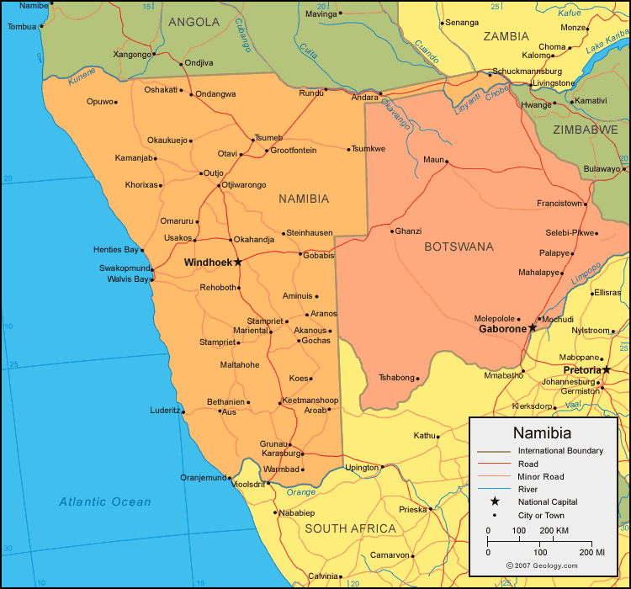
How will Namibia position itself in AfCTFA?
◊ Master plan
◊ Position
◊ Identify our Competitive advantage
◊ Value preposition
◊ Manufacturing in value addition
◊ Create synergies and partnership through investment
◊ Develop industries

Slide 8
Republic of Namibia
THANK YOU!

