Slide 1


Affordable Housing
  February 2023

Slide 3
Housing landscape in Namibia
Housing landscape in the market is defined by 2 major detractors. High house prices and lack of credit affordability. High house prices informed by slow & costly land delivery as well as negligible affordable formal housing. Coupling this with a lack of credit affordability due to low household disposable income, rising interest rate environment and a trend of urbanization, further exacerbates the challenges to provide dignified housing to all Namibians.
375m2 erf, 3 bedroom | Cost of Land | Cost of Construction | Total | ~ Loan Installment
Windhoek (most expensive) | N$228,000 | N$616,886 | N$884,886 | N$9,437
Keetmanshoop (cheapest) | N$20,300 | N$407,940 | N$428,240 | N$4,567
HIGH HOUSE PRICES
Negligible affordable formal housing
Slow & Costly Land delivery
CREDIT AFFORDABILITY
Urbanization
High Interest Rate Cycle ~ Delinquency
Low Household Income
Lack of affordability to purchase spills over into Rental Markets
“Although the structure of the Namibian residential rental market is inherently characterized by the single-family market, the multi-family rental units are increasingly gaining traction due to the worsening affordability levels.” FNB Sep’21 Rental Index overview
Source: Africa housing finance yearbook 2022

Slide 4
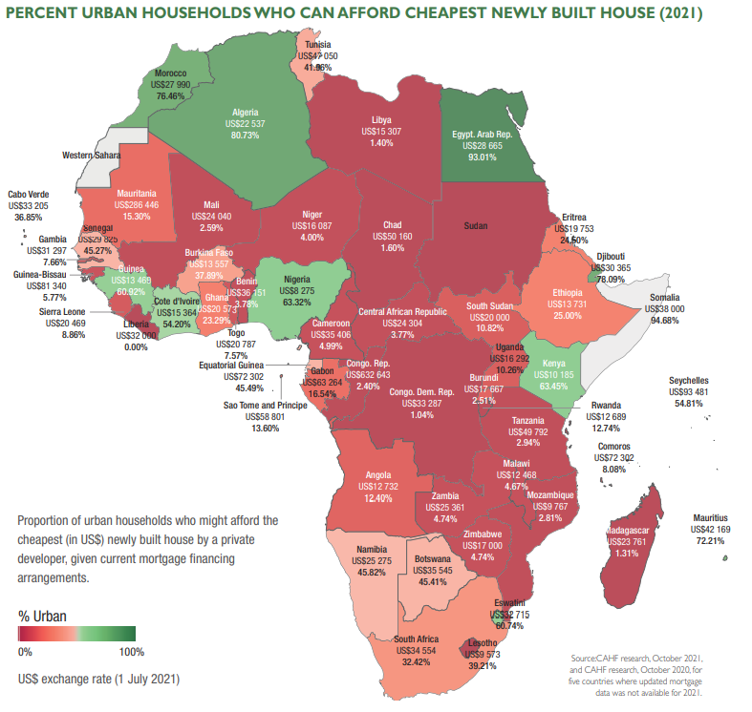
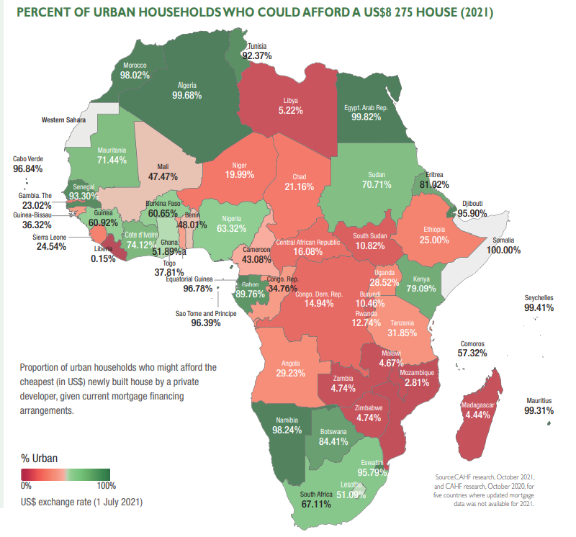
Housing affordability in Africa
Map 1 shows current landscape of perceived affordability for housing in Namibia as dictated by current landscape
Map 2 shows the opportunities available should Namibia shift to affordable housing ~ cost of 150k
8725 USD = 148,950 NAD

Slide 5
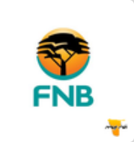




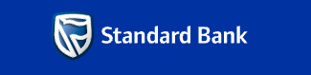


Financiers in the market
Increasing credit delinquency reduces credit risk appetite for financial institutions, amidst rising interest rate cycle
Housing finance providers include the five commercial banks, as well as a non-bank mortgage lender, First Capital Namibia and NHE.
Namibia’s mortgage market is focused on the middle and high income segments of the market, and on towns.
Over the past 10 years, the focus has shifted towards the affordable housing segment, with bank lenders creating products that allow zero down payment, or a 100 percent loan-to-value (LTV)
The deposit payable on a second property was reduced from 20 to 10 percent, and from 30 to 20 percent on a third property (there are still no deposit restrictions on first residential properties

Slide 6

Letshego affordable housing product
PRODUCT BENEFITS TO SUPPORT AFFORDABILITY
No pre-approval fees
Free home owner’s insurance embedded on home loan
Competitive interest rate offerings
Discounted admin fees
Tailor made financial solutions

Slide 7
Stakeholders for change
Policy & Regional Councils
Financiers
Property Developers
What needs to change?
Property developers to redirect focus towards alternative-building material dwellings, cheaper alternatives to existing building methods
Policy to drive expedition of alternative title deeds on ‘partly’ serviced land to enable faster & cheaper land delivery
Financiers to accommodate credit policy and product changes to accommodate low cost housing initiatives, alternative title deeds & incremental housing financing
Consumer education drives to instill confidence in alternative building materials & alternatives title deeds (non-serviced land)

Slide 8
Thank you!

