Slide 1
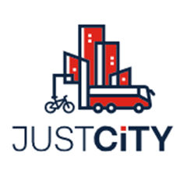
Just City
FES Namibia
ALAN Conference
20-23 February 2023
Inge Neunda & John Nakuta

Slide 2
Background to Just City Concept
Population Growth Estimation
  Population Namibia is estimated at 2.5 million.
  Will grow to almost 2.96 million in 2030 and 3.44 million in 2040.
  In 2021, 53.01 percent of Namibia’s population lived in urban areas.
  In 2030, more than 60 percent of the population will live in urban areas.
  (Sources: World Bank Data, NSA Population projection report 2022-2041)
Pull Factors to urban area
  Education
  Employment opportunities and better living conditions
Notes:
I will share with you in detail the data on the pull factors when we look at some of the findings of the Just city survey in Namibia.

Slide 3
What will happen to the existing
Challenges in urban areas
The Informal Settlements continue to grow
Access to public service/goods become limited and risk becoming inaccessible
The dignity of life / human rights are compromised.
The cities /urban areas risk to continue to become UNJUST

Slide 4
FES Just City Approaches
FES offices in Africa have joined the global network of partners in the debate on JUST Urban Development.
Regionally: Just City Namibia is embedded in the regional project of Just Cities in Africa.
We Aim at
Stimulating urbanization debates that are analytically rooted and economically viable yet normative about the human rights approach.
FES wants to promote and shape narratives of people-centered urban transformation.

Slide 5
FES Just City Approaches
Keeping a spotlight on informality and providing safe spaces for marginalized groups to develop their own approaches will contribute to making the urban invisible visible.
In view of the transformative role of public goods, we want to join forces with our partners and foster inclusive alliances to advocate for democratic decision-making processes.

Slide 6
Just City Survey Namibia
A representative Just City Survey in Namibia was conducted at the end of 2021 through Survey Warehouse. It sheds light on:
  Who migrates to Cities? What are the socio-demographic patterns behind this migration?
  Why do people come to the city, and what are their expectations regarding public goods and democratic participation?
  What public goods are of the highest importance in the eyes of city dwellers?
  How, if at all, does the city make its inhabitants into citizens who shape urbanization themselves through democratic participation?
  The Just City Survey results were launched last year, and we will continue to analyze the results and form the basis of our debates with partners.
Notes:
I should also mention here that a similar study/survey was conducted in nine other countries, with the participating FES office in the Just City Project.

Slide 7
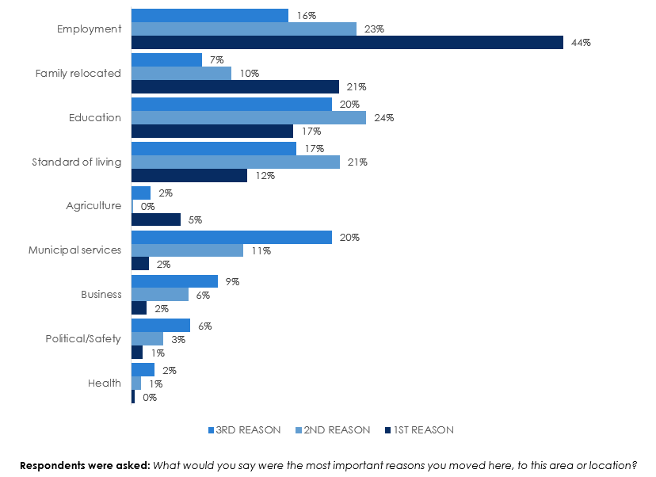
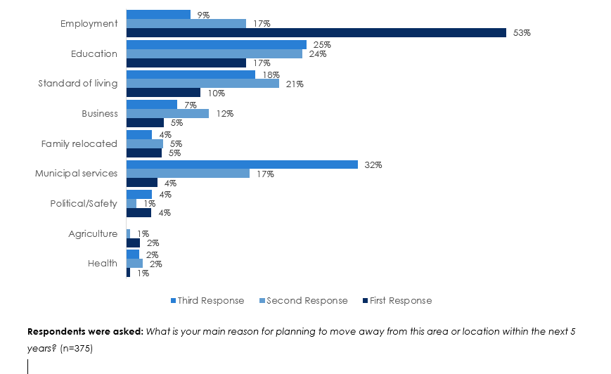
Snapshot of the Just City Survey Results
Figure 14: Reasons for moving to current area or
location outside region of origin
Figure 24: Reasons for planning to move away from current area or
location within the next five years
Notes:
Figure 14 on page 20 of the report
Figure 24 on page 23 of the report

Slide 8
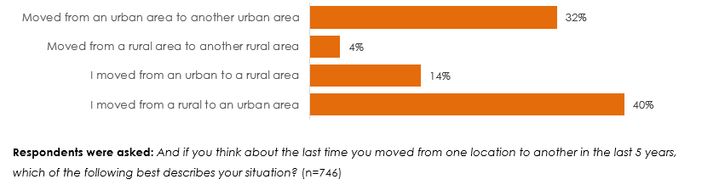
Snapshot of the Just City Survey Results
Figure 19: Most recent move in the past five years
Notes:
On page 22, fig.19 The trend over the past five years shows that migration from rural to urban areas has been high just as much as urban to urban

Slide 9
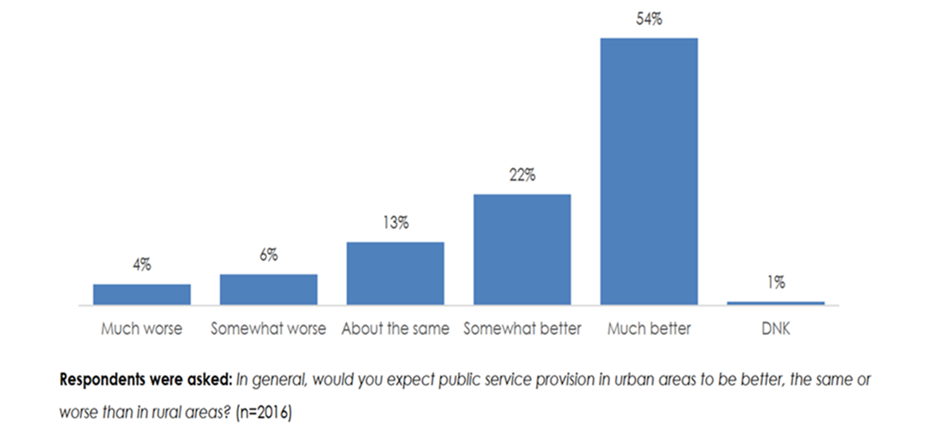
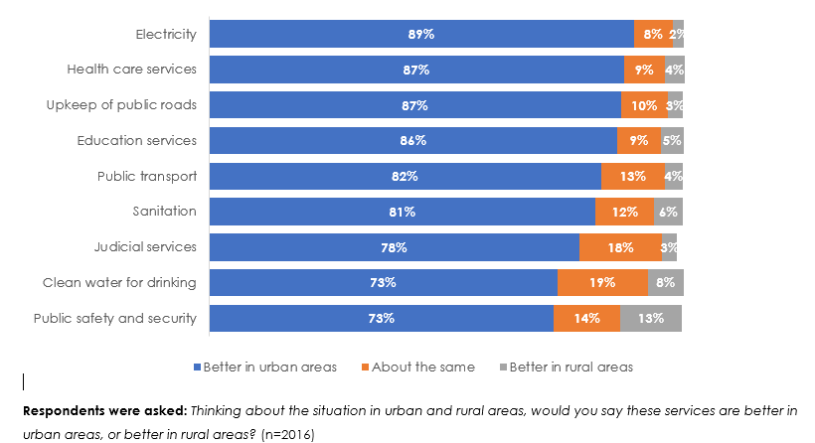
Snapshot of the Just City Survey Results
Figure 16: The expectation of public service provision in urban areas
Figure 31: Service quality
Notes:
Page 21, The migration to urban areas is more likely coupled with expectations by the city/urban dwellers.
.

Slide 10
Mainstreaming the Just city concept in our work
In partnership with Namibia Informal Sector Organsiation (NISO)
Code of Conduct for the Informal Economy –developed through a participatory process and sought to proactively lead the transition of the country’s informal economy into the mainstream economy.
Operational Guidelines of the Code of Conduct were launched last year by the Minister of Trade and Industries, Hon. Lucia Ipumbu
In Partnership with The Economic and Social Justice Trust
Namibia Journal on Social Justice Volume 1: Namibia’s Housing Crisis in Perspectives, Volume 2: Inequality and Social Justice
Another worth mentioning mainstreaming is the socio-economic debates by the youth on urban development.

Slide 11
Thank you

