Slide 1

OLD MUTUAL ALTERNATIVE INVESTMENTS
Presentation to the Association for Local Authorities in Namibia on 21 February 2023

Slide 2
Agenda
WHO WE ARE
CURRENT STATUS QUO
OUR ALTERNATIVE INVESTMENT CAPABILITIES
FUTURE FOCUS
TRACK RECORD

Slide 3
1. WHO WE ARE

Slide 4
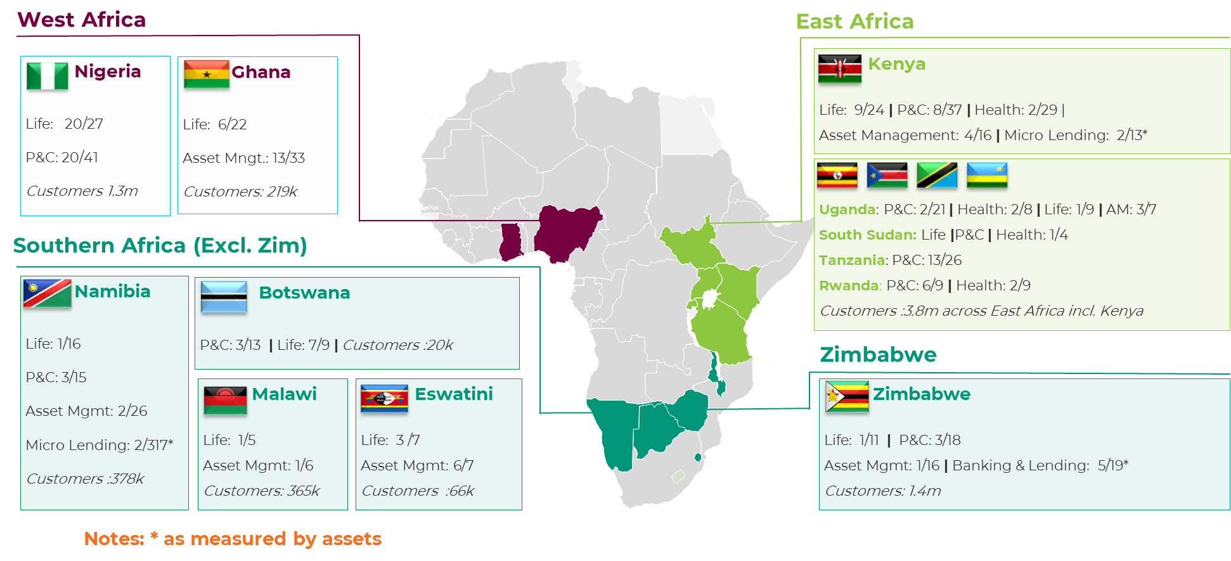
Old Mutual Investment Group Namibia
Who We Are
Responsible Investing
Established as a branch of Old Mutual Life Assurance (Namibia) Limited during the late 1990’s. As a leading African investment manager, we offer a comprehensive range of investment capabilities. Being the largest asset manager in the country we are responsible for delivering sustainable, long-term investment returns to institutional, corporate and retail clients while also being responsible stewards of the assets we manage. With a strong local Namibian Team, we manage in excess of N$45 Billion of Assets Under Management through our local team of Portfolio Managers. As an Unlisted Fund Manager we were the first Fund Manager to Manage an Unlisted Investment Vehicle in Namibia in 2003 continue to be market leaders in that space.
Old Mutual Limited is a signatory of the United Nations-backed Principles for Responsible Investing (PRI). We apply these principles in our investment and ownership practices in a manner that is consistent with Old Mutual’s Responsible Investment Guidelines.
Responsible investing enables us to pursue superior, risk-adjusted returns for our clients, while also positively impacting the communities and environments in which we operate. Our approach incorporates three components:
Our Competitive Edge
Disciplined framework. By using a structured, disciplined and measurable implementation framework, our philosophy captures both price (valuation) and theme (environment) in a two-dimensional approach.
A dynamic, well-resourced team. We are an experienced and a well-qualified and diverse team. A collaborative leadership style ensures that investment ideas are challenged and debated, with only the best-ranked ideas being selected.
The full toolbox of asset classes. We access the full toolbox when building portfolios to provide superior risk-adjusted returns to our clients. We look beyond the conventional asset classes and break the investment universe into smaller asset clusters that behave similarly. We also access other assets such as commodities, convertible bonds and alternative assets in our more dynamic offerings.
Risk management through intelligent portfolio construction. Our disciplined portfolio construction process provides detailed insight into each share’s contribution to portfolio volatility. This enables us to create an optimal and a risk-adjusted portfolio of shares and enhances our ability to achieve more stable returns through various market cycles.
Our African Footprint

Slide 5
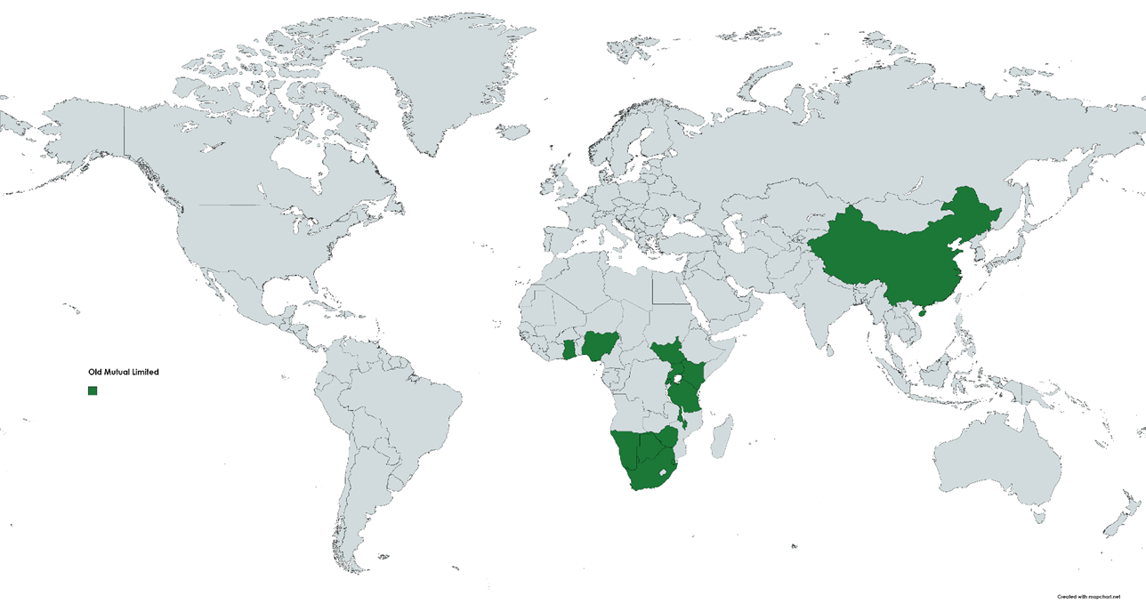
Areas of Operation
Operates in 14 countries

Slide 6
2. CURRENT STATUS QUO

Slide 7

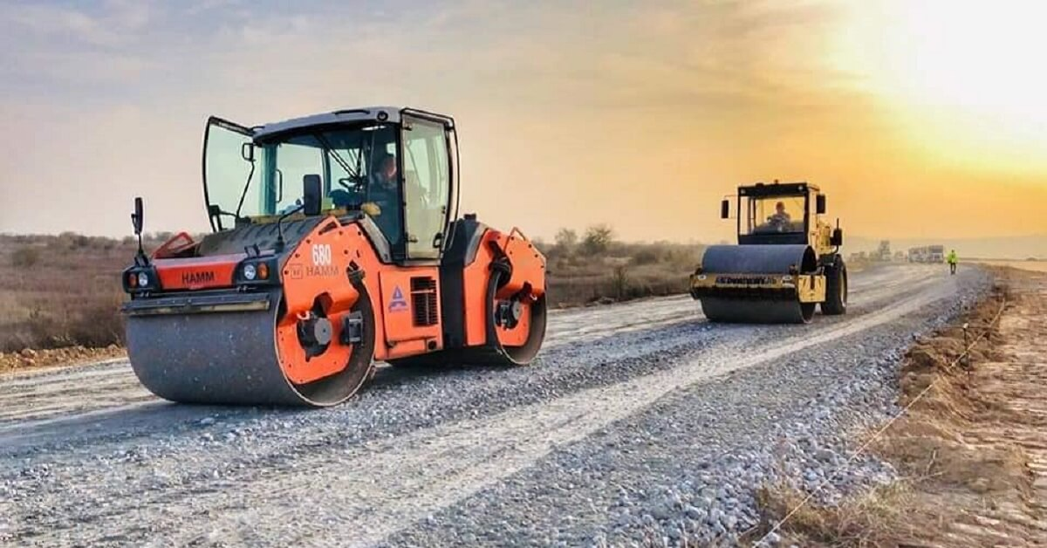
“housing is an urgent undertaking”
The delivery of urban land and housing is an urgent undertaking, that involves overlapping stakeholders, markets and legal systems for accessing land, finance, services like water, electricity, sewerage and eventual construction. ~ The Harambee Prosperity Plan II

Slide 8
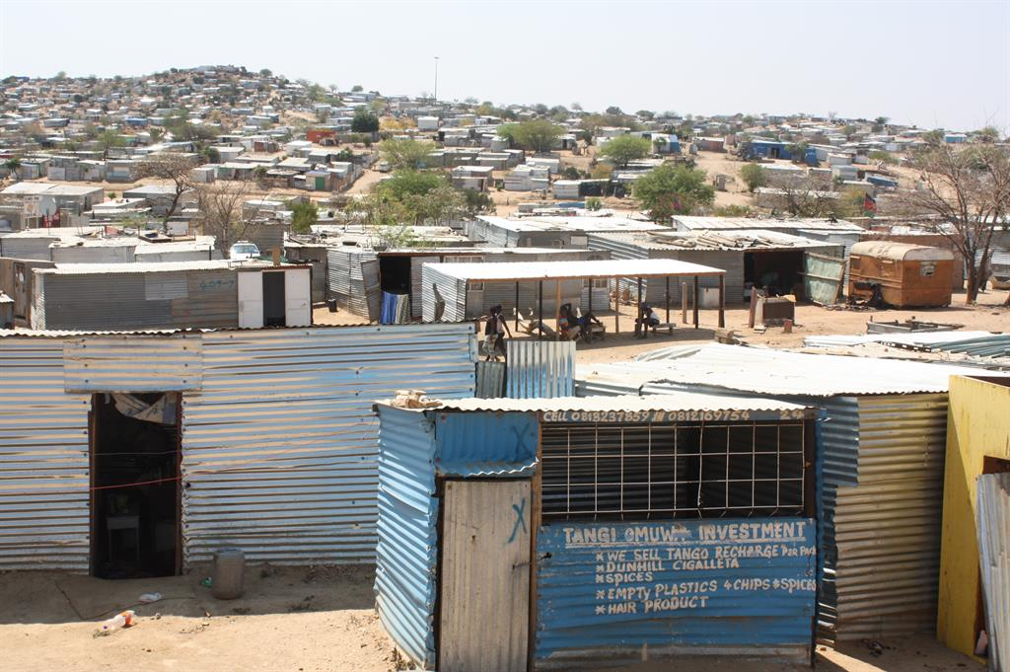
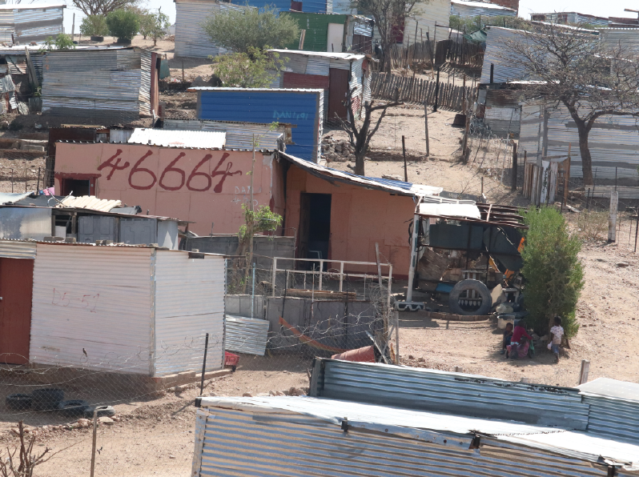
CURRENT STATUS QUO:
LAND DELIVERY & HOUSING
01
Land
Abundance of Land
02
Demand
Abundance of Demand
More than 300 000 Namibians live in Shacks
03
Housing
Yet Still no housing

Slide 9
Alter the Current Market Approach
Award of Land To Developer
Developer Adds Own Mark Up to Land
Developer Approaches Financier for Funding Top Structure
Further Markup Added
Developer Goes to Market with Development

Slide 10
3. OUR ALTERNATIVE INVESTMENT OFFERING

Slide 11
Funds under Management
Approximately N$2.5 billion

Slide 12
Funds under Management 2/2
Infrastructure |  | MIDINA Fund
 |  | Expanded Infrastructure Fund
 |  | Namibia Infrastructure Equity Investment Fund
Private Equity |  | Old Mutual Private Equity Portfolio
Property |  | Tunga Real Estate Fund
 |  | Old Mutual Property Portfolio

Slide 13
Highlights
Who we are | What we do | How we do it
One of Namibia’s most established investment manager with a 18 year history of success in private equity, infrastructure investing and property | Rigorous and structured investment process focused on core set of capabilities of infrastructure assets, private equity, unlisted debt and property & real estate | Financial investor with access to market-leading partners and in-house development capabilities
Experienced local investment team supported by market-leading partners from within the Old Mutual Group | Active origination and value-added ownership through our cradle to grave philosophy | Active pipeline management aimed at bridging the infrastructure gap diversity of sectors
Access to unique and proprietary investment opportunities through unique origination network | Strong track-record of launching funds, drawing down commitments and delivering benchmark-beating returns | Emphasis on active ownership, ESG and risk management

Slide 14
Impact
Over 2,000 serviced erven delivered in Windhoek, Swakopmund, Walvis Bay, Otavi, Mariental, Rundu (Kaisosi), and Otjiwarongo
Over 1,000 houses built in Windhoek, Okahandja, Walvis Bay, Mariental, Rundu (Kaisosi), and Otjiwarongo
26.5MW of Renewable Energy Generation added to Grid
Education Facilities in Walvis Bay, Windhoek, and Nkurenkuru
Malls in Arandis, Keetmanshoop, Rehoboth, Grootfontein, Windhoek, Ondangwa, Oshakati, Oshikango
Medical Facilities in Ongwediva and Rehoboth

Slide 15
Alternative Investment Capabilities
Old Mutual Investment Group (Namibia)
Old Mutual Alternative Investments
Property
Structured Finance
Infrastructure
Private Equity
Capital Growth or Yield-Driven Investment Strategies
SPV or Policy-Wrapped Investment Structure

Slide 16
4. FUTURE FOCUS

Slide 17
Future Focus
Infrastructure
Property
Land Development and Housing
Debt and Equity funding for Municipal Infrastructure, Healthcare, Education, ICT, and Energy Generation
Retail and Convenience centres, Office, Warehouse, Cold Storage, Healthcare, and Education
Customised funding to facilitate land development and affordable housing development

Slide 18
5. TRACK RECORD

Slide 19
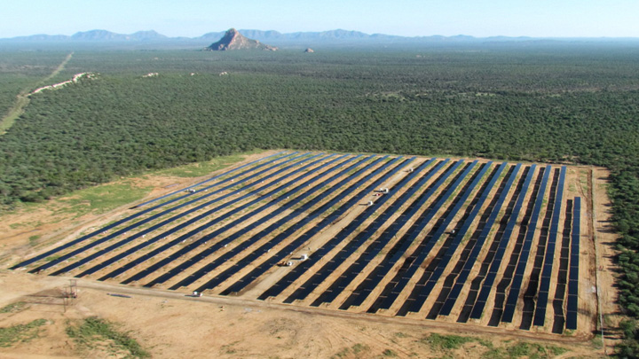
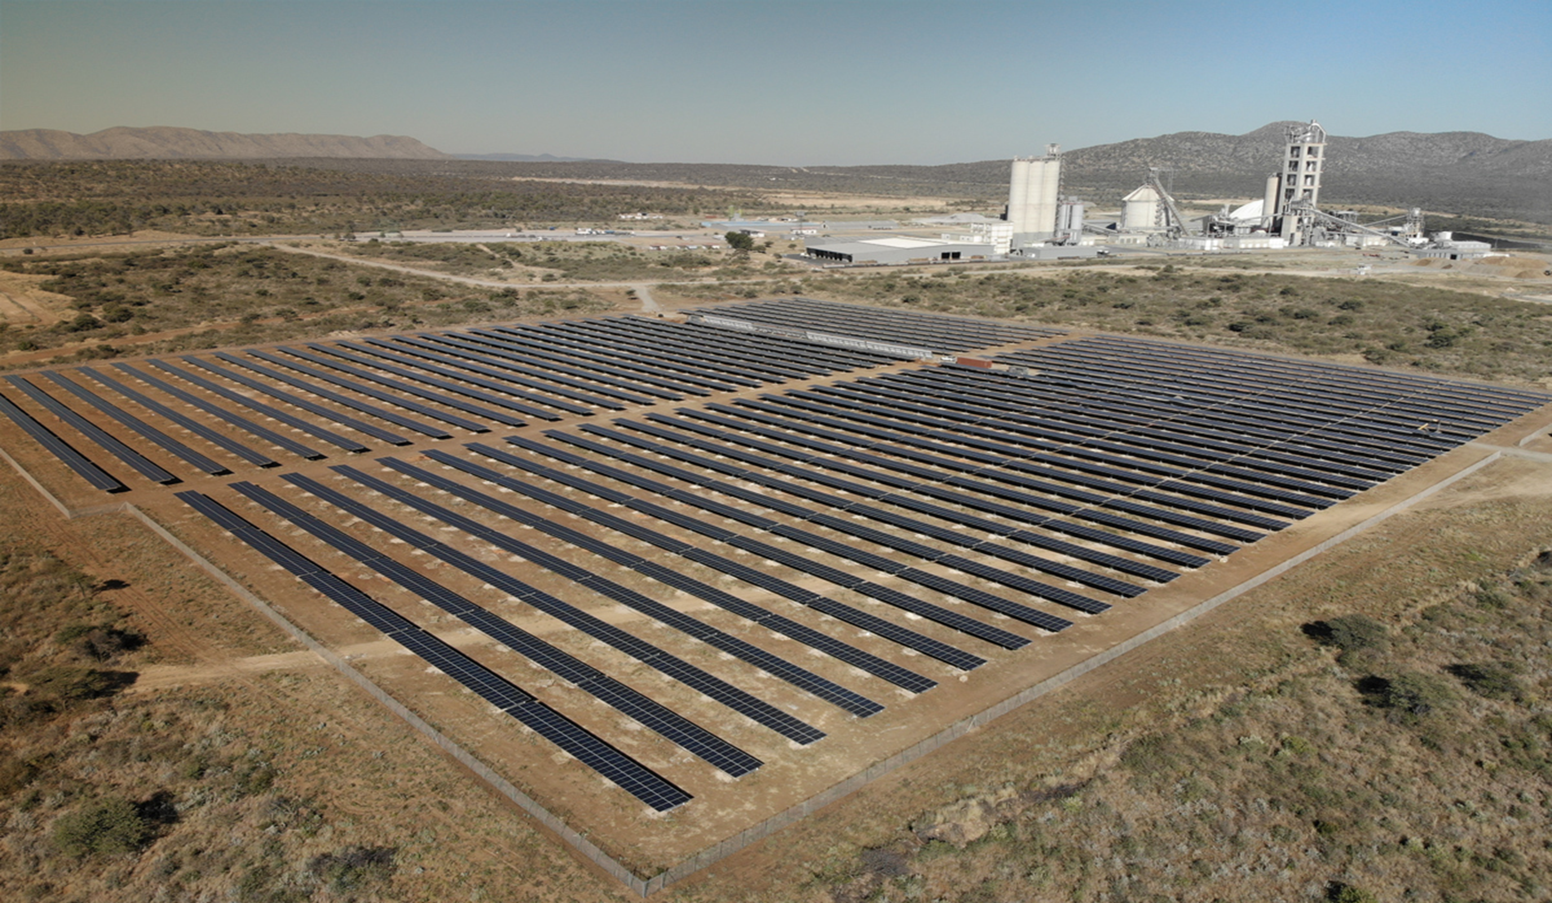
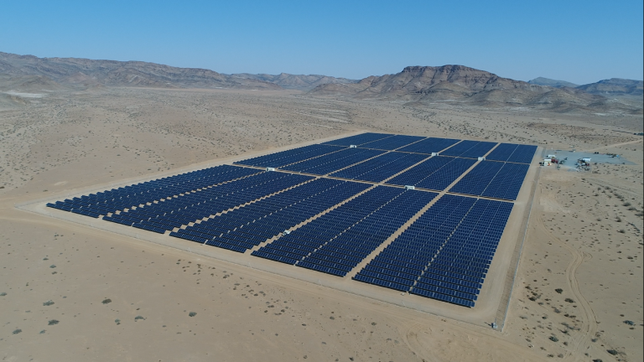
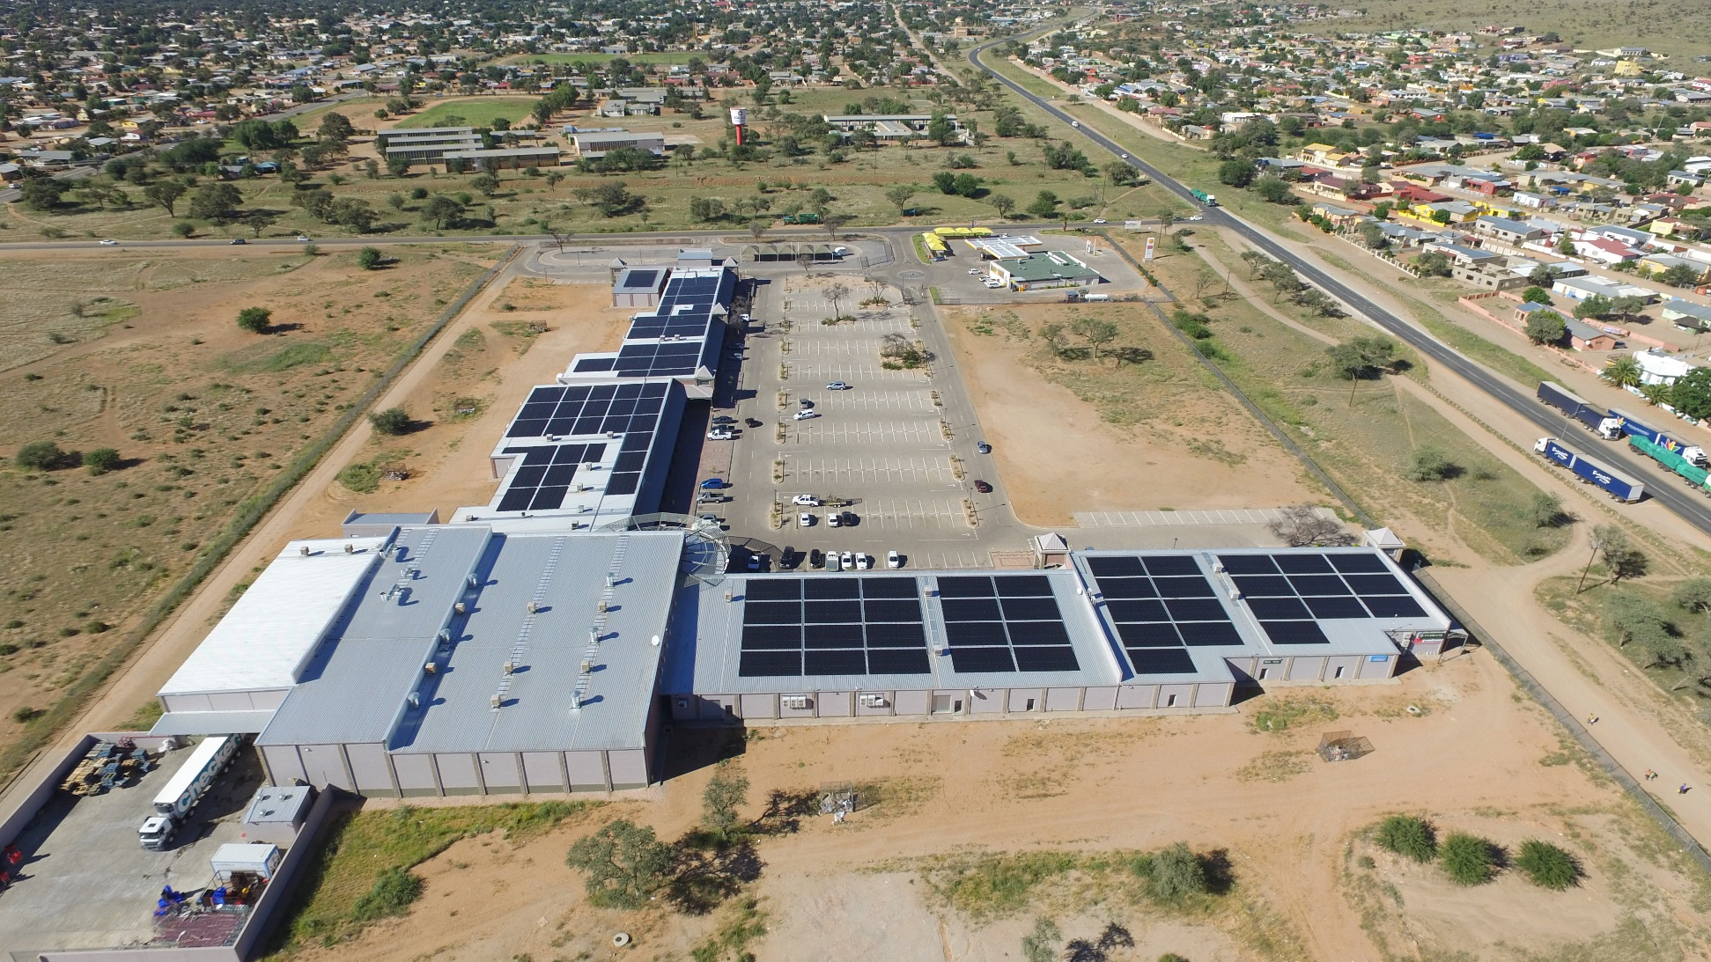
Track Record - Renewable Energy Assets
Omburu Sun Energy
SunEQ Investment Four
Rosh Pinah
Roof top solar

Slide 20
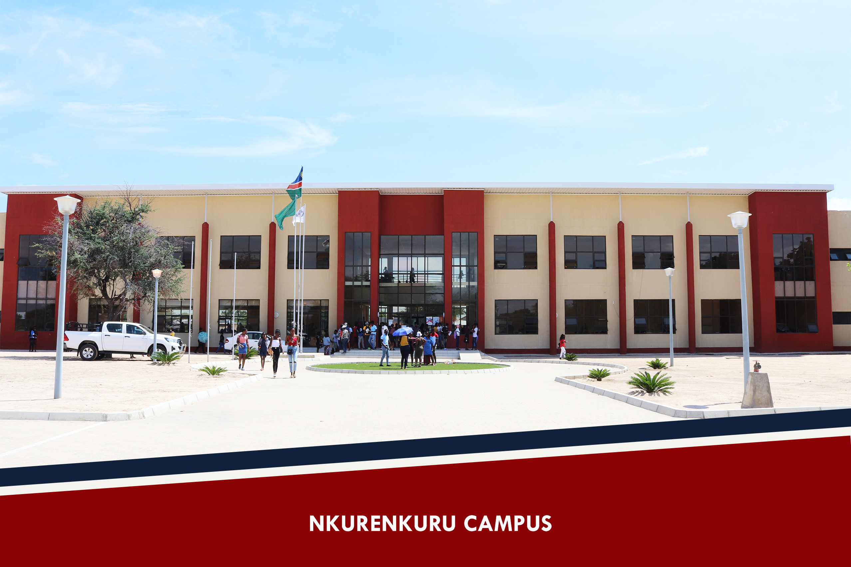
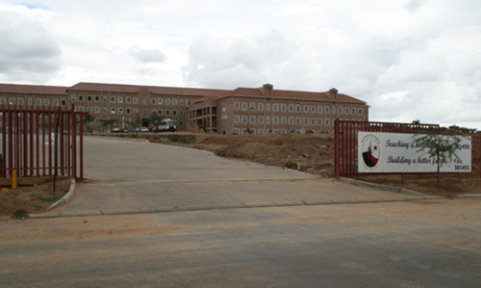

Track Record - Education
IUM – Nkurenkuru Campus
Windhoek Gymnasium
Dolphin Schools

Slide 21
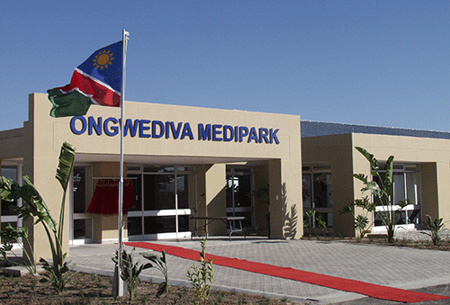
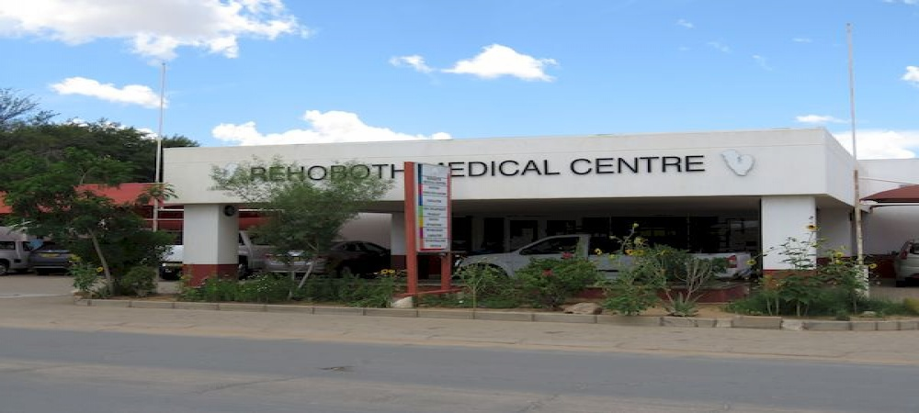
Track Record - Healthcare
Ongwediva Medipark
Rehoboth Medical Centre

Slide 22
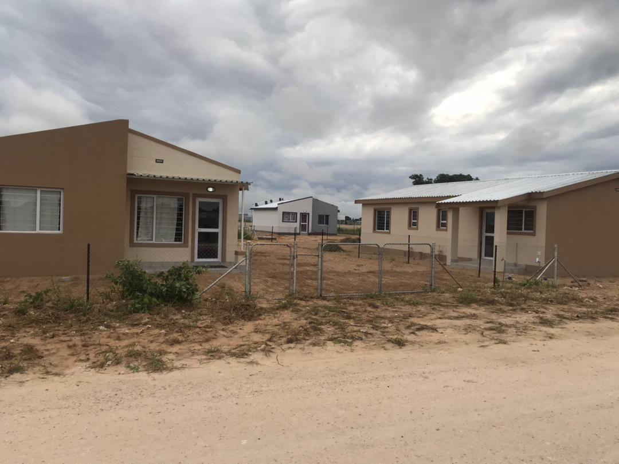
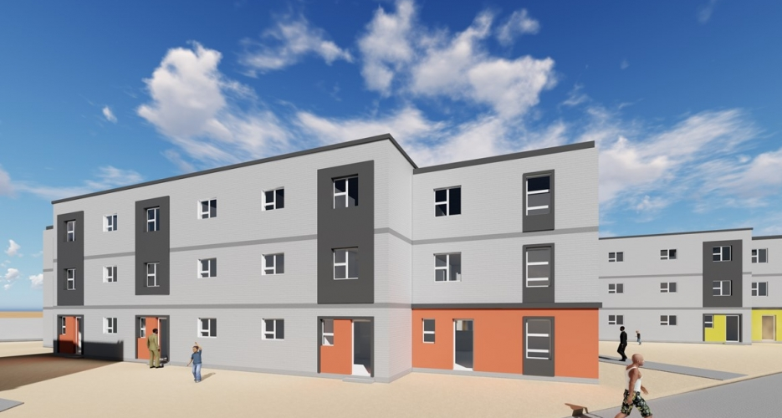
Track Record – Land Servicing and Housing
Rundu Affordable Housing
Otjiwarongo Affordable Housing
Walvis Bay Affordable Housing
Mariental Housing

Slide 23
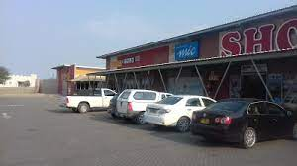
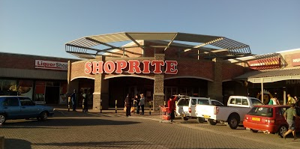
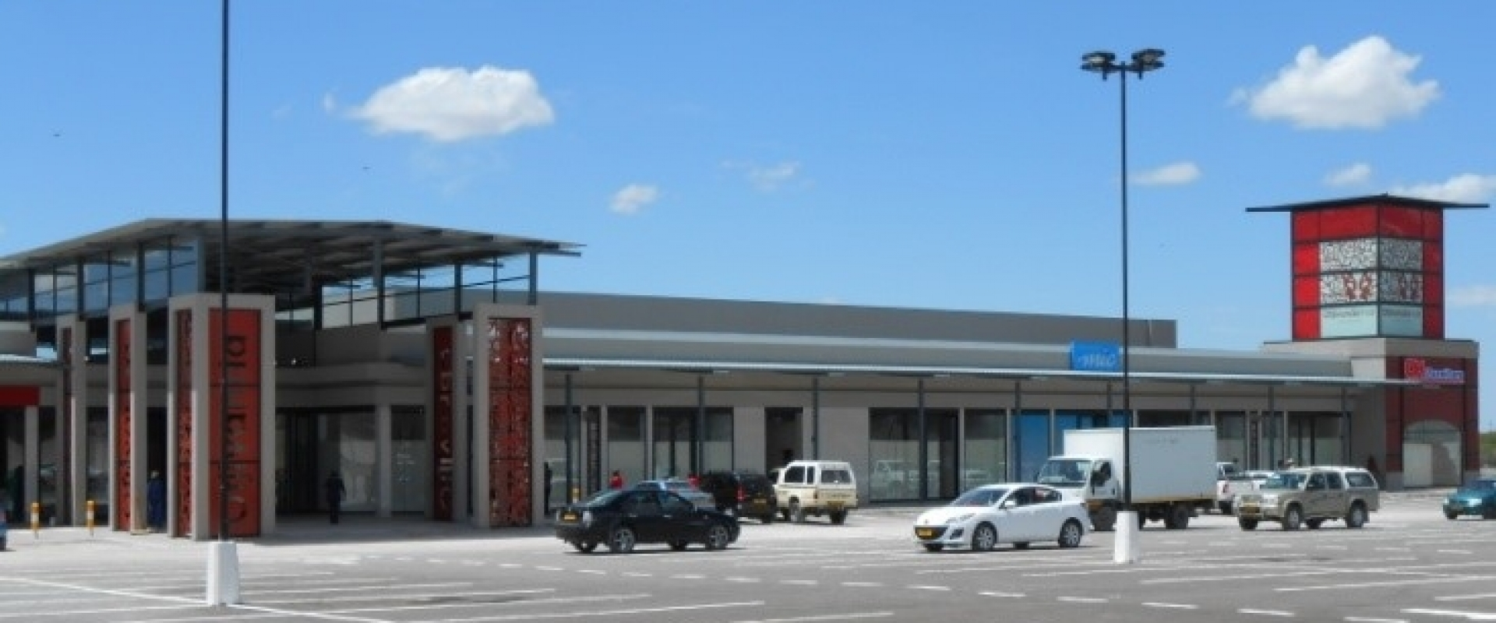
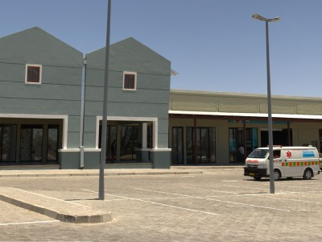
Track Record – Commercial Property
Keetmanshoop Mall
Rehoboth Mall
Otjivanda Mall - Grootfontein
Arandis Convenience Centre

Slide 24
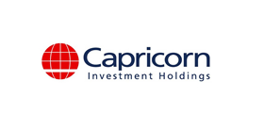
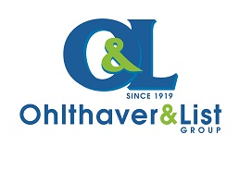
Track Record – Private Equity

Slide 25
Regulatory Information
Old Mutual Investment Group (Namibia) (Pty) Ltd / Old Mutual Alternative Investments (Namibia) (Pty) Ltd
Physical Address: 10th floor, 223 Independence Avenue, Windhoek
Telephone number: +264 61
Old Mutual Investment Group (Namibia) (Pty) Ltd (Reg No 25/12/01) (OMIGNAM) is approved as an Investment Manager by the Namibian Financial Institutions Supervisory Authority(NAMFISA)
Market fluctuations and changes in rates of exchange or taxation may have an effect on the value, price or income of investments. Since the performance of financial markets fluctuates, an investor may not get back the full amount invested. Past performance is not necessarily a guide to future investment performance. The investment portfolios may be market-linked or policy based. Investors’ rights and obligations are set out in the relevant contracts. In respect of pooled, life wrapped products, the underlying assets are owned by Old Mutual Life Assurance Company (Namibia) Limited who may elect to exercise any votes on these underlying assets independently of OMIGNAM. Returns on these products depend on the performance of the underlying assets.
This document is not an advertisement and it is not intended for general public distribution. The recipient is advised to assess the information with the assistance of an advisor if necessary, with regard to its compatibility with his/her own circumstances in view of any legal, regulatory, tax and other implications. The information herein does not constitute an offer to sell or a solicitation of an offer to buy any securities. This document is expressly not intended for persons who, due to their nationality or place of residence, are not permitted access to such information under applicable law.
Disclaimer: OMIGNAM does not provide advice. This document is for information purposes only and is not an offer to issue or sell, or any solicitation of any offer to subscribe for or purchase any particular investment. We believe in the value of sound advice and so recommend that you consult a financial advisor before making investment decisions.

Slide 26







INVESTING WITH SIGNIFICANCE
INVESTMENT GROUP

