Slide 1


ALAN Seminar Housing Provision through PPP
Dr Martin Mwinga – Executive Chairman
Ms. Laina Amutenya - CEO
21 February 2023

Slide 2







PRESENTATION FLOW
Problem Defined: Housing Problem or Income Problem?
Population, Income and Housing Data Analysis
PPP Housing Delivery Model
First Capital Housing Fund (FCHF) – PPP Model
Way Forward - FCHF Proposed PPP
Questions

Slide 3
HOUSING AFFORDABILITY CRISIS

Slide 4
PPP: PROVIDING HOUSING IN FACE OF FIVE CRISIS
The Five Crisis Posing a challenge for Affordable Housing Delivery in Namibia:
Food Affordability Crisis (low-middle income earners spending 70% of their income on food)
Debt Crisis (Individuals, GRN, and Local Authorities Highly Indebted)
Housing Affordability Crisis (Housing Cost to Income Ratio close to 50%)
Housing Production/Supply Crisis (limited serviced land & tight government budget, limited access to finance by property developers)
Poverty & Unemployment Crisis (low or no income and high-income inequality)
4

Slide 5
PPP: PROVIDING HOUSING IN FACE OF FIVE CRISIS
Question: Is Namibia or Your Town Experiencing a Housing Problem or an Income Problem?
As ALAN members and Policy Makers ponder on possible solutions (PPP) to the housing problems in their particular towns and Village Councils, they must also reflect on what is behind the Five Crisis in their Town or Region.
5

Slide 6
Namibia Income levels (N$): PPP must Take this into account
National
Low Income | Medium Income | High Income
0 – 10,000 | 10,001 - 20,000 | 20,001 >
33.9% | 53.6% | 9.7%
First Capital
Low Income | Medium Income | High Income
0 – 10,000 | 10,001 - 20,000 | 20,001 >
10% | 62% | 28%
The poor and low-income earners spend 60 – 80% of their Income on Food
Housing cost (instalments, etc) accounts for 33 – 50% of Income
Government employees receive a 60 – 70% subsidy. GRN pays 70% and the client pays 30% of the housing instalment.
6

Slide 7
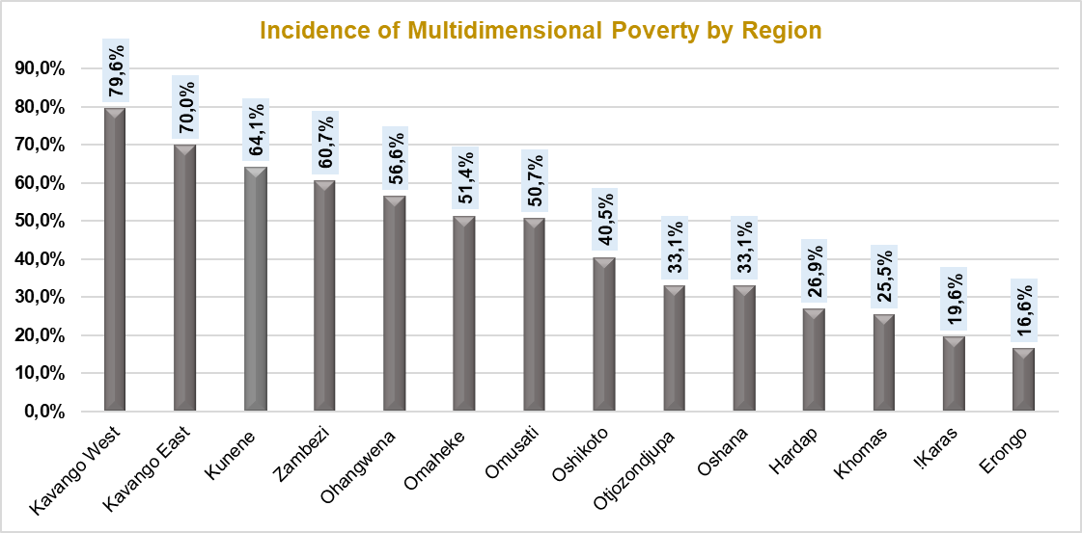

Multidimensional poverty
POVERTY CRISIS
New employees & anniversaries

Slide 8
ANALYSIS

Slide 9
Population Segmentation: Who can afford a house?
Total Population = 2.4 Million
(Segment the Population in terms of income)
Children under 15 years
881,676 (36.5%)
Adults 15 years of age and above
1,531,967 (63.5%)
Economically Inactive
438,770 (29%)
Economically Active
Labour Force
1,090,153 (71%)
Students 54.4%
Housewife 8.9%, Retired,
Too old, disabled 36.7%
Employed
725,742
(66.6%)
Unemployed 364,411 (33.4%)
9

Slide 10
HOUSING POPULATON: POPULATION PER TOWN
10

Slide 11
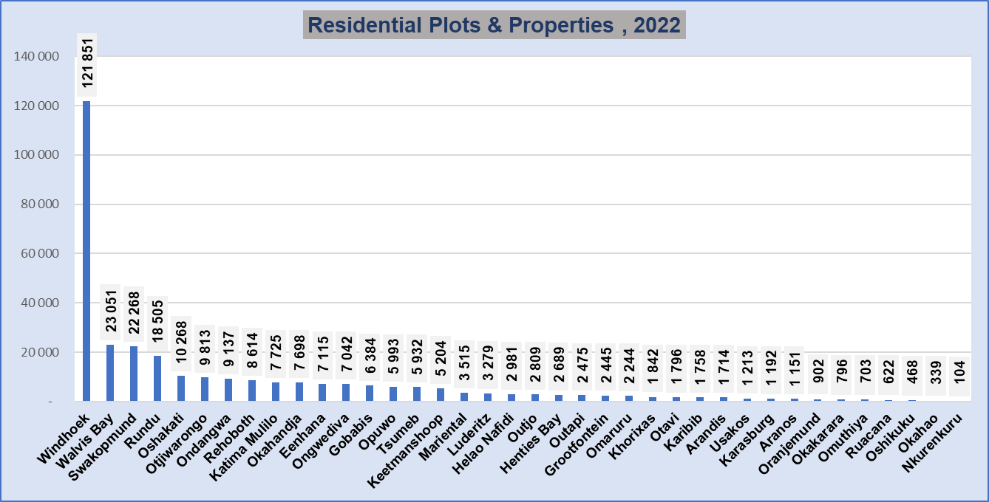
No. Residential plots & properties
HOUSING PROBLEM: HOUSING STOCK PER TOWN
New employees & anniversaries

Slide 12
HOUSING PROBLEM: TOWN AREA SIZE
12

Slide 13
HOUSING PROBLEM : POPULATION DENSITY
13

Slide 14
PPP Housing Delivery model

Slide 15
PPP MODEL FOR AFFORDABLE HOUSING DELIVERY
Local Authorities/Town Councils
Regional Government
Central Government
Land Provider
Land Transfer
Land Transfer
Affordable
Housing Grants
Institutional Investors
(Pension Funds)
(SPV)
Trust or Private Company
Development Finance Institutions
DBN
Financier
Other Local Investors
Private Sector
Private Equity
Developers
Land servicing, Design, Construction, and Operate

Slide 16
PPP: LAND INFRASTRUCTURE SECURITIZATION FUND
WALVIS BAY TOWN COUNCIL
Land Transfer
Land Securitization SPV
Land Servicing
Cash
Profit
For example, Walvis Bay Town Council wants to borrow N$500 million to service 1000 plots but cannot access bank funding because of a weak balance sheet.
Housing Construction
Land-Backed Securities (LBS)
Cash
Cash
Home Buyers Customers
Investor
Rates & Taxes

Slide 17
PPP: LAND INFRASTRUCTURE SECURITIZATION FUND
Securitization will Link the Council with the Capital Market/Investors such as Pension Funds.
Legal framework: Determination under the Banking Institutions Act, 1998 as amended: Securitization Schemes
LA Land Securitization SPV will issue bonds and raise funds directly from Institutional Investors (pension funds & Insurance)
17

Slide 18
HOUSING COST ANALYSIS

Slide 19
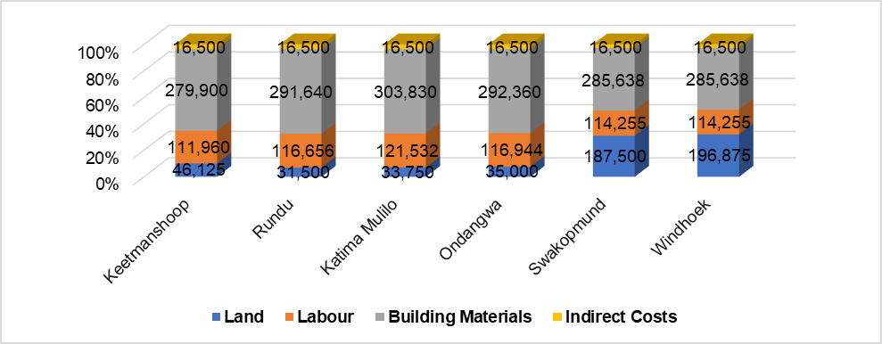
Housing Challenges: Total cost of building a house
19

Slide 20
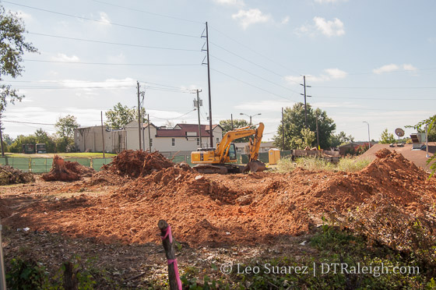


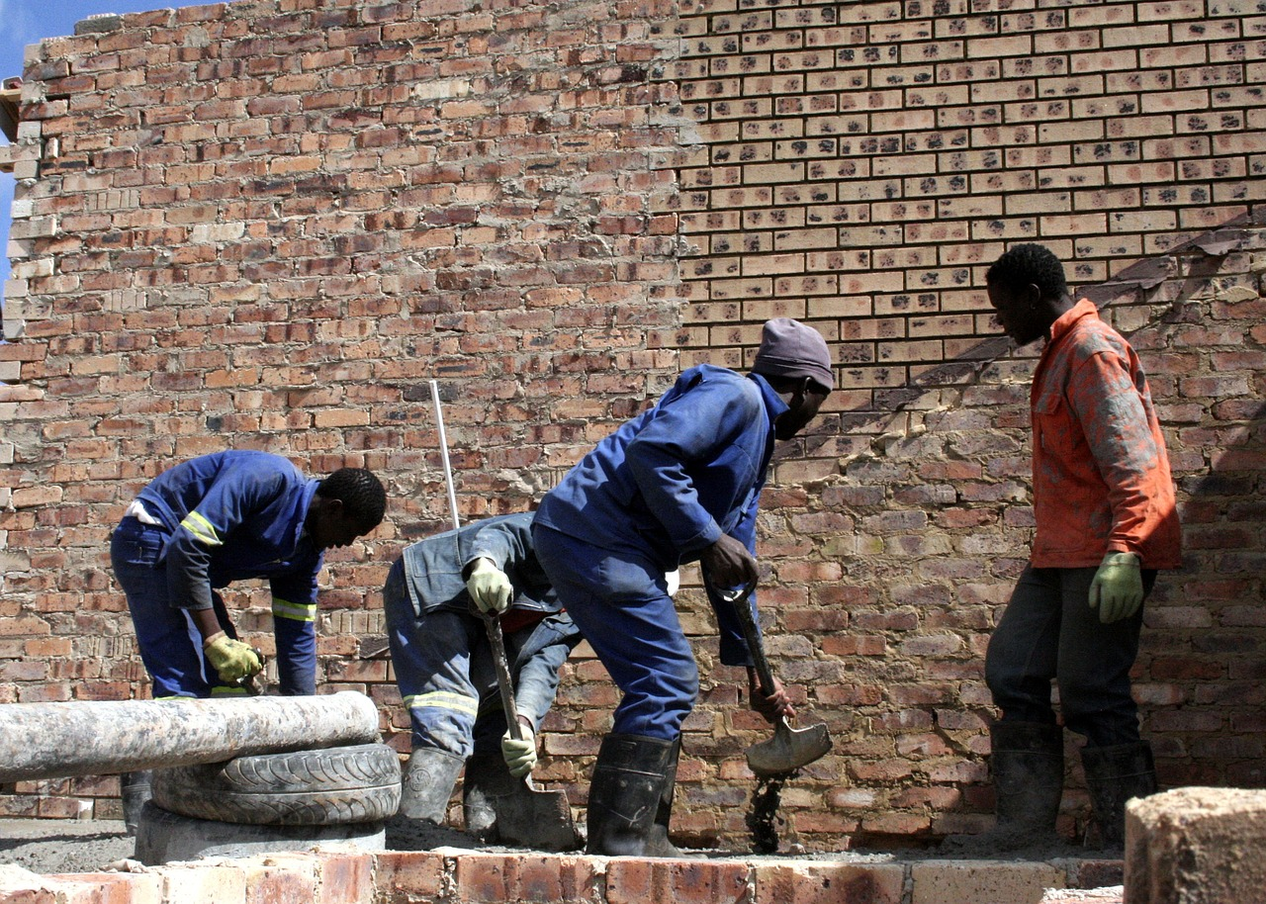

CASE STUDY : SWAKOPMUND
Building Materials
N$285,638
Land
N$187,500
31.2%
47.2%
Labour
N$114,255
Indirect costs
N$16,500
18.9%
2.7%
20

Slide 21
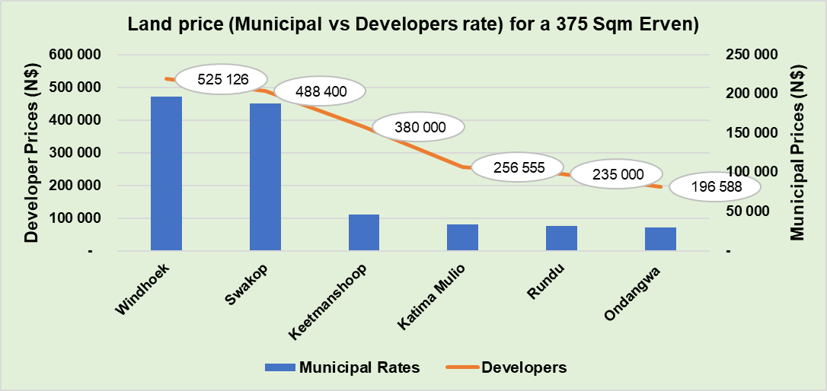
Land cost per town (N$)
LAND COST (PER TOWN)

Slide 22
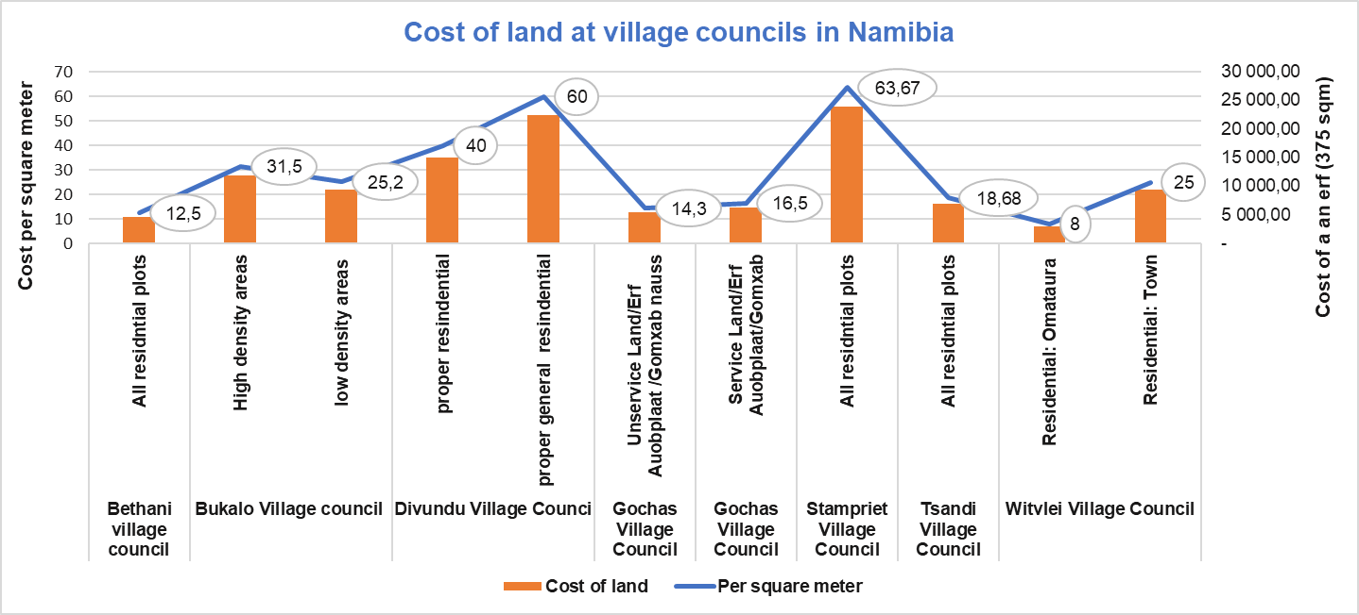
Cost of land (village councils)
New employees & anniversaries

Slide 23
FIRST CAPITAL HOUSING FUND - OPERATIONS

Slide 24



First Capital Housing Fund
FUND OBJECTIVE
INVESTOR
INVESTMENTS
GIPF Anchor Investor
FCTS Co-Investor
N$1.5 billion
3500 home loans
2 Infrastructure loans
N$2 billion
Home loan financing
Low to medium earners
Investor’s beneficiaries
Proclaimed areas

Slide 25
IMPACT AND EXPOSURE (Regional)

Slide 26
IMPACT AND EXPOSURE (Occupation)

Slide 27
FIRST CAPITAL HOUSING FUND PROPOSED PPP MODEL

Slide 28
PPP HOUSING DELIVERY MODEL
Local Authority
(Serviced land)
GIPF
FCHF
(Clients & Home Loan Financing)

Slide 29
PPP HOUSING DELIVERY MODEL IN ACTION
 | BUKALO VILLAGE COUNCIL | ONDANGWA TOWN COUNCIL
NUMBER OF PLOTS | 72 | 30
PLOT SIZE | 415sqm | 386.8sqm
PLOT PRICE | N$17,500.00 | N$58,000.00
HOUSE SIZE | 63sqm | 62sqm
HOUSE PRICE | N$440,000.00 | N$480,000.00

Slide 30
HOUSING SUBSIDY
Notes:
Provided we have access to payroll.

Slide 31
REQUIREMENTS

Slide 32

HOME LOAN APPLICATION REQUIREMENTS
Active GIPF member
National identity documents
Latest pay slip
Subsidy booklet
3 months banking statements
Tax certificate

Slide 33
First Capital Housing Fund
Free pre-approvals
Low interest rates
No
ICT check
Turn Around Times
Credit life facility
Financing in proclaimed informal areas

Slide 34
QUESTIONS?

