Slide 1
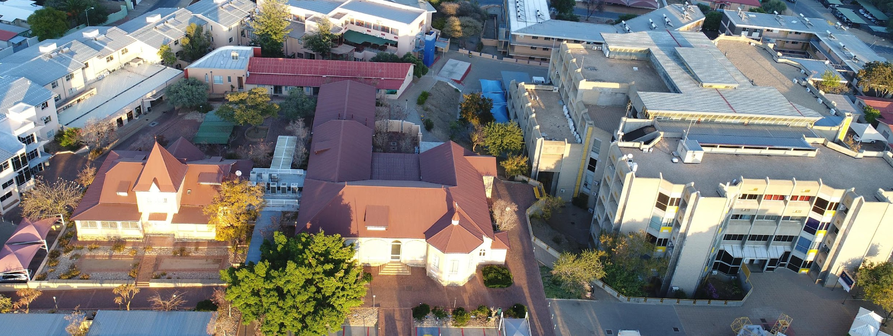


Office of the Vice-Chancellor
How can LAs Modernise Administrative Architecture by Use of 4IR?
By: Dr Erold Naomab
NUST Vice-Chancellor
21/February/2023
Notes:
The lecture is composed of two sections based on two critical questions of strategic importance to all LA.
How can LAs Modernise Administrative Architecture by Use of 4IR?
In essence here we are talking about how to transition and transform Las in modern operational context through digitisation. Unfortunately, such a transformation is no longer a mere choice, but is now an imperative and mandatory in terms of good corporate practise. Digitalisation is a matter of legal compliance with respect to good order of governance, a matter that is vested with the fiduciary responsibility of the board. It is so important that if you are not engaged with digital transitioning irrespective of your sector or focus you will soon be out of business and reduced to irrelevance.

Slide 2
What is a revolution in the context of industrialisation?
Two distinct parallels
Che Guevara is quoted saying.. "The revolution is not an apple that falls when it is ripe! You have to make it fall.
“Cogito Ergo Sum” I think therefore I am. 17th century French Philosopher called Rene Descartes
Notes:
Why is it call a revolution? What is a revolution? I will draw two parallels one from political perspective and the other from psychology to explain the concept of revolution. Perhaps there are many revolutionary examples in the political perspective, but I want to used one example Che Guevara is quoted saying.. "The revolution is not an apple that falls when it is ripe! You have to make it fall." you can see the paradox here. Che himself is revolutionary and a revolution.
The second example is takes us psychology and I think therefore I am suggest that there is only one evidence that passes redical doubt of existence. Meaning how to you know that you exsist. The only way that you can truly tell that you exsist is because you can think. The minute you stop thinking you dont exsist...hence I think therefore I am.
HE is excellency Dr Hage G Geingob thinking like a revolutionary put together the national 4IR task force of which I am proud member.

Slide 3
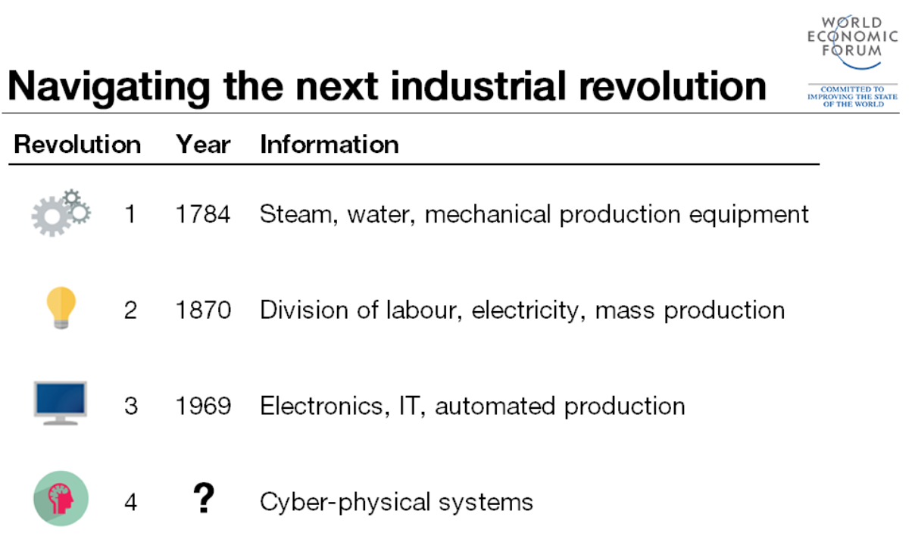
4IR?
Notes:
So here we standing in middle of a technological revolution. There is commonality or similarities or invariable factor or common aspect of all industrial revolutions. That is they are all labout market oriented. From the 1st to 4th industrial is clearly about how workforce and labour market has transformed.
S
The First Industrial Revolution used water and steam power to mechanize production. The Second used electric power to create mass production. The Third used electronics and information technology to automate production. The Fourth Industrial Revolution is building on the Third, the digital revolution that has been occurring since the middle of the last century. It is characterized by a fusion of technologies that blurs the lines between the physical, digital, and biological spheres.
Source: https://www.weforum.org/agenda/2016/01/the-fourth-industrial-revolution-what-it-means-and-how-to-respond/
Blurring the lines it is meant by creating systems allows us to communicate and interact with almost anything thus Internet of Things/Everything is often used.
For us to communicate/interact with almost anything this can be achieved with AI thus AI is the dominant technology in 4IR.

Slide 4
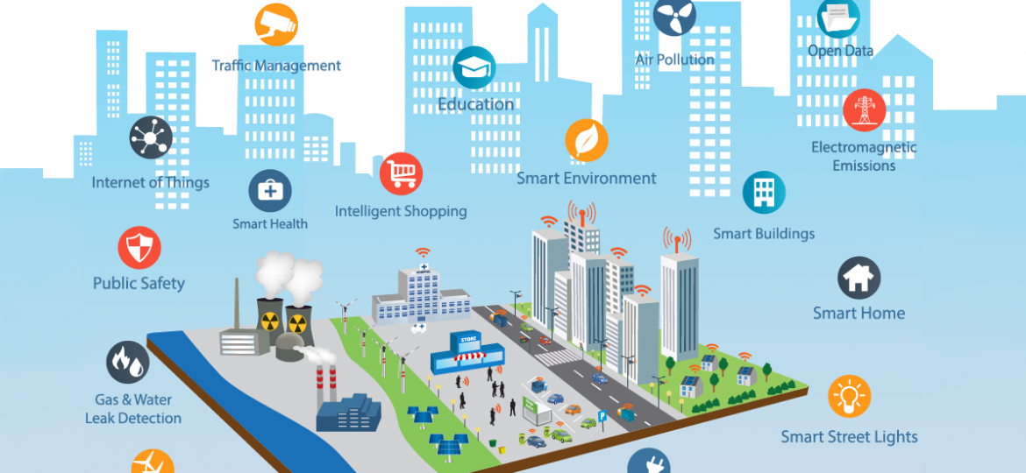
Notes:
The future of work is illustrated in the diagram above. What is clear on the picture is that every physical infrastrure is somehow connected and talking to each other using frontline technologies including AI. Every production system from agriculture, manufacturing to mining is affected by 4IR
Let us do a quick assessment. How many LAs is ready for the future of work and that you can proudly say that in your constituencies workers are ready for the eventual future.
The picture depicts smart city concept. How can NUST assist in this regard.

Slide 5
NUST 4IR Research Projects for ALAN
Natural Language Processing (NLP) through High Performance Computing (HPC) - Local language instant translation
Drones - Drones and AI for crime surveillance and community-based natural resource management.
Smart City Solutions - Smart and Secure Environments
Robotics and coding for School Learners
Notes:
Provide possible/existing research 4IR activities that NUST can collaborate with ALAN
In Estonia, 99% of public services are available online 24 hours a day.

Slide 6
Office of the Vice-Chancellor
How can LAs benefit from the envisaged National Green Hydrogen Projects?
By: Dr Erold Naomab
NUST Vice-Chancellor
Notes:
How can LAs benefit from the envisaged National Green Hydrogen Projects?
The topic of Green hydrogen cannot be devolved or separated from 4IR as they are intricately connected. I will go into some detail on how as Namibia we simply cannot afford to stay behind the quest of energy sovereignty. Energy sovereignty is a complex matter from a global context of geopolitics, north-south economic devide but the answers on how it can be done is simple and straight forward. It is perhaps this simplicity that comes as supprised to many.

Slide 7
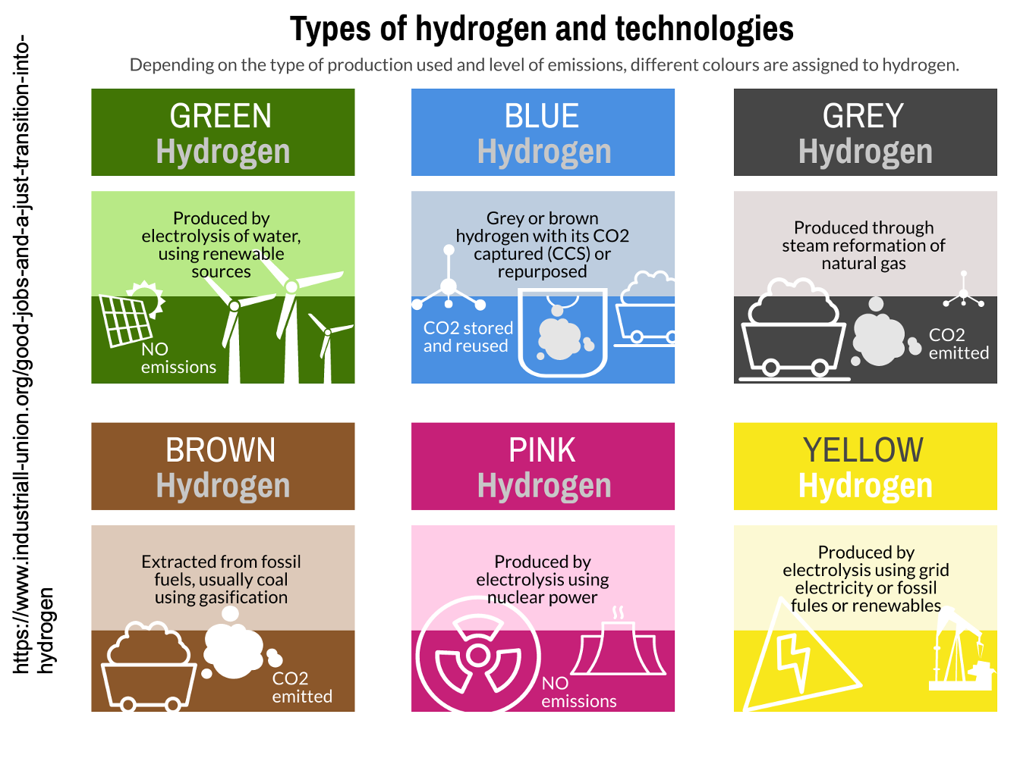
Notes:
What is Hydrogen? How is it produced
Hydrogen is the lightest gas in abundance but mostly in combination with other elements, like water.
Hydrogen is an energy carrier.
Green hydrogen is produced by splitting water into hydrogen and oxygen using renewable energy. So what are the other forms of Hydrogen.
To produce Green Hydrogen you need:
Water
Renewable energy from sun, wind and biomass
The production is with zero-CO2

Slide 8
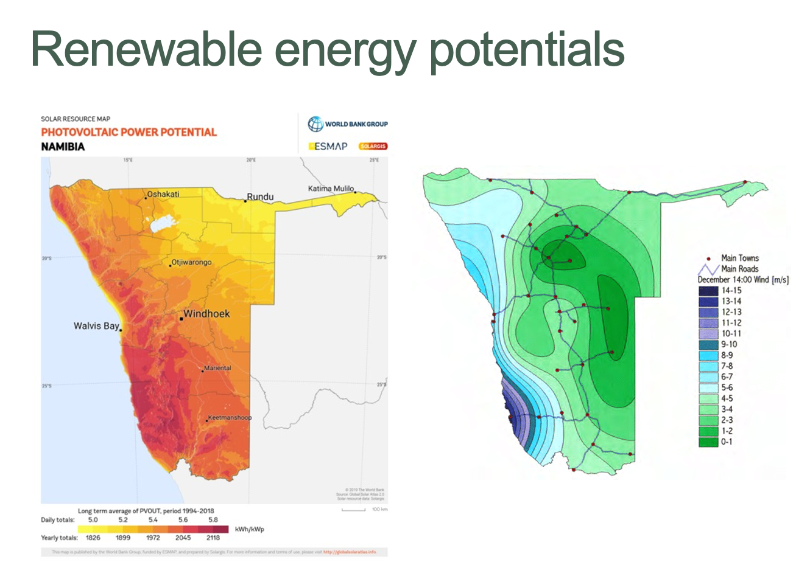
Best location for green H2 Production
Solar energy resource
Wind energy resource
Notes:
Namibia is one of the excellent places on earth to produce GREEN HYDROGEN
What is clear is that every LA in this country is excellently placed to produce green hydrogen. The only question most investors will focus on is unit cost of production. What is the offtake market? Power to X. The x depends on your core economic sectors and how GH2 can drive improvement in productivity.

Slide 9
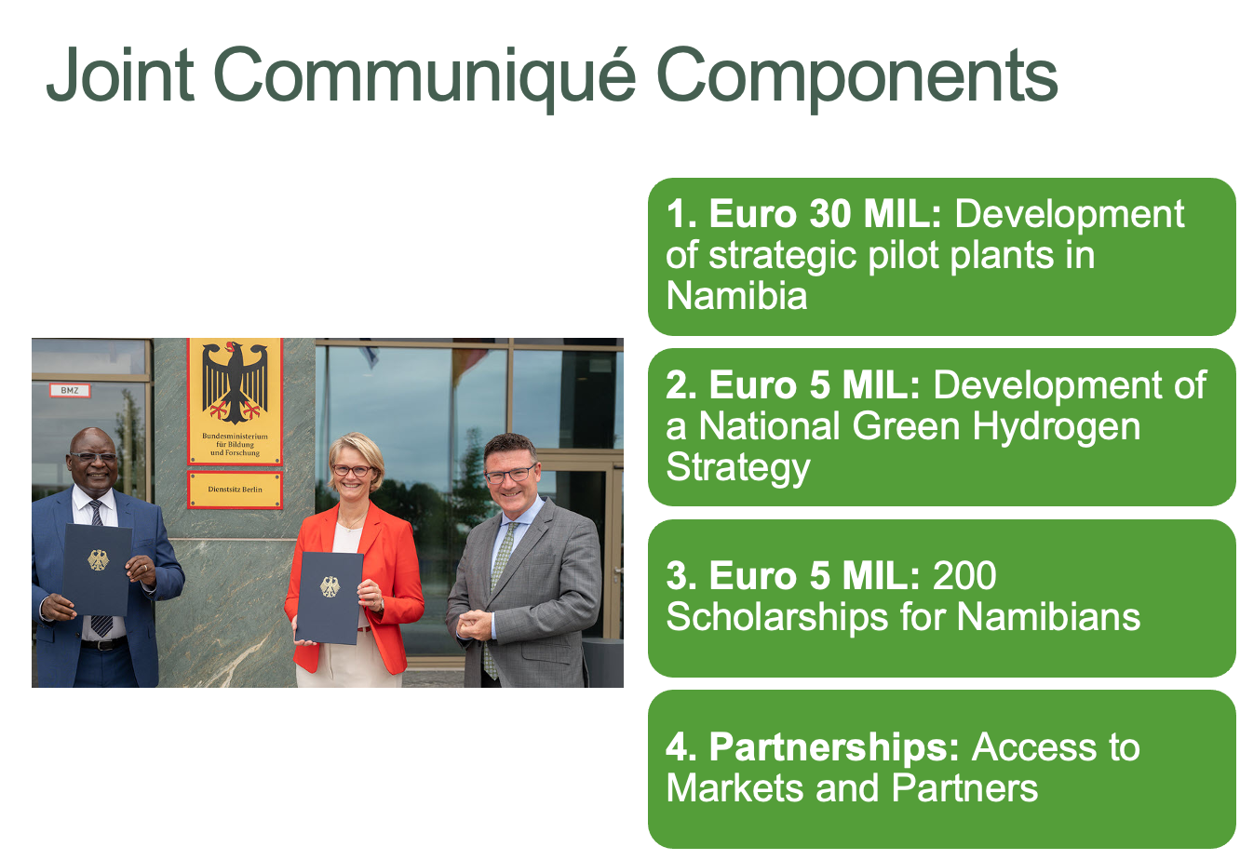
Namibia’s strategy
Namibia and Germany Signs a Joint Communiqué of Intent (JCoI)
Notes:
Based on well informed and research business case Namibia remains globally an attractive proposition for GH2. In practical ways this is affirmed by investment already secured as an example

Slide 10
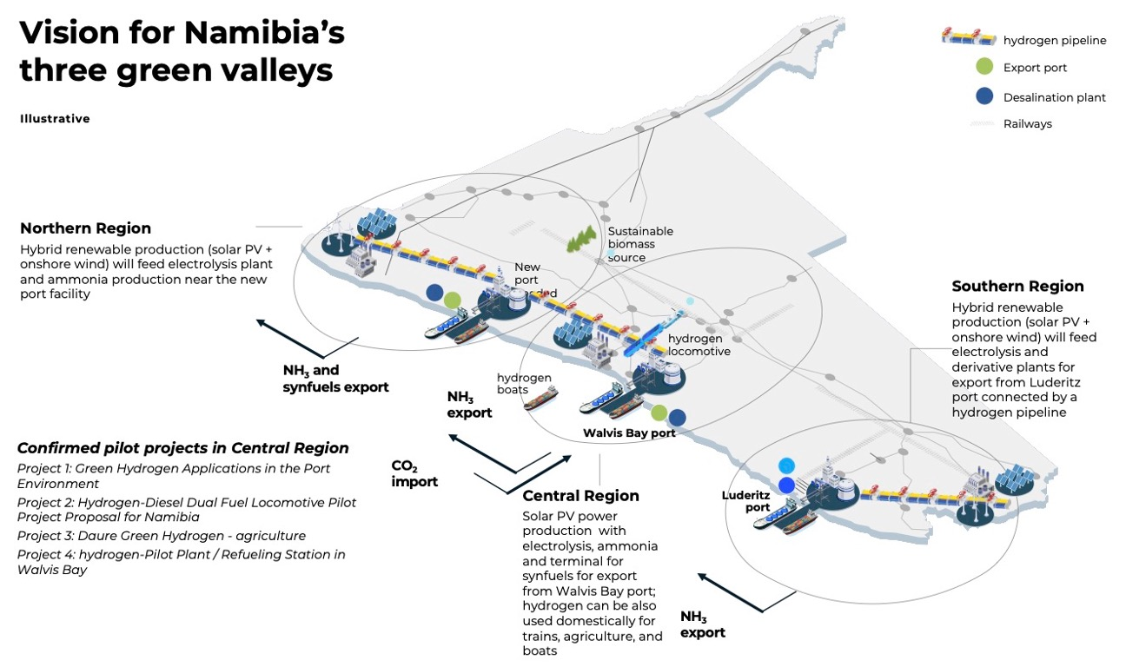
Notes:
Awarded projects and sites

Slide 11
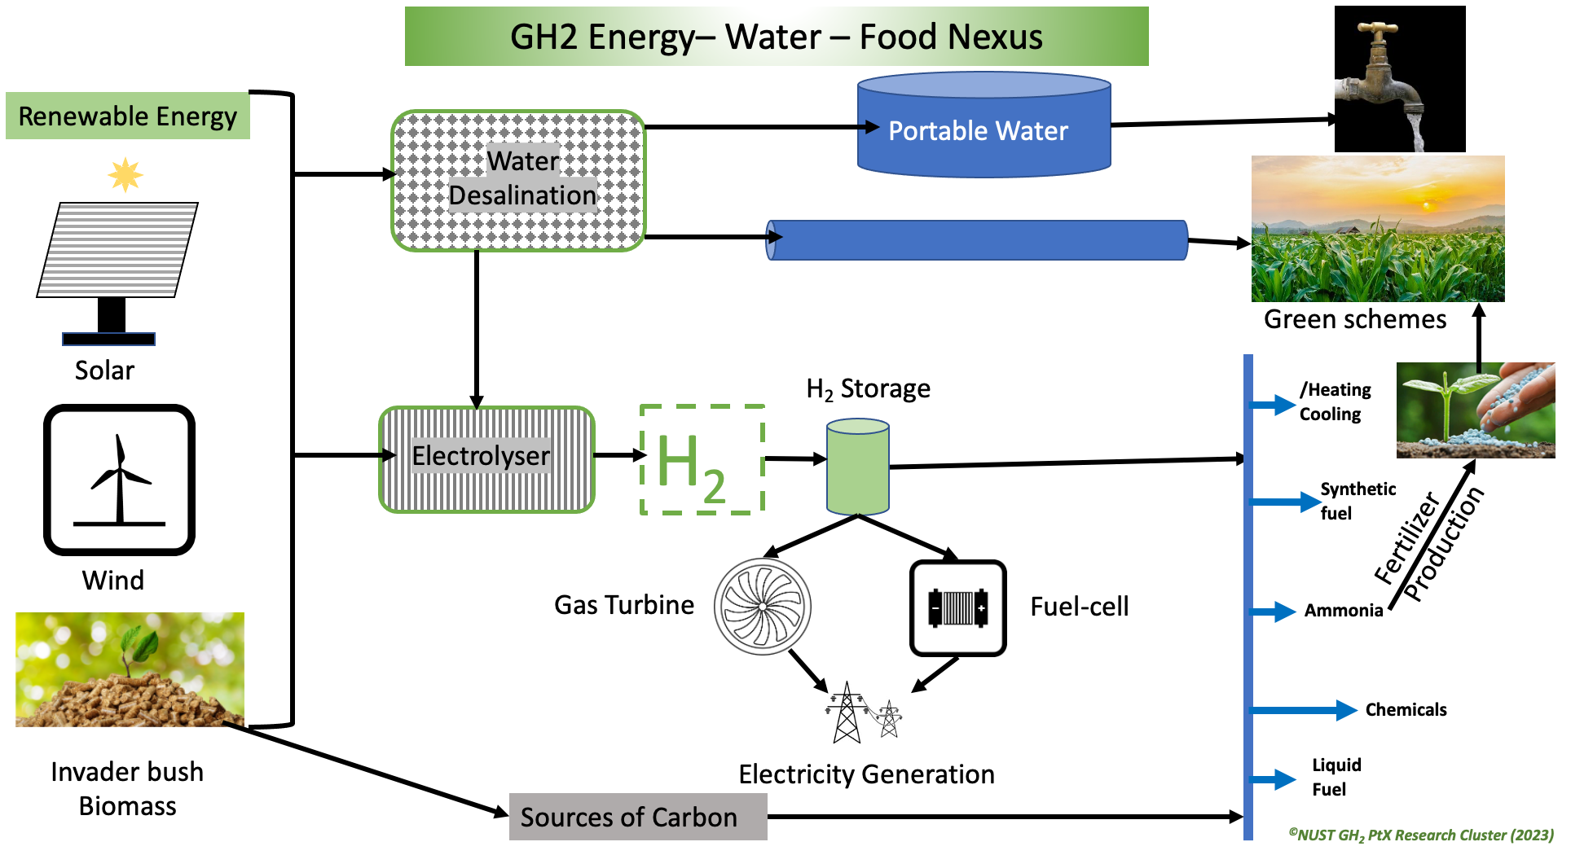
NUST’s vision for coupling Green Hydrogen to Economic Prosperity.
Notes:
NUST value proposition to All LAs

Slide 12
What NUST is offering ALAN
Short courses on the following:
Understanding the green hydrogen sector (Basic knowledge)- 1 day workshop
Renewable Power-to-X economies and markets (How ALAN can cash-in)
Hydrogen production infrastructure and impact on the environment.
Socio-economic factors, hydrogen and the sustainability goals
Partnership in following:
Developing a GH strategy at the Local Authority Level for socio-economic impact.
Creating smart partnerships with green hydrogen producing companies.

Slide 13
13 Jackson Kaujeua Street
Private Bag 13388
Windhoek
NAMIBIA
T: +264 61 207 2001
F: +264 61 207 9444
E: vc@nust.na
W: www.nust.na
Office of the Vice-Chancellor
Thank You.

