Slide 1
FNB Commercial: Public Sector Banking
Value Proposition to service Land to Town Councils
P
Presented by: Leslie Puriza (0817086682)

Slide 2

Value Proposition: Servicing of land
Municipalities/Town councils have the land and funds but their funds are applied to various needs e.g. Servicing of land; and providing of services to inhabitants of their towns for residential and business purposes. This limits their budgets. We directly fund the municipality/town council and this helps to minimise costs to the end user who is the beneficiary of the plot since there is no 3rd party profit.
The cost factors are:
The cost of servicing of land
The Town Council’s mark-up which is on average 25% depending on each respective municipality/town council.
Interest on the loan
We are involved in this to contribute to delivery of affordable land to our people. This contribution is a token of our participation in achieving the GRN objectives in terms of Vision 2030 and Harambee Prosperity Plan (HPP).

Slide 3
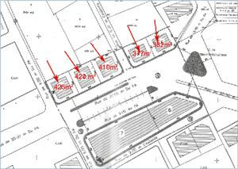

Solution
The Town Council identifies the land to be serviced that is sub-divided and zoned already.
We provide a loan not to be paid through operational cash flows but it is reduced by every plot/erven sold. This means that the person or institution who bought the land or erf pays towards the reduction of this loan.
*In some instances FNB offer to take up plots for our staff on identified land to be serviced in order to boost sales for the municipality/town council. This is done on ‘arm-length principle’.

Slide 4
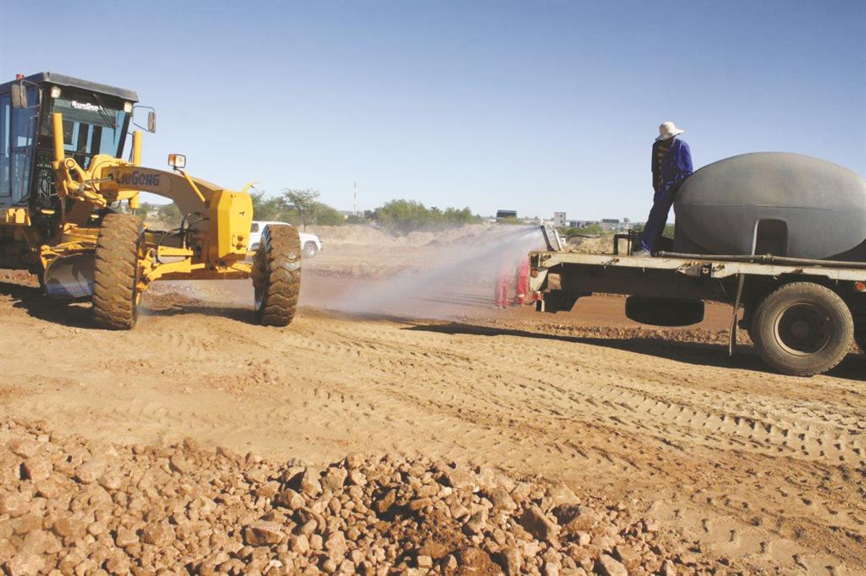

Terms & Conditions of Loan
1. The Loan term is 3 years (negotiable). Depends on the time from servicing to the sale of the ervens, taking into consideration the appointment of contractors, subdivison of ervens, registration of title deeds and actual sales of the plots.
2. The Bank may consider the following Collateral:
Lodging of individual title deeds to be released once the plot has been sold. This is the preferred option as there are no cost involved.
b) Registration of a first mortgage bond. Not preferred due to high cost

Slide 5
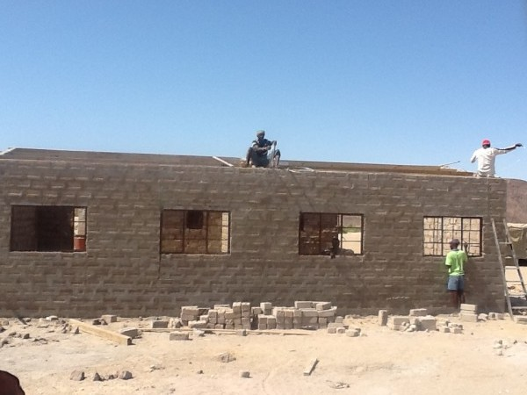
Requirements
Latest Annual Financial Statements (AFS)
Costing and CFF of the project
Lending mandates from relevant authorities. In order not to delay the process we start assessment parallel with the Town Council’s applications to obtain approval from their relevant authorities.

Slide 6

Questions?
Comments?

