Slide 1
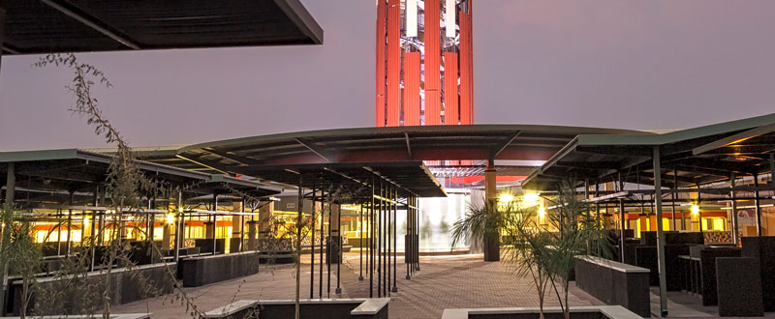

HOUSING AND LAND DELIVERY MODELS: BEST PRACTICES FROM OSHAKATI
TIMOTEUS NAMWANDI – CHIEF EXECUTIVE OFFICER
February 2023

Slide 2

Presentation Outline
Introduction
Land delivery approach
Housing delivery model
Challenges
Recommendations

Slide 3

Oshakati Town “the Commercial Center of the North”
Oshakati was founded in the 1960’s and was proclaimed as a town in 1992.
Oshakati is currently serving about 90 000 residents (36,541 census report 2011).
Over the last five years, Oshakati has serviced and allocated 4000 erven to residents and has been listed as one of the leading town in land and housing delivery in Namibia.
Informal settlements
Upon proclamation
Informal settlements (inherited)
Uupindi South
Uupindi North
Evululuko
Oneshila
Okandjengedi
Pohamba
Oshimbangu
Oshoopala
Kalaula
Eemwandi
Sky
Two (2) formal townships
Oshakati East (1238 erven)
Oshakati West (597 erven)
Total: 1835 erven

Slide 4
Land Delivery Model
Land servicing under Oshakati flood master plan program from 2011 to 2014
Bank financed (DBN) program for Oshakati extension 16 servicing
Mass urban land servicing at Ehenye proper, Ext 2,3,7 & 8
NHE partnership for Ehenye extension 4 servicing in 2013 (mass housing program)
Government funds (MTEF) for Ehenye extension 5 & 6
Land delivery program for ultra-low and low-income groups -ONAWA
Special land delivery program – Internal Financing
Public private partnership: Ompumbu Townships
Formalization and servicing of informal settlements in Oshakati

Slide 5
Land Servicing Under Oshakati Flood Mitigation Master Plan Program
In 2011, the Central Government through the decision of the cabinet approves the implementation of Oshakati Flood Mitigation Master Plan.
A total of 2250 erven in Ekuku Townships were serviced with the intention of relocating flood affected residents.
The servicing commenced in 2012 and completed in 2017.
EXTESION OR LOCATION | NO OF ERVEN
Ekuku Proper | 270
Ekuku ext 1 | 301
Ekuku ext 2 | 297
Ekuku ext 3 | 255
Ekuku ext 4 | 261
Ekuku ext 5 | 297
Ekuku ext 6 | 276
Ekuku ext 7 | 293
Total | 2250

Slide 6
Bank Financed (DBN) Land servicing program for Oshakati Extension 16
In 2014, Oshakati Town Council borrowed N$ 50 million from Development bank of Namibia for the servicing Of Oshakati Extension 16 with the approval of the line minister.
A total of 270 Erven were serviced. This area is low density and earmarked for higher income earners.
The Council settled this loan within a period of 3 years instead of 5 years as planned due to rapid sales.

Slide 7
Mass Urban Land Servicing at Oshakati North Proper, EXT 2,3,7 & 8
A total of 807 erven were serviced under Mass Urban Land Servicing Program
Servicing completed in 2017 at a total cost N$ 137 million.

Slide 8
NHE Partnership for Oshakati North Extension 4 Servicing in 2013 (Mass Housing Program)
National Housing Enterprises (NHE) in partnership with Oshakati Town Council was allocated Oshakati North Extension 4 on a Turnkey principle to service and Construct houses under Mass Housing Program.
A total of 268 erven were serviced.

Slide 9
Government Funds (MTEF) For Oshakati North Extension 5 & 6
A total of 428 erven were serviced and completed in 2015 at Oshakati North (Ehenye) Extension 5 & 6.
Ehenye Ext 5 | 153
Ehenye Ext6 | 275
TOTAL | 428

Slide 10
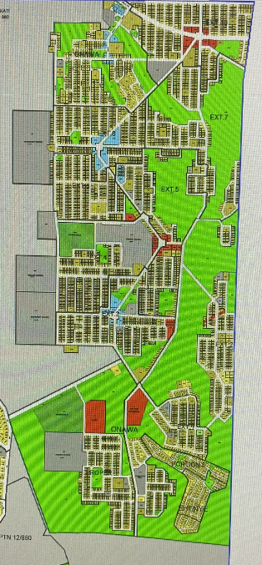
Land delivery program for ultra-low and low-income groups: Onawa
Onawa consist of 11 townships comprising of
3600 plots with average size of 300m².
The area is serviced with water by the Council’s technical team (in-house work), access roads and electricity (free house connection) at a cost of N$45 million.
A total of 1000 households were relocated from informal settlement such as Eemwandi, Sky, Oshimbangu, Kalaula and Oshoopala informal settlements.

Slide 11
Special land delivery program – Internal Financing
In June 2022, the Council availed N$40 millions to service 283 erven in Ehenye Ext 11 and 12 using a principle of internal financing principle.
Erven are pre-allocated and clients paying off their erven. Basically, clients pay for servicing of their own plots.
Plots are costed at a cost recovery basis with a minimum profit margin as a return on investment.

Slide 12
PUBLIC PRIVATE PARTNERSHIP (PPP) PROGRAM: OMPUMBU TOWNSHIPS
Council Explore the PPP program for servicing and housing development in Ompumbu Township.
Currently, one developer signed an agreement for construction of services and houses, Ompumbu extension 1 & 2.
In February 2023, Council requested for expression of interest in Local newspapers for servicing and houses construction at Ompumbu Extension 5 & 6, the process is anticipated to be concluded in March 2023.
So far , this model did not yield any results, however it is considered and prospecting to be an effective method of land and housing delivery.

Slide 13
FORMALIZATION AND SERVICING OF INFORMAL SETTLEMENTS IN OSHAKATI
Formalization of informal settlements, allows resident to have land ownership.
Oshakati Town Council formalized the following informal settlements:
Ompumbu Proper
Uupindi South
Oshakati Extension 10, 13, 14 & 15
Formalization allows the residents to purchase off their plots and enable the Council to generate rate and taxes.

Slide 14
Housing Delivery Model
Integrated Housing development model:
Engaging key stakeholders
Community
Central Government
Private Estate Developers
Estate agents
Low-income housing schemes (Shack dwellers federation and Decentralized Build Together Program)
National Housing Enterprise (NHE)
Financial institutions (Banks)

Slide 15
Housing Stock
LEGEND
Formalized
Formalised & Relocated
TOWNSHIP | NO OF ERVEN | NO OF HOUSES
Oshakati East | 1238 | 1206
Oshakati West | 597 | 445
Extension 16 | 270 | 238
Oshakati North (Ehenye) | 2355 | 1799
Ekuku | 2272 | 2185
Okakukiipupu (Proper & Ext. 1 | 525 | 458
Ompumbu | 1769 | 1627
Uupindi South | 235 | 184
Oshakati Ext. 10 | 182 | 169
Oshakati Ext. 14 | 436 | 398
Oshakati Ext. 15 | 344 | 315
Okandjengedi South Proper | 122 | 118
TOTAL | 10345 | 9142
To be formalised
Uupindi North
Evululuko
Oneshila
Okandjengedi North & South
Pohamba (Ext. 13)
Oshimbangu
Oshoopala
Kalaula
Solar Plant site
Eemwandi
Sky

Slide 16
Housing Delivery Approach, Ctd’
Application form for land
Housing waiting list (Database) in Excel format
Applicants are considered on a First Come – First Serve Basis
Council has a Land Allocation Policy to guide land allocation
Land and Housing Allocation Committee

Slide 17
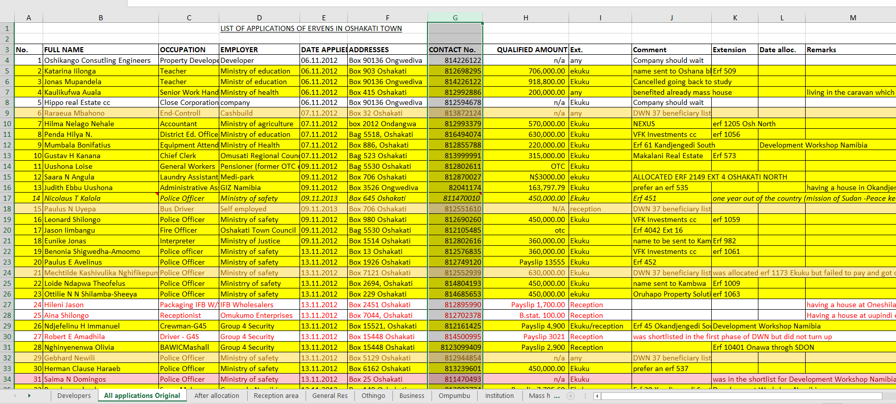
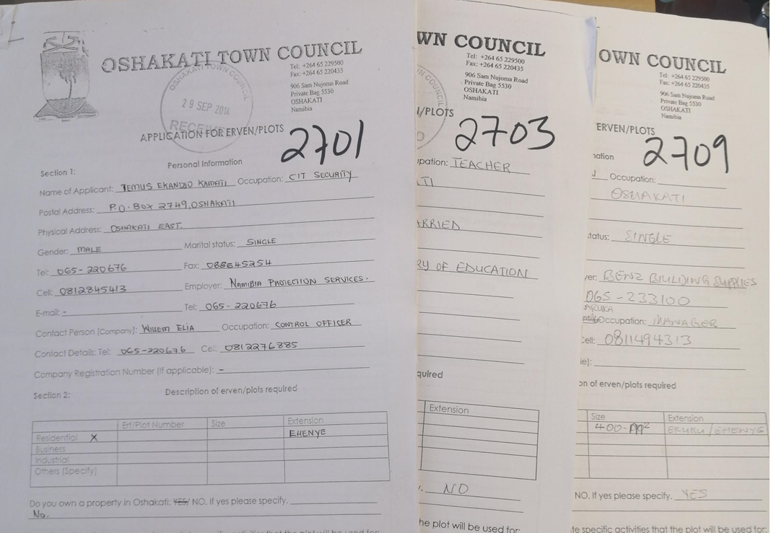
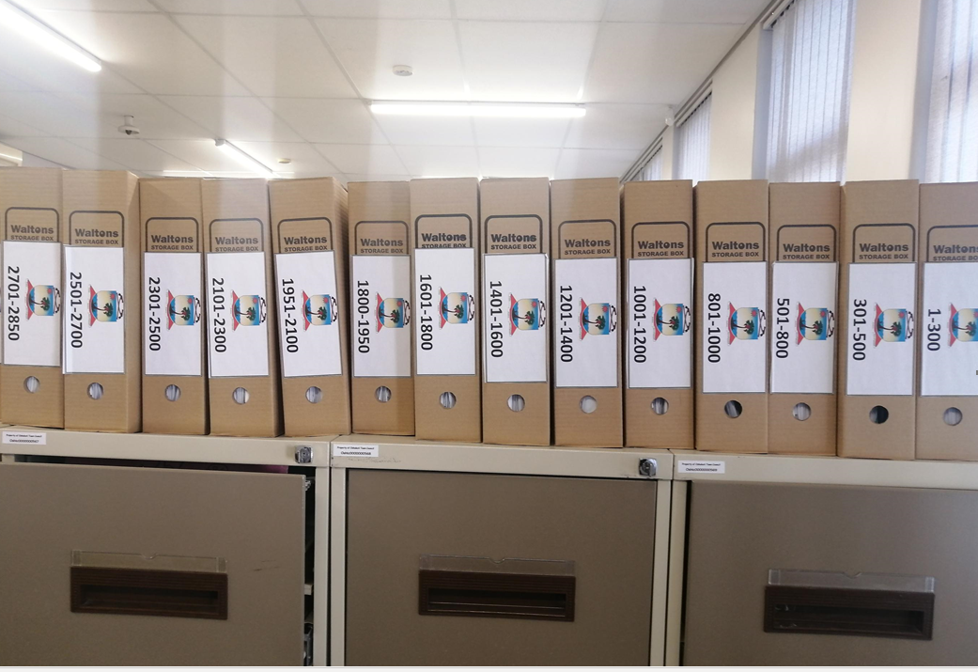
Waiting list Conti…..

Slide 18
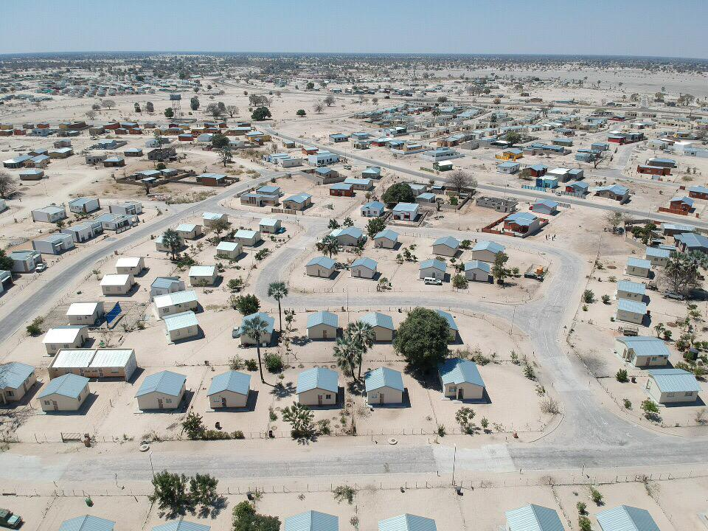
Private Estate Developers
In 2014, Council allocated residential erven to Private Developers to construct houses for low- middle income earners
This initiative was unique and first of its kind in Namibia
The agreement entails awarding of serviced land to Developers for the sole purpose of construction of the top structure
Land is purchased and transferred directly to the beneficiaries from the Council’s Waiting List
About 1,950 erven have been allocated under this initiative between 2014-2022, to 64 local estate developers.
The initiative continues to yield positive results in terms of housing delivery

Slide 19
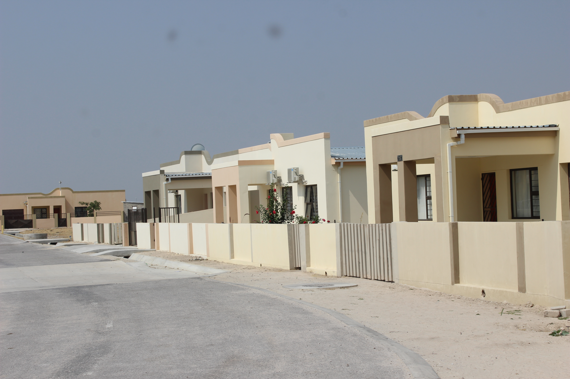
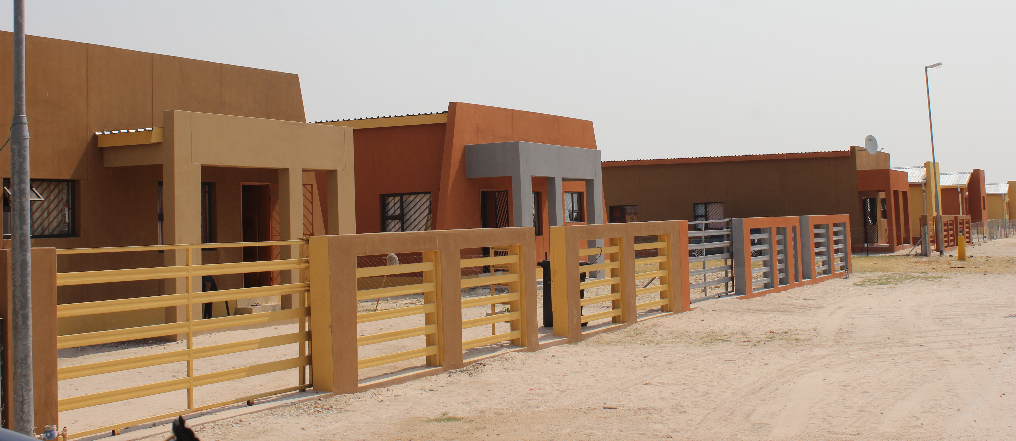
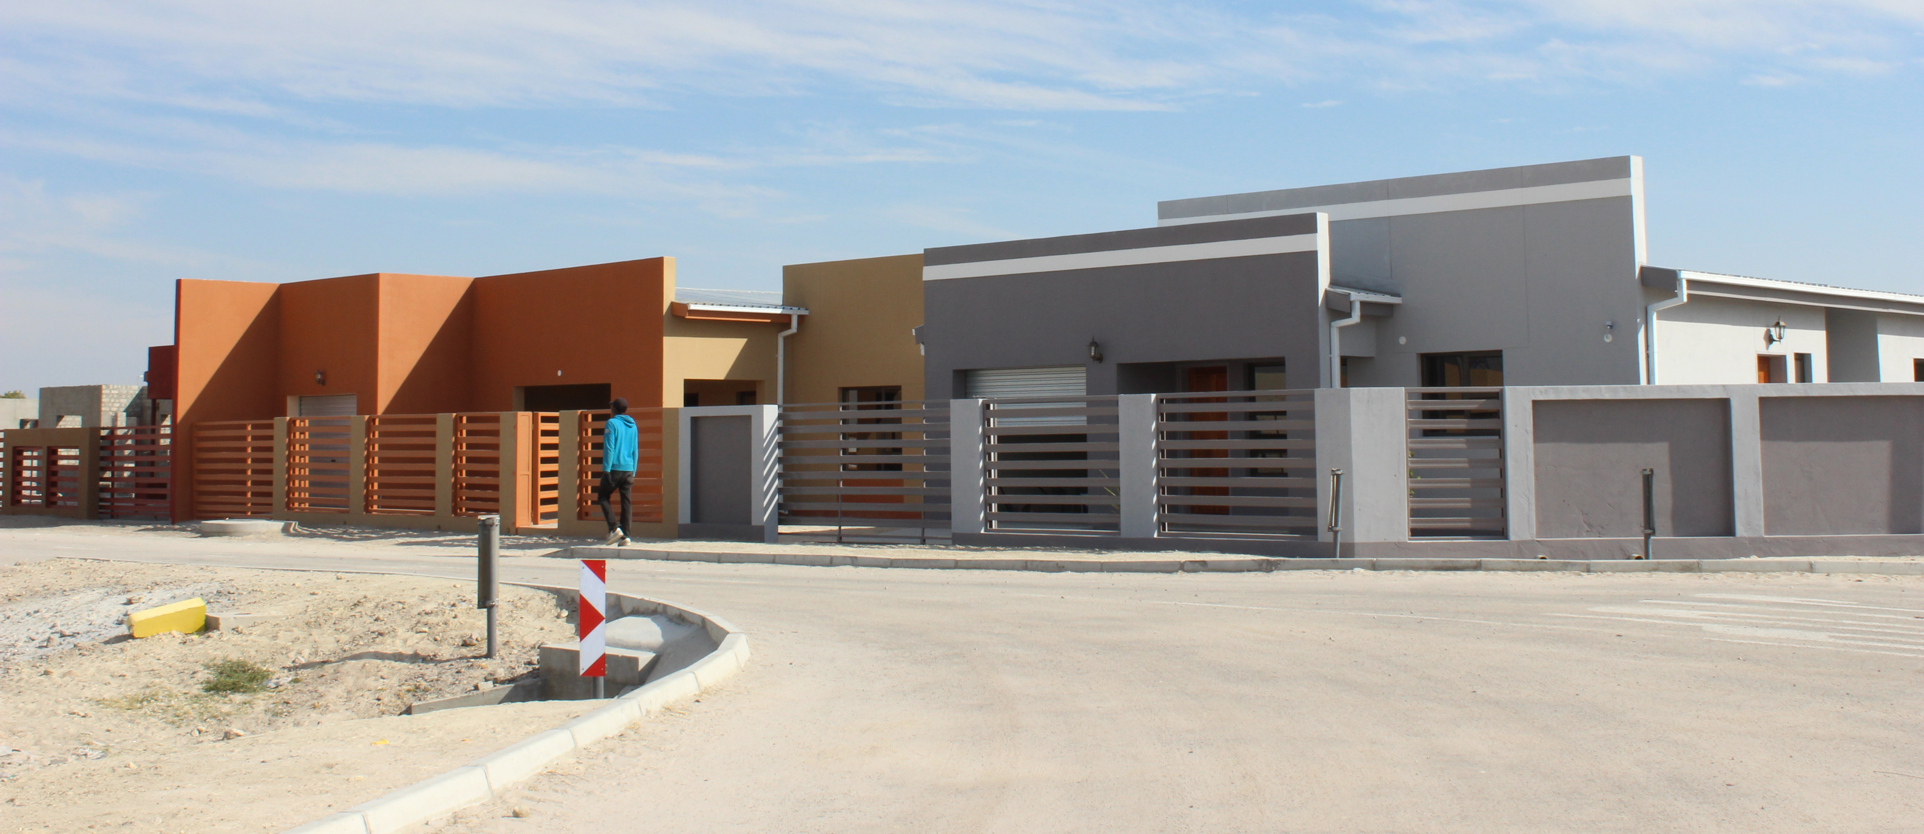

Slide 20
Decentralized Build Together Program
Council revived the Built Together Program in August 2022 after a 10-year dormancy
Decentralized Build Together Committee
First allocation of 35 beneficiaries with their own erven in October 2022 (phase 1),
Maximum loan amount of N$80,000.00 for a one bedroom house
Under phase 2, Hundred (100) houses under the DBTP
Cross subsidization of water connection fee for the beneficiaries
Free electricity connection to their houses

Slide 21
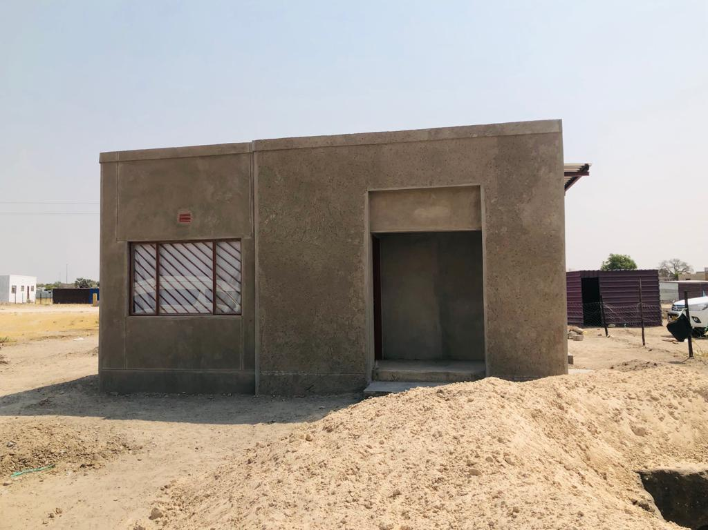
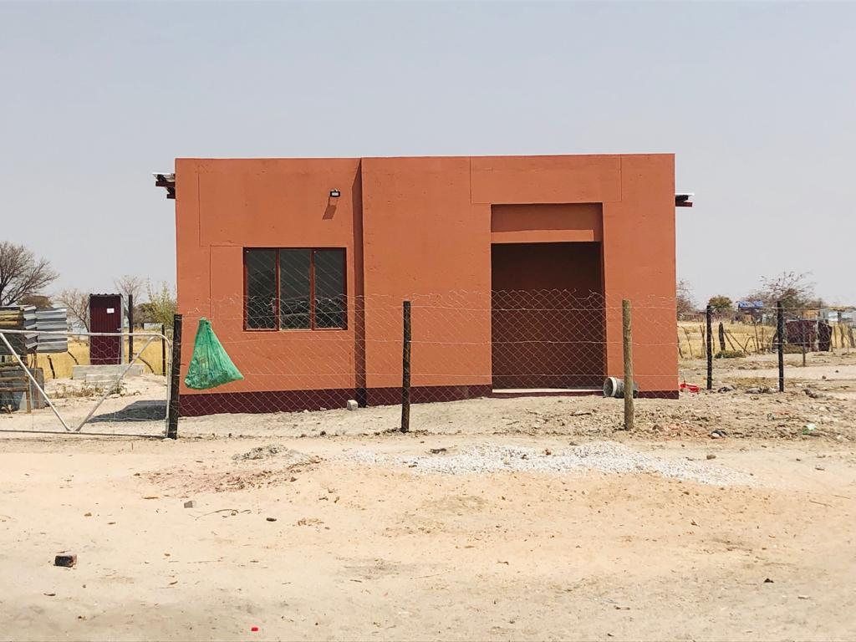
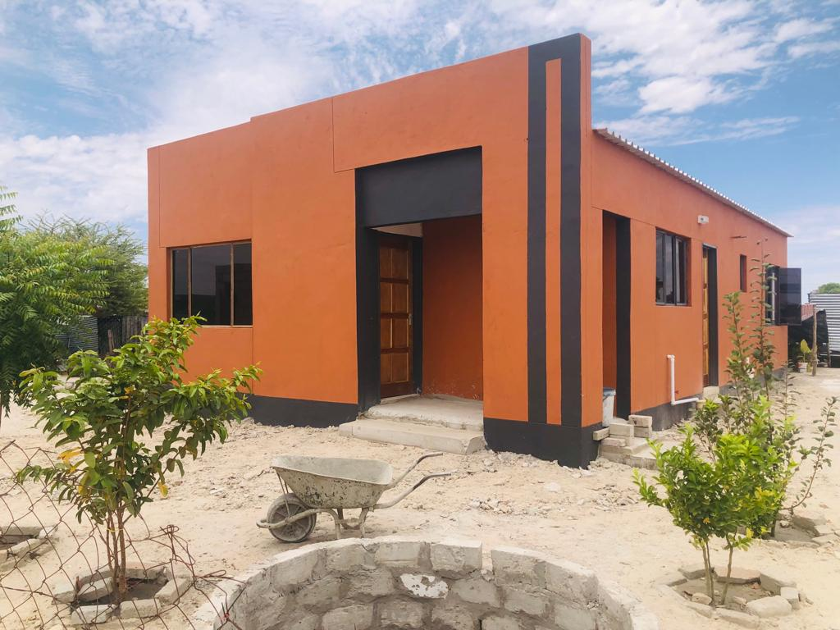
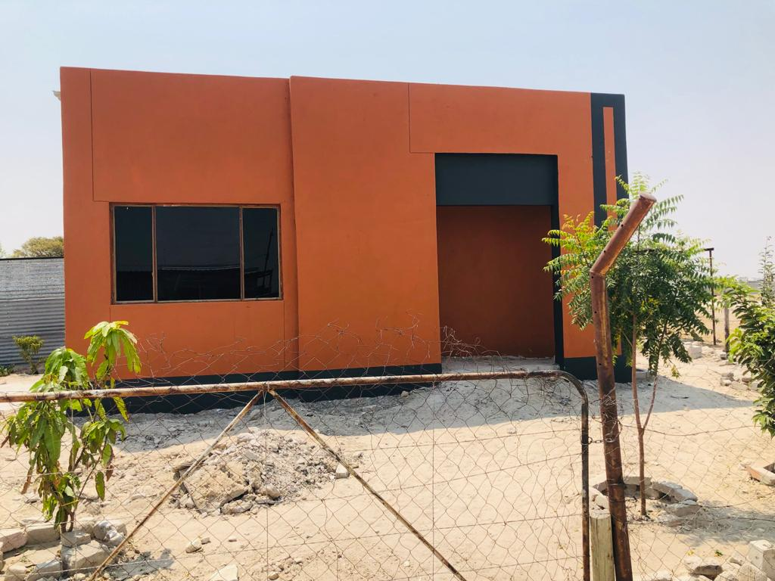
Typical houses of Build Together constructed in Oshakati,2022

Slide 22
Shack Dwellers Federation
Council allocated Onawa Extension 4 with 300 erven in December 2018.
A total of 195 houses are completed & occupied.
Houses handed over officially by the Minister of URD on 21st May 2022
About 105 houses still to be completed
Shack Dwellers Federation awaits budget approval in order to commence with the remaining houses

Slide 23
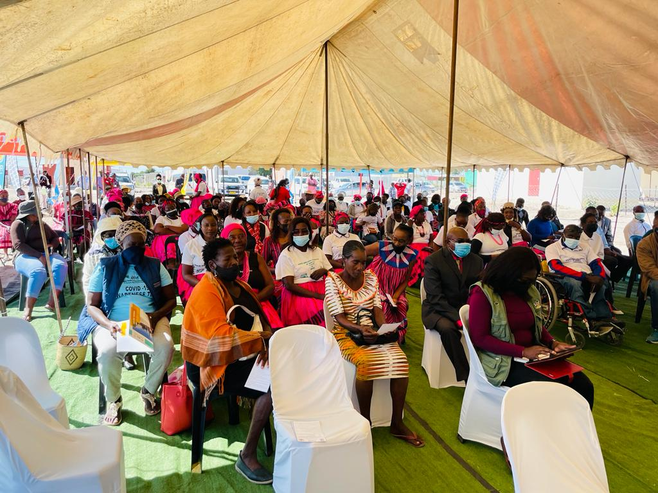
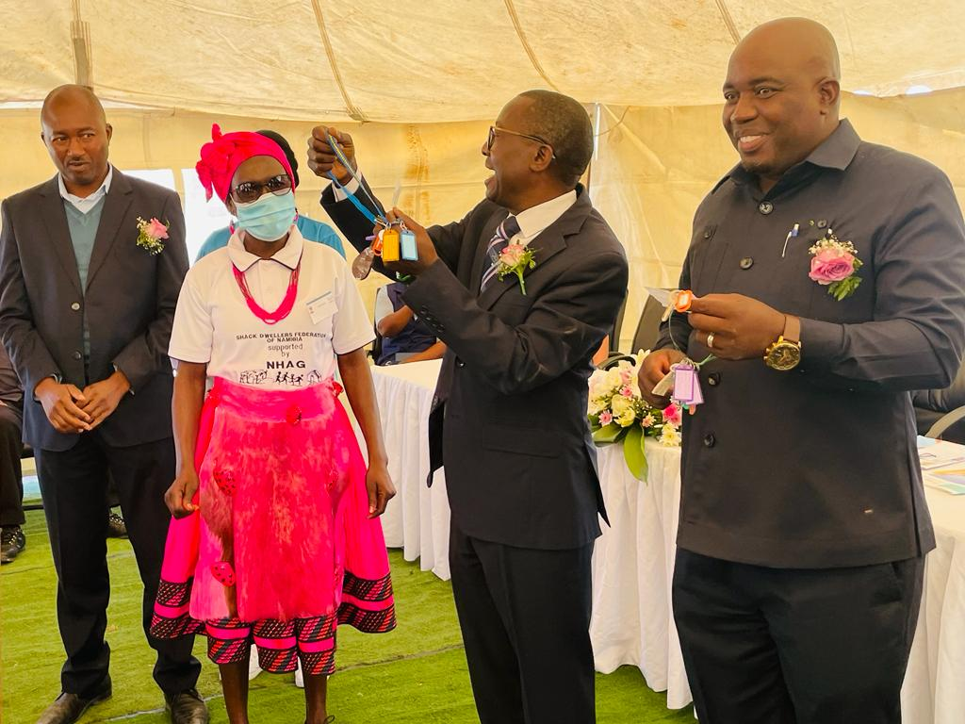
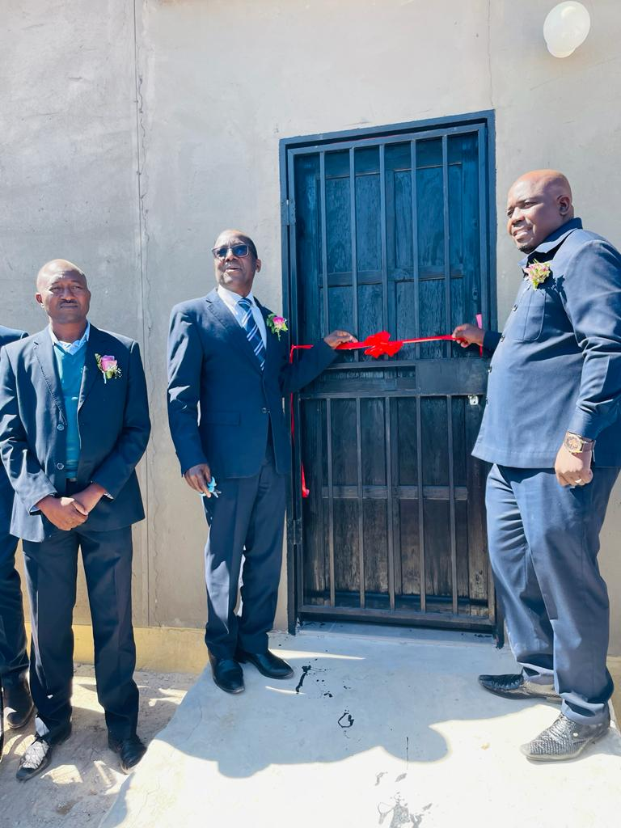
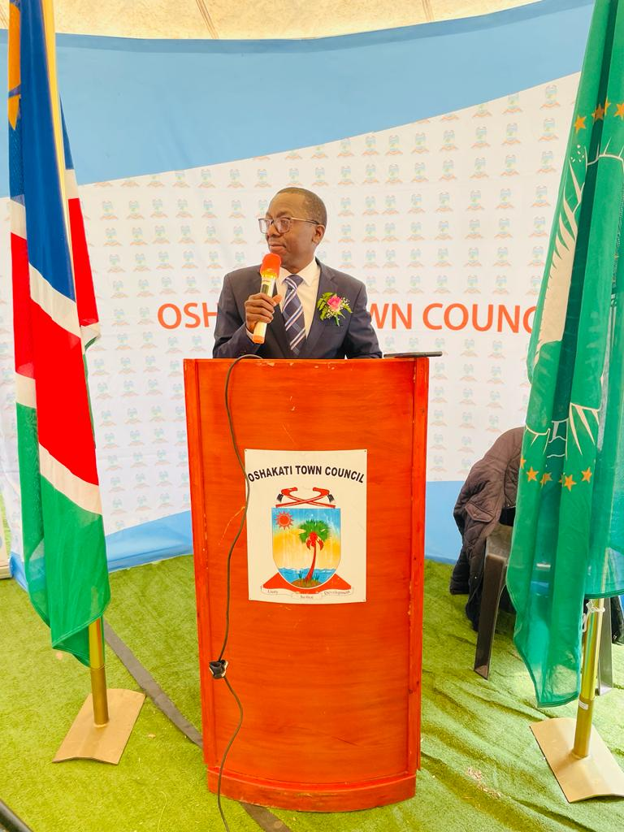
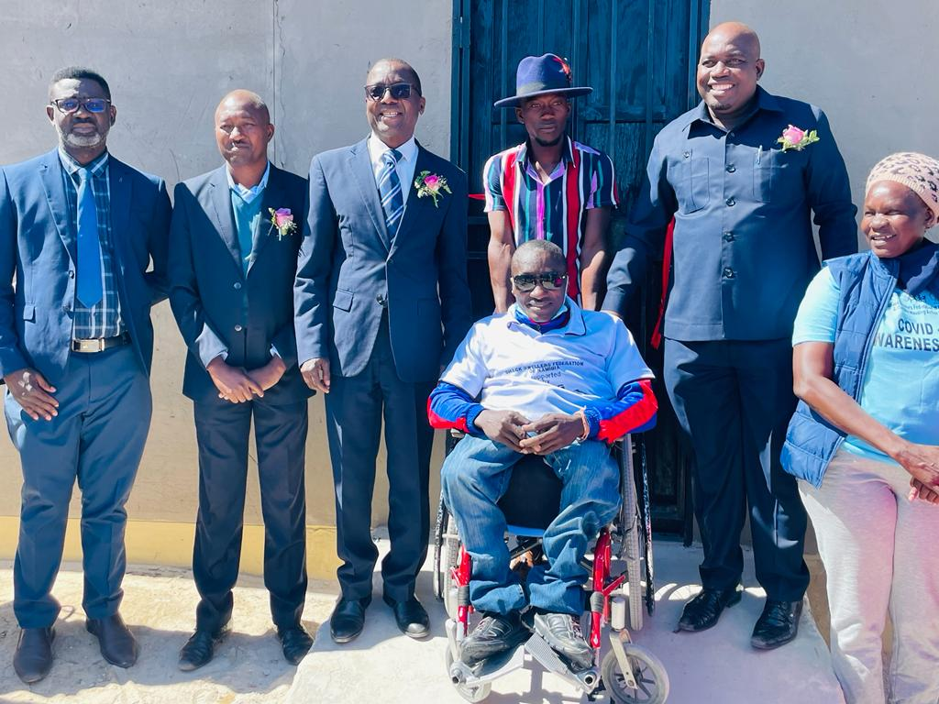
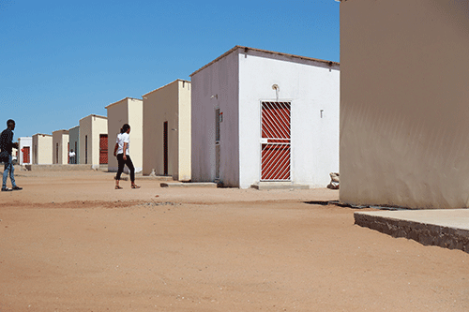
Hand over of Shack dwellers houses Oshakati, 21 May 2022

Slide 24
NATIONAL HOUSING ENTERPRISE (NHE)
Oshakati Town Council is having a good working relationship with the NHE and continues to build on this relationship to deliver affordable housing units
NHE land allocations and housing development:
200 Houses constructed in Ekuku
209 Housing units built in Oshakati North (Ehenye) Ext. 4
100 erven allocation in Oshakati-North – Year 2022
NHE and Council is also in an agreement for a Special Housing Project for Men and Women in Uniform
A total of 70 residential erven allocated for this project.

Slide 25
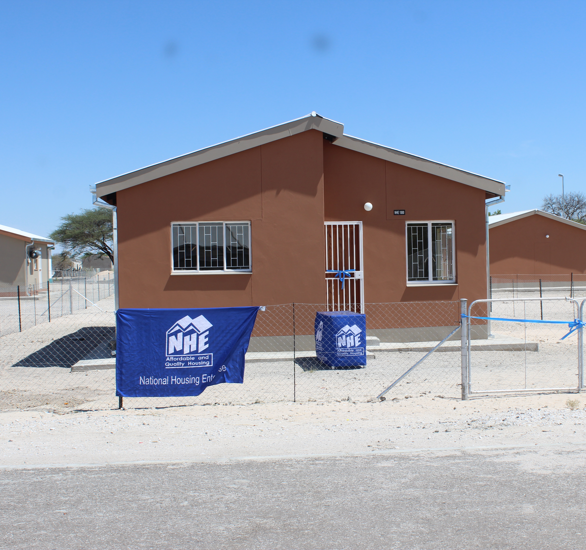
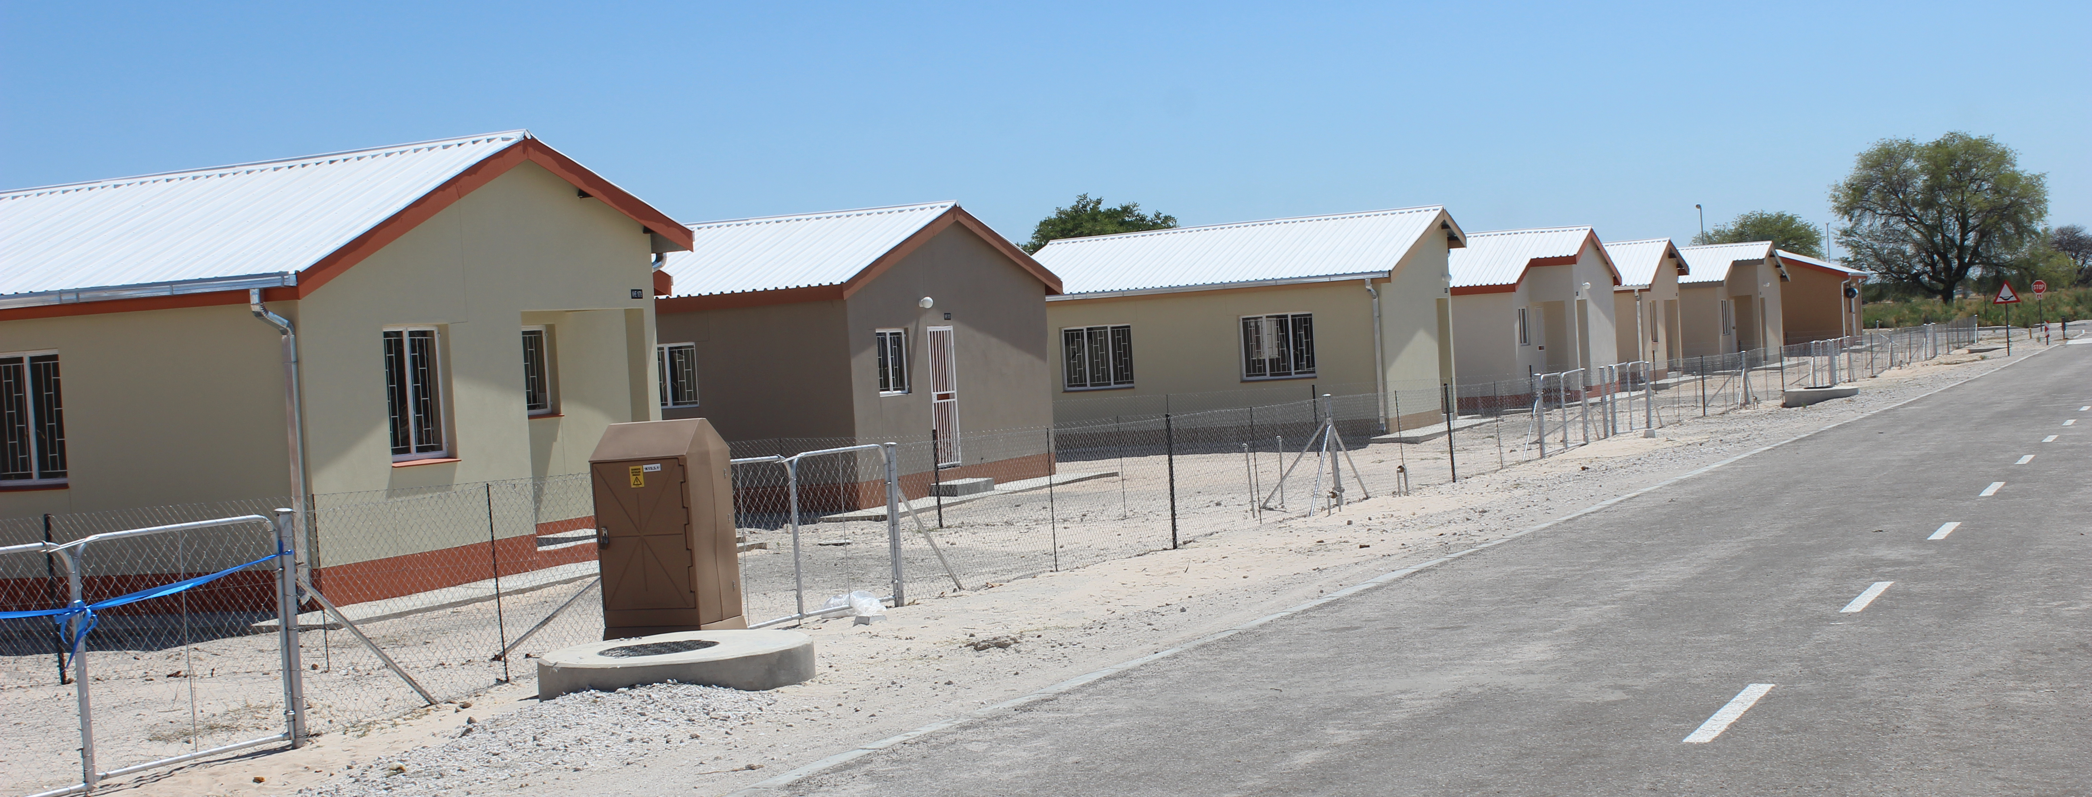
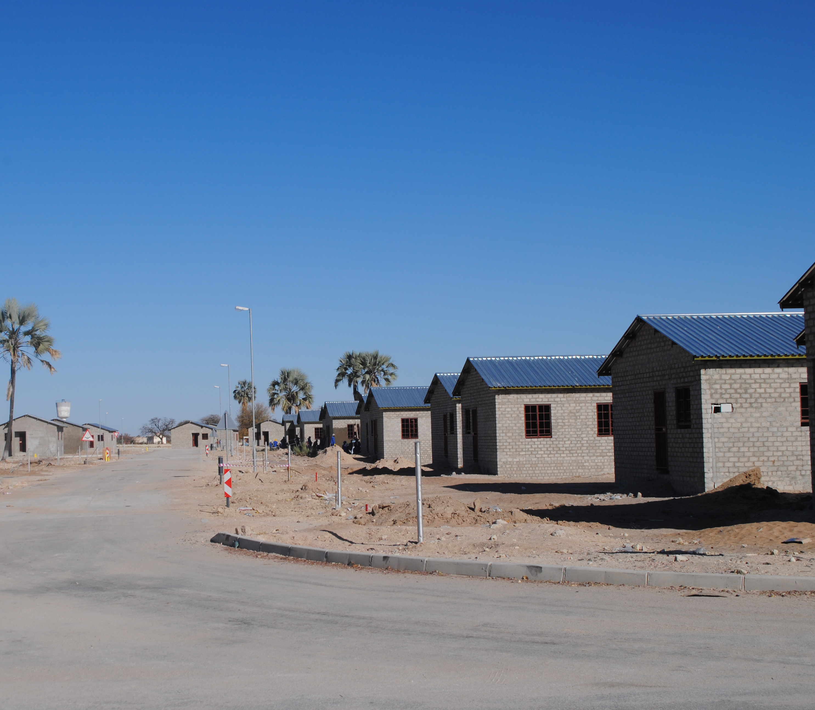
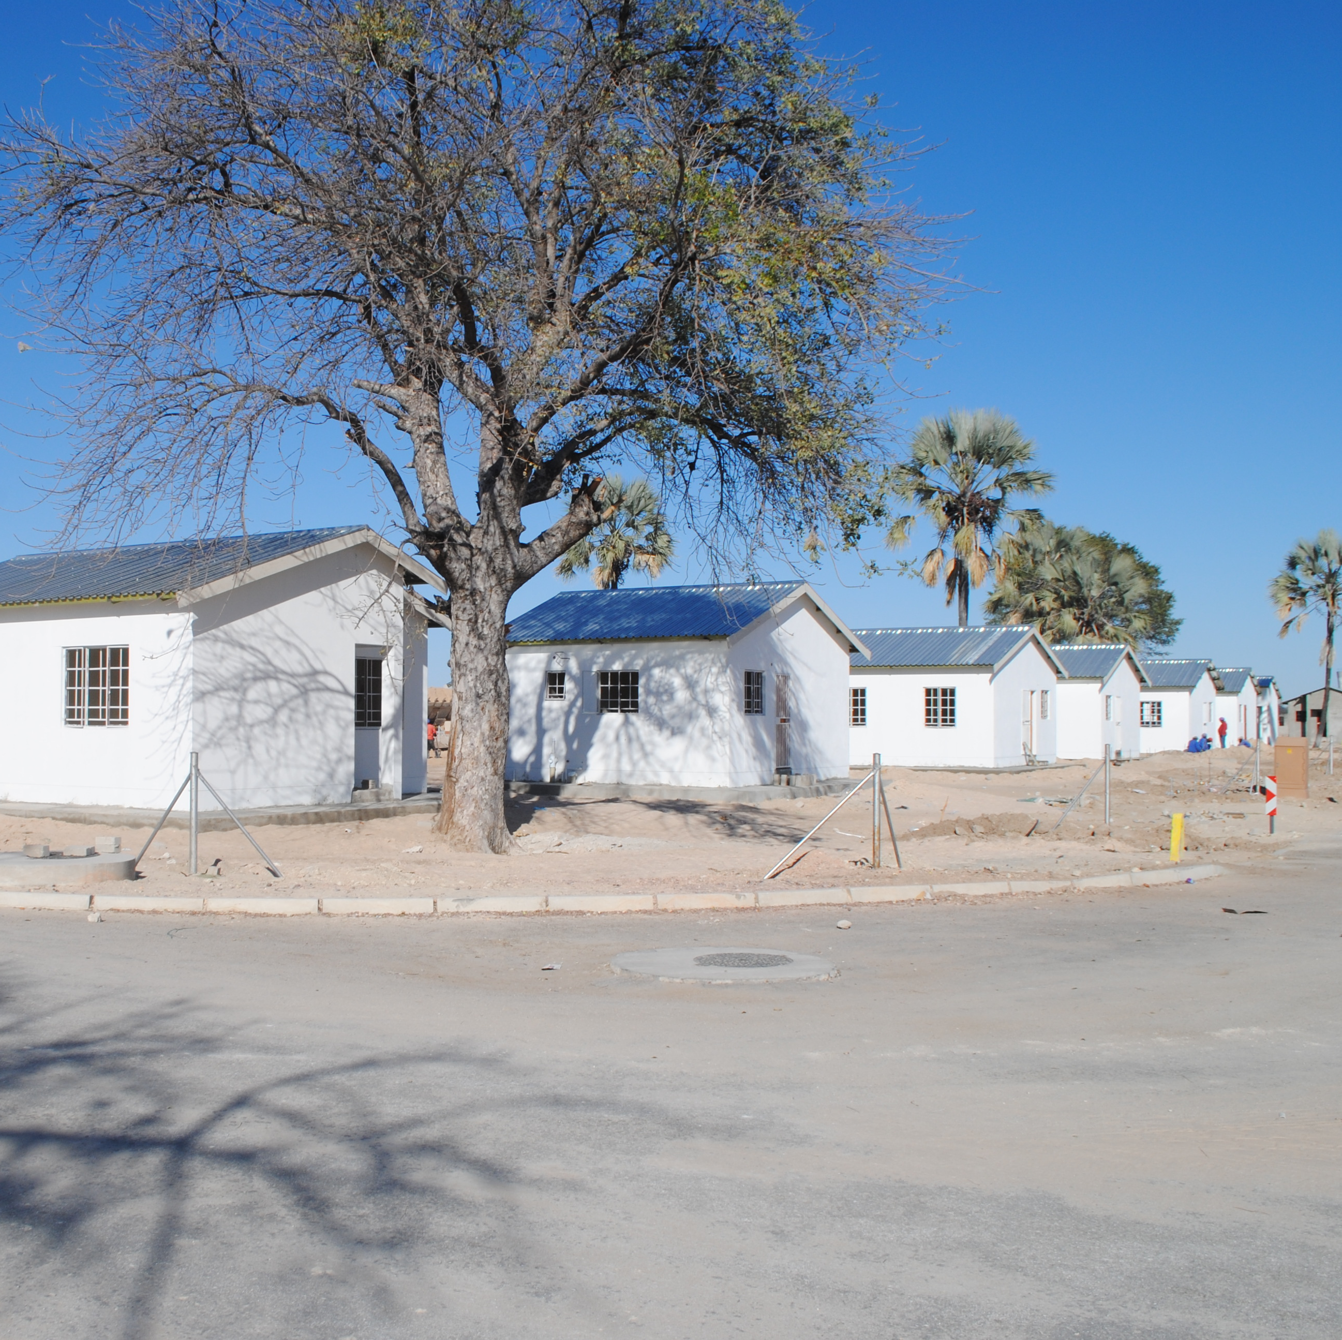
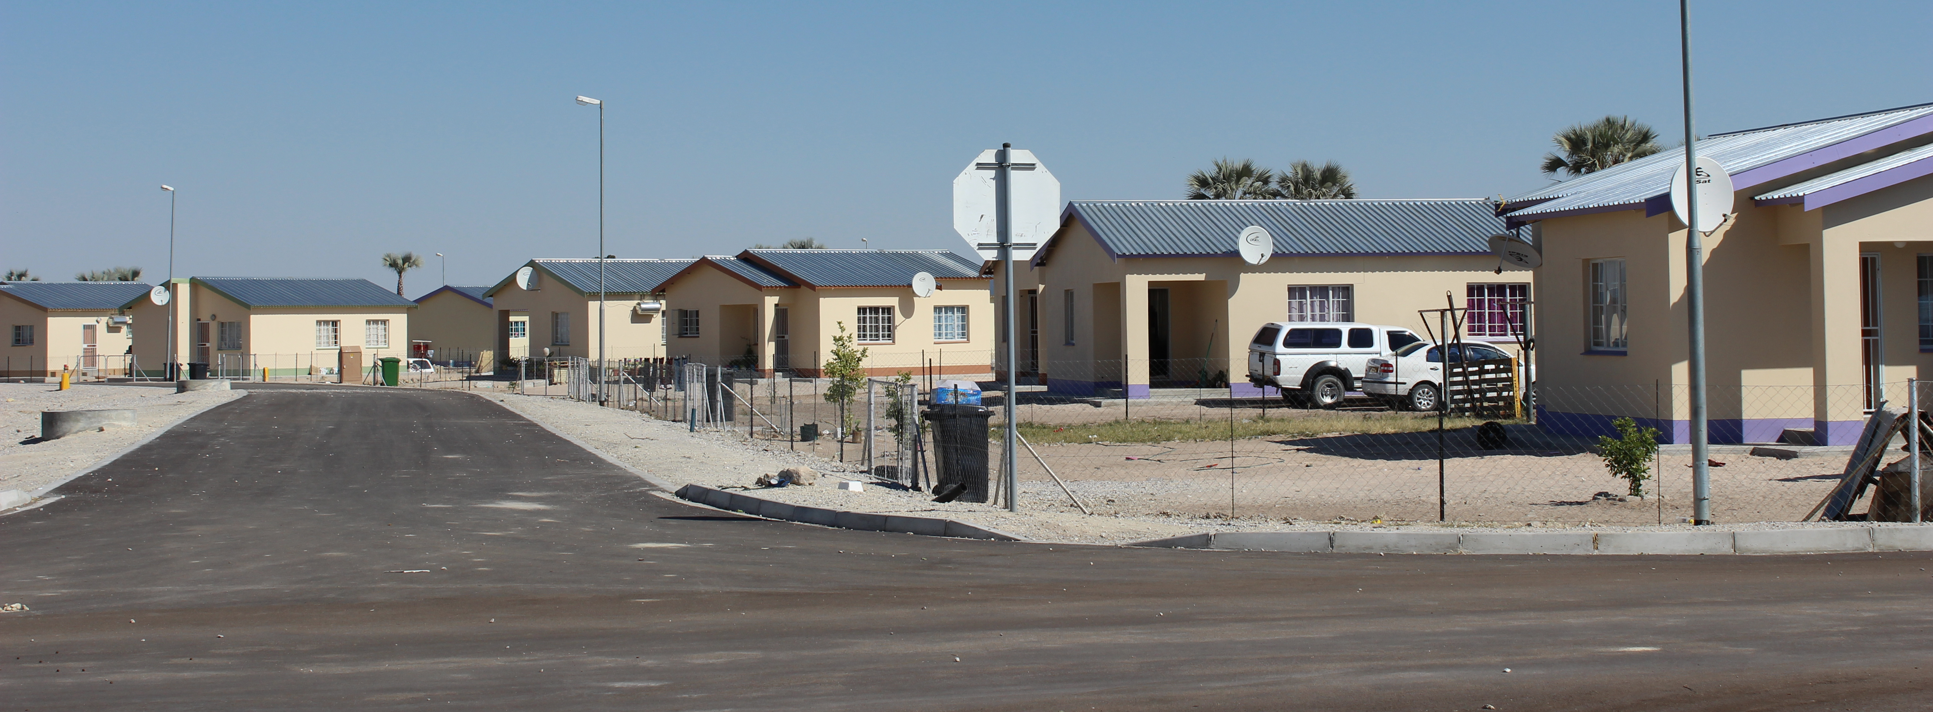

Slide 26

DEVELOPMENT WORKHOP NAMIBIA (DWN)
Partnership agreement, signed in May 2018
Affordable land delivery initiative for housing development by the Ultra low-income earners.
A total of 122 residential erven were serviced under phase 1.
Plots sold to low- income earners from the Council’s waiting at a cost of N$10,000, tittle deed issued to beneficiaries
Revolving fund approach
FNB Namibia provides loan financing for the construction of houses for qualifying beneficiaries at a maximum loan amount of N$50,000.00
Phase 2, in 2022 the Council allocated Onawa Ext. 9 comprising of about 320 erven.

Slide 27
Challenges
“Creating solutions for providing affordable and inclusive housing is a challenging enterprise where adequate planning policies and community participation play a fundamental role”
Rapid increase of urbanisation
Influx of people from rural to the town
Delays in obtaining Ministerial consent for the sale of land
Increasing in housing demands and cost of housing construction
Limited serviced land and increasing cost of servicing
Unavailability of developable land
Lack of employment opportunities compounded by economic downturn and Covid 19

Slide 28
Recommendations
Strengthen internal Council’s technical capacity to service land in-house (e.g., water reticulation)
Explore Public Private Partnerships and Joint Ventures for land servicing and housing development
Strengthen and resource Decentralized Build Together Program and other low- income earners housing scheme and land delivery initiatives (Shack dwellers federation, Development Workshop of Namibia)
Lobby for the amendment of the Local Authorities Act to enable all Local Authorities to sell land without Ministerial consents
Explore development financing for land servicing on a ring fencing approach

Slide 29

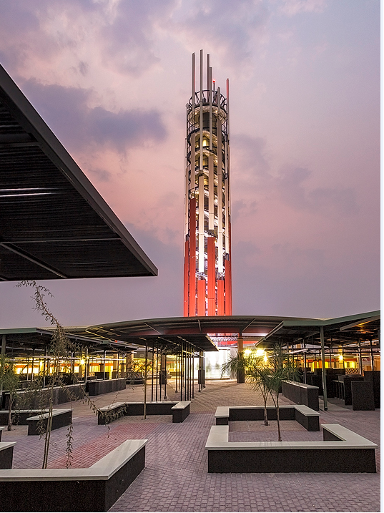
Thank You !
Contact Details
Tel: +264 65 229 500
Fax: +264 61 283 5067
906 Sam Nujoma Road
Civic Centre - Oshakati

