Slide 1

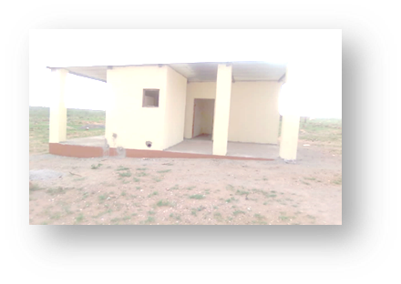
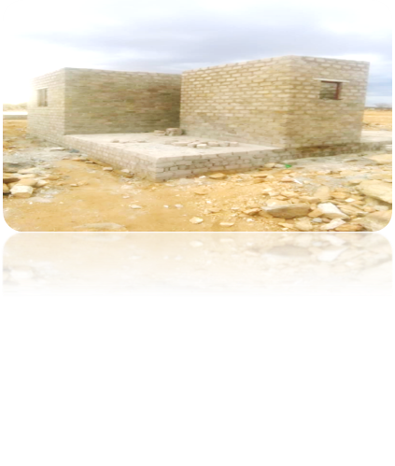

KAMANJAB VILLAGE COUNCIL
LAND AND HOUSING ALLOCATION STRATEGY AND INFORMAL SETTLEMENT FORMALIZATION, DECONGESTION AND ULTRA AND LOW COST HOUSING STRATEGY
2020-2030
Presented by
Bianca Miriam Nguaiko
Chief Executive Officer
Kamanjab Village Council

Slide 2
Definition : Kamanjab Village Council Land and Housing Waiting List Beneficiaries
As registered tenants with a lease agreement who resides in informal settlements , or a backyard squatter, or a resident in any rental flat or house , or a owner of a undeveloped or unimproved residential erf, above the age of 21 years , with a voters registration of Kamanjab Constituency , employed or self employ , or with proof of income of which the total household basic income be from N$1,000 – N$30,000 per months , and who do not have any title Deed else where, or who did not benefit from any subsidies housing scheme in Namibia .
Such beneficiary shall further meet the criteria's and requirement as per National Housing Development Act ,28 of 2000 and to or any directives and resolutions by Council .

Slide 3
KVC LAND AND HOUSING STRATETIC SEMINAR
section 57 (1) a,b,c,……
ALIGNED TO HHP2 ,SUSTAINABLE DEVELOPMENT GOALS ,NDP5 ,LA STRATEGIC PLANS LOCAL AUTHORITY ACT , REGIONAL COUNCIL ACT VISION 2023 – AND THE PROPOSAL IS TO ENHANCE FULL PARTICIPATION, IMPLEMENTATION , INVOLVEMENT TO ACHIEVE THE TARGETTED GOALS WITHIN 7 YEAR PLAN
HPP2
Pilla4 4
INFRASTRUCTURE DEVELOPMENT
Section 30(1) (f)Energy supply
Section 30(1) (a) Water supply
Section 30(1)(b) Sewerage and drainage
Section 30(1)( c) refuse removal…….
Section 30(1) (d) Maintain cemeteries
Section 30(1)(j) estabhip a housing scheme with prior approval of the Minister(Decentralization Act of 2000))
HPP2
PILLAR 3
SOCIAL PROGRESSION
Delivery of urban land,housing&sanitation
HPP2
ECONOMIC ADVANCEMENT
Enhance productivity of priority economic sectors
HPP2
PILLAR 1
IMPROVE PERFORMANCE REGIONALLY , LOCAL AM SERVICE DELIVERY
Enhanced regionally and locally participation and engagement

Slide 4

SUSTAINABLE DEVELOPMENT GOALS
Goal 6
Clean water and sanitation
Goal 3
Good health and wellbeing
Goal 13
Reduce inequality
Goal 12
Responsible consumption and production
Goal 9
Industry innovation and infrastructure
Goal 11
Sustainable cities and communities
Goal 7
Affordable and clean energy
Goal 13
Climate action
Goal 16, peace, justice and strong institutions
Goal 17
Partnership for the goals
HPP2
Economic advancement

Slide 5
COMMUNITY PARTICIPATION
Be the change if you want change
Community Meeting held to introduce the new strategy on how to submits application form and the deadline
Community Meeting held to decide on the monthly tariff and subsequently Council resolution taken
Included in the 2021/2021 Gazetted tariffs
Community meetings held in session on the sale of erven pre allocation and pre payment options prior actual construction
Brouchers design further and youth deploy to explain to members
Census and engage and dissemination information and objective and input from Community
Took stock of status of all occupied erven , improved, unimproved, bulk services , informal occupied area
Call for first self registration May 2020
Annually updating in April - May each financial year

Slide 6
PROCLAIMED PLOTS ALLOCATION STRATEGY TO PRE APPROVAL -FASTRACT APPROVAL
Advertise locally the available erven to waiting list residents regardless income
Reservation forms , one for each available plot is printed
Erf size
Erf zoning
Erf price per square meter
10% deposit require
Receipt Number
Method of payment
Provision made on the form to indicate application form number
3.Willing and ready landless complete reservation form with 10% deposit payment or in 4 instalment and if 10% deposit is redeem in full, administration submits to full Council for approval
4. After confirmation of minutes within 7 days advertisement is placed and ministerial approval is obtained within 21 days .

Slide 8
CAPITALISING ON EXISTING HUMAN SETTELEMENT AND RESOURCES
at each erf
Plan the area according to land use prior planning
Survey the areas to avoid encroachment (pegged)
Register each erf owner on finstel and open accounts for basic charges at N$59,00 per months
Due to available sizes , offer to sell erven at N$15m² which is a KLAF resolution adapted by all 4 Local Authorities in Kunene
Capitalize of CENORED social responsibility and all erven has electricity
Capitalize on NPC funding phase out standpipes and all erven has a conventional or pre paid meter

Slide 9
CAPITALISING ON EXISTING HUMAN SETTELEMENT AND RESOURCES
8.Capitalize on NPC funding phase out standpipes and all erven has a conventional or pre paid meter at each erf
9.Outstanding bulk services sewerage network about N$16mil needed and construct a septic tank for the beneficiaries to be able to use flushing toilet, which is pump once week.
10.Capitalize on RFA road Upgrading and monthly where possible is graded

Slide 10
CAPITALISING ON EXISTING HUMAN SETTELEMENT AND RESOURCES
11.Approval of permanent construction of houses by plot owners and with own funding with Council subsidy for reduce sand tariff, borehole water for construction to reduce high cost of consumption during construction
12.Refuse removal done once a week, Wednesday ( donation of 210 liters used empty drums needed to allocated to 1027 residential plots )
13. Reconstruct and legalise and approved illegal constructed dwelling before deciding demolishing and approval of boundary relaxation where possible due to previous poor town planning where houses has been constructed on roads and street.
Challenge illegal dumping site on the streets need continuously to use JCB and redundant fleet AND the hard rock.

Slide 11
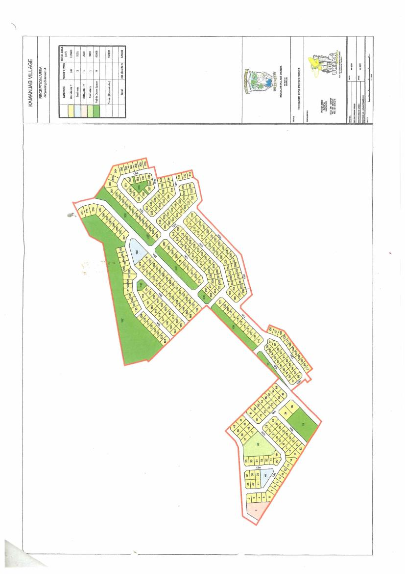
NEWLAND INFORMAL BLOCK

Slide 12
INFORMAL AREA | TOTAL ERVEN | ILLEGAL CONSTRUCTION | TOTAL PLOTS | POPULATION JUNE 2020
NUWELAND EXT 4 | 347 SURVEYED RESIDETIAL PLOTS | 68 UNITS COSTRUCTED AT OPEN SPACES resettled to OURAB informal Settlement Reception area 1 INSTITUTIONAL PLOT 2 BUSINESS PLOTS | 415 including 68 other land use plots | As per data as member of household was captured 2490
BULK INFRSTRUCTURE : AVAILABILITY AND OR EXCESS TO ESSENTIAL SERVICES
WATER | ELECTRICITY | SEWARAGE | FLUSHING TOILETS | BRICK HOUSES
347 CONNECTED GRN FUNDING 2018/2019 N$8 MILLION | 347 BY CENORED PRE PAID METERS IN SHACK | NONE Built built drain in the meantime until funding is solicited VIP TOILET DONATED BY RC AS SAANITAION | 14 with drains 8 connected to sewer opposite street EXT 1 | O6 SELF CONSTRUCTION

Slide 13
Planed and not yet proclaimed Informal area | Total ERVEN | Total PLOTS | population June 2020
414 OURAB INFORMAL SETTLEMENT | 414 (in-house) ON DEMARCATED RESIDETIAL PLOTS size 300m² each | 414 Only residential | As per data as member of household was captured 2070
AVAILABILITY AND OR EXCESS TO ESSENTIAL SERVICES
WATER | ELECTRICITY | SEWARAGE | FLUSHING TOILETS | DRY TOILETS | BRICKS HOUSES or buildings
414 CONNECTED | none | 1 drain connected to 4 pilot houses | 005 | 25 | 05 Includes 4 pilot houses constructed by Council

Slide 14
OUR STRATEGY FOR HOUSING CONSTRUCTION STRATEGY
Once 50% of the erf price is deemed and or fully paid, the accountant give information to property clerk
If the targeted beneficiary is willing to participate based on income the debtors loan agreement is completed
The beneficiary is requested to solicit a builder and the agreement between the builder and beneficiary is signed
Funding from the sale of erven deposited in a special account is used to buy building material , bulk cement and pay the builders

Slide 15
OUR STRATEGY FOR HOUSING CONSTRUCTION STRATEGY
5. To minimise import of bricks , Council initiated 2 youth brick making project from whom we are buying the bricks
6. Council provide borehole water and sand to the youth project at N$500 per month . Sand is delivered once a week and water pump when tanks are empty.
7. The initiative create employment to 12 youth
Challenge : Rocky terrain, slow builder, limited builders

Slide 16


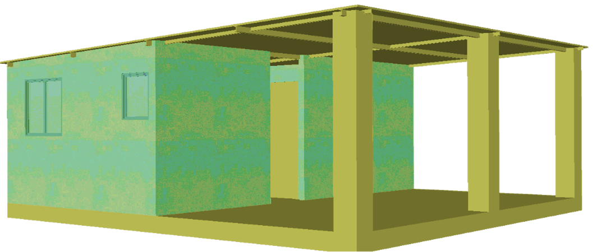
Kamanjab Village Council
option 2
1 bedroom
Kitchen
Toilet/ shower
Roof structure and floor for additional bedroom, living room already completed
N$35,000.00

Slide 17

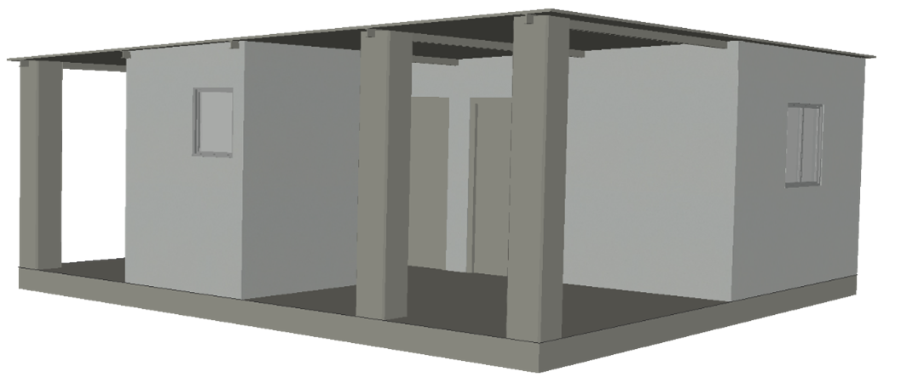

Kamanjab Village Council
option 3
2 bedrooms
Toilet/ shower
Roof structure and floors for the living room and kitchen completed
DIY (beneficiaries to reduced loan by completing the external walls as household initiative gradually
N$40,000.00

Slide 18

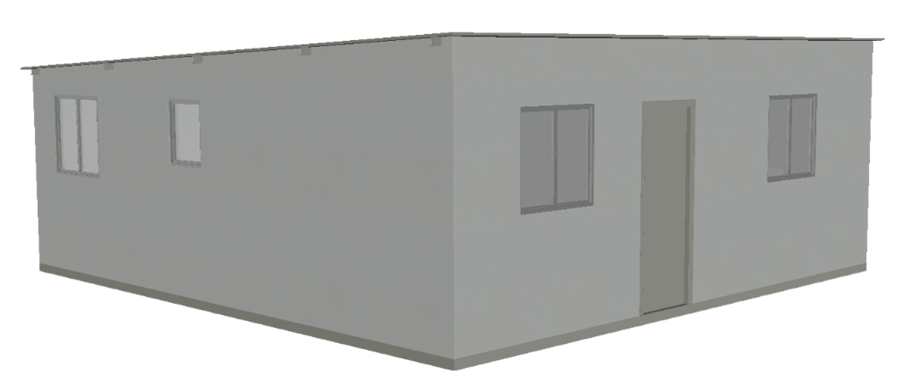
Kamanjab Village Council
option 4
2 bedrooms
Living room
Kitchen
Toilet/ shower
No floor tiles and n0 ceiling
N$80,000.00

Slide 19

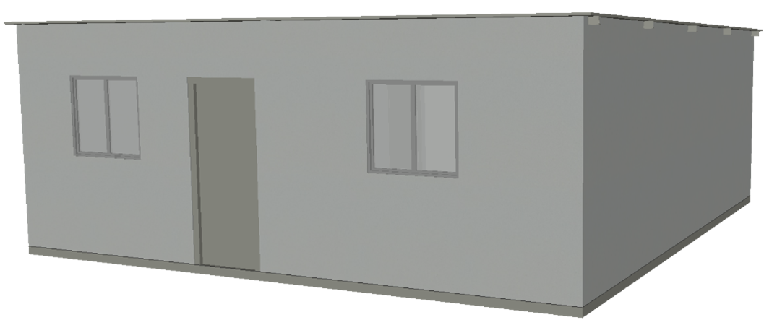
Kamanjab Village Council
option 5
2 bedrooms
Living room
Kitchen
Toilet/ shower
Ceramic floor tiles
Ceiling
Piloting
(
N$125, 000.00

Slide 20
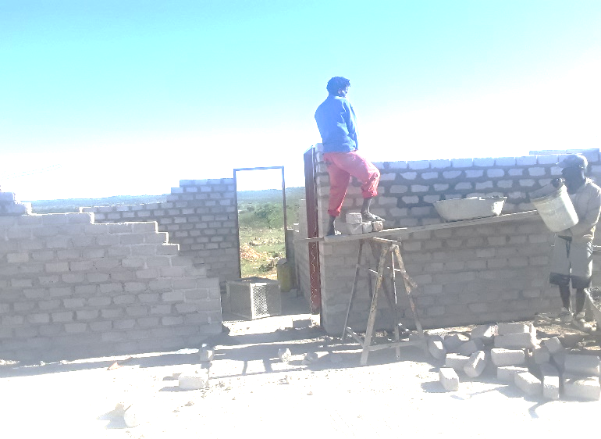
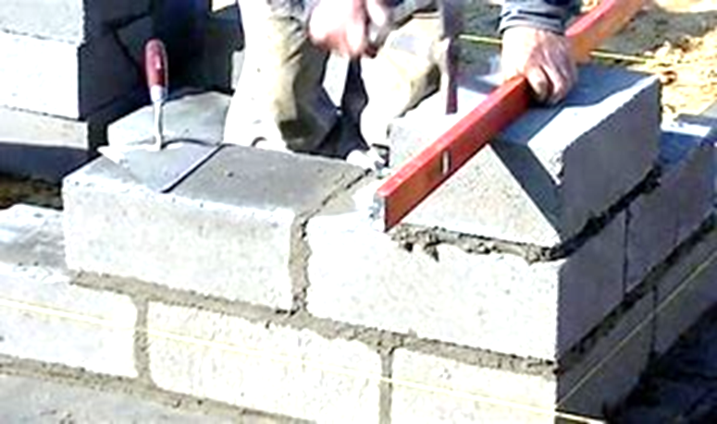
Construction Project Team
Artisan Supervisor/Building Artisan
Material procurement
Plans approval per plot and income
1
KVC Youth Bricklayers
12
2 per group) bricks to be tested
Water to be provided from KVC boreholes
VTC Carpenters / Joiners
3
VTC Tile, Plumbers
2
VTC Bricklayers
4
Tranches
Foundation casting
Flooring
Brickworks
Plastering

Slide 21
Construction Project Team
27 houses project to be completed in April 2023

Slide 22
Certificate awarded for allocation of residential plot
in new land informal settlement
erf no 250 (temporary erf NR)
prior proclamation to be new extension 4, Rotsvesting –Kamanjab
To
Ms Isabella doeses
CHIEF EXECUTIVE OFFICER
MRS BIANCA MIRIAM NGUAIKO
20 NOVEMBER 2020
20 NOV 2020
CHAIRPERSON OF KAMANJAB VILLAGE COUNCIL
CLLR JOKKIE RICARTUS MBAHEE
20 NOVEMBER 2020

