Slide 1
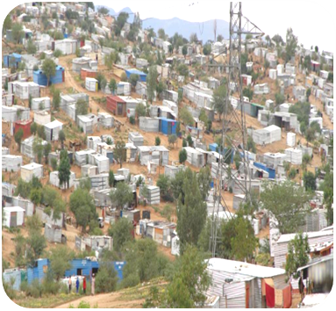

ALAN LAND AND HOUSING STRATEGIC SEMINAR
THE NEED FOR A
ALAN NATIONAL HOUSING DEVELOPMENT FUND

Slide 2

The need to establish, fund and support national Housing and Residential Development Fund
In terms of the National Housing development act , act 28 of 2000,
Section 2 , stipulates that the is established an Advisory Committee to be known as the National Housing Advisory Committee NLHDF INTERIM BOARD AND OR INITERIM TASKFORCE COMMITTEE
SUBCOMMITTE
SUB COMMITTEE
SUBCOMMITTEE
SUB COMMIITTE
SUB COMMITTEE
Chairperson
3
5
Vice
Member
Not less than 3
Section 3(1) of the national Housing development Act , 28 of 2000
Secretary designated by the Minister to as secretary
Not more than 5
Section 3(1) of the national Housing development Act , 28 of 2000

Slide 3
Functions of the National Housing Development Housing Advisory Committee AND SUB COMMITTEES(IF ANY) AS APPOINTED (section 5(1)MAY
Advice the Minister on any of the national housing including the formulation and implementation of specific policies and programmes relating to low cost residential accommodation
Monitor and evaluate and make reports to the Ministry on, housing programmes in Namibia
Consider and determine an appeal under section 31 (1)(b)
Review , in the prescribed manner and subject to subsection (20 .any decision of a regional council or local authority on any matter relating to housing

Slide 4
e)Make recommendation to the Minister on regulations or to be made under this Act,
f) Co-opt ,subject to subsection (6) not more than five additional members to assist the Advisory Committee in the performance of the functions and
h) Perform such other function as the Minister may designate to it in writing
I)Further the advisory committee when reviewing any decision of the Decentralized Build Together Committee under subsection (1) (b) , MAY confirm set aside, amend or substitute such decision , or in writing refer such decision back to such regional or local authority concern , as the case may be , for further investigation or consideration. Subject to such condition as the Advisory Committee may determined

Slide 5
Most relevant to Local Authorities and Regional Council is that
The Advisory Committee shall review recommendation furnish to it by regional Council or local authority as the case may be in terms of subsection
Further the act make provision for the AD to promote and encourage . When performing its function in terms of the act the use of materials manufactured and the labour available , in ots region concerned.

Slide 6
NATIONAL HOUSING DEVELOPMENT FUND
A REINENTING & REVIVAL SOCIAL PROGRESSION
ENGINE
TO FINANCE OR MORTGAGE HOME OR HOME AND ERF LOANS FOR TARGETTED BENEFICIARIES
For purposes of procuring residential erven proclaimed , to service and if fully service with government NPC funding
AS PER GAZETTED WAITING LIST BENEFICIARIES ON THE NATIONAL HOUSING AND LAND WAITING ROLL
for the purpose of constructing or acquiring low cost (Ultra Low ,Middle High and Higher residential accommodation

Slide 7
REVENUE SOURCE | 2023/2024 | 2024/2025 | 2025/2030
REGISTRATION | 500,000.00 | - | -
NLHDF CONTRIBUTION | 220,222,800.00 | 220,222,800.00 | 220,222,800.00
GOVERNMENT FUNDING | 660,668,400.00 | 660,668,400.00 | 660,668,400.00
LOAN REAPYMENT | 359,645,156.52 | 359,645,156.52 | 359,645,156.52
 | 1,241,036,356.52 | 1,240,536,356.52 | 1,240,536,356.52

Slide 8
MURD
FUNDING, ALIENATION, PROCLAMATION
ALAN +NALAO
57 LOCAL AUTHORITIES +2
WAITING LIST STRATEGY
STEP 1
GAZETTED 7 YEARS WAITING LIST
RESIDENTIAL ERVEN STOCK LIST
STEP 2
HOUSING OPTIONS
STEP 3
ARC
14 REGIONAL COUNCIL
SETTLEMENTS ?
NAMINBIA(ALAN) HOUSING DEVELOPMENT FUND

Slide 9

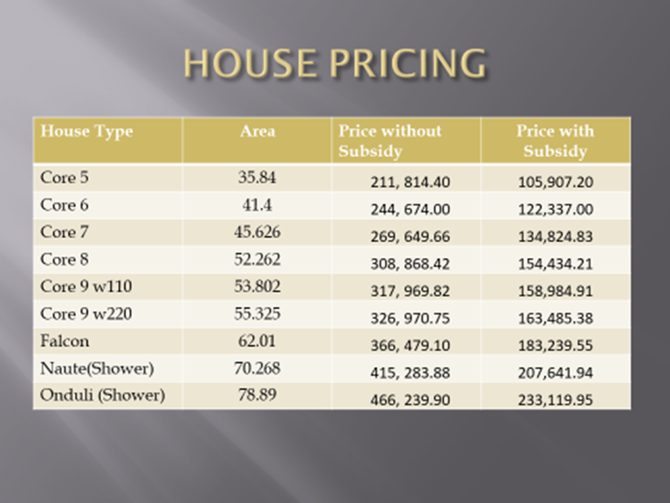
NHE 2015 MASS HOUSING BEFORE AND AFTER SUBSIDIES PRICES

Slide 10
TOTAL HOUSEHOLD INCOME // HOUSING AND RESIDENTIAL ERVEN NEED
(500 000 ESTIMATED UNCONFIRMED BACKLOG ):
CATEGORY | TOTAL HOUSEHOLD INCOME | BASED ON THE ESTIMATE OF 500 000 HOUSING BACKLOG
 |  | % | LOAN AMOUNT
Ultra-low Income earners | N$1,000.00-N$5,000.00 GROUP A | 62% 310 OOO HOUSING UNITS | N$40,000
Low income earners | N$5001-N$10,000.00 GROUP B | 25% 125 OOO HOUSING UNITS | N$60,000- N$80 ,000
Middle Income earners | N$10,001.00 – N$20 000.00 GROUP C | 10% 50,000 HOUSING UNITS | N$125,000- 200 000.00
High Income earners | N$20,001.00 –N$40,0001.00 GROUP D | 2% 10,000 HOUSING UNITS | N$250,0000-300 000
Super-Higher Income Earners | N$40,001.00-N$ 60,000.00 GROUP E | 1% 5000 HOUSING UNITS | N$350 0000- 600 000

Slide 11
REVOLVING FUNDS SOURCE
1. ESTABLSIHMENT OF A APPLICATION FORM ELECTRONIC HANDLING FEE AFTER REGISTRATION AND WITH VERIFICATION OF NAME
Beneficiaries | Once off Fee | Projected Revenue
500 000 | N$100 00 | N$50 000 ,000 BY 30 JUNE 2023- June 2024
THE PROPOSED N$ 100 IS ONLY PAYABLE ONCE THE BENEFICIARY NAME IS ON THE MASS LAND AND HOUSING WAITING LIST IS RELEASED, AS WITH PAYMENT BENEFICIARY NEEDS TO INDICATE WAITING LIST REFERENCE NUMBER CARD TO BE ISSUED AFTER PAYMENT WITHIN 14 DAYS

Slide 12
SPOURCE 02: OTHER REVENUE SOURCE
MONTHLY SECURITY FEE (1%) OF BASIC SALARIES AND MINIMUM BASIC INCOME ESTIMATES
Min Income | Beneficiaries per Group | Basic % from min basic salary | NLHDF Employee | Employer or if self employed excepted | Total employer/Employee | Total monthly per month
1,000.00 | 310,000.00 | 0.50% | 5.00 | 5.00 | 10.00 | 3,100,000.00
5,001.00 | 125,000.00 | 0.50% | 25.01 | 25.01 | 50.01 | 6,251,250.00
10,001.00 | 50,000.00 | 0.50% | 50.01 | 50.01 | 100.01 | 5,000,500.00
20,001.00 | 10,000.00 | 0.50% | 100.01 | 100.01 | 200.01 | 2,000,100.00
40,001.00 | 5,000.00 | 0.50% | 200.01 | 200.01 | 400.01 | 2,000,050.00
 |  |  |  |  |  | 18,351,900.00
REVENUE STREAM 3
Annual revenue 220,222,800.00 X 3
N$ 660 668,400.00
WHAT EVER COLLECTION PER ANNUM CENTRAL GOVERNEMENT TO FUND 3 TIMES MORE ANNUALLY(NLHDF DEDUCTION ONLY)
Annual revenue 220,222,800.00

Slide 13
PROJETED DEVELOPMENT FUND REVOLVING FUND(/REVENUE PER ANNUM
TOTAL UNITS PER INCOME GROUP | TOTAL UNITS & ERVEN PER ANNUM | LOAN AMOUNT Erf plus dwelling | 23/24-29/30 PER ANNUM FOR 7 YEARS | ERF AND DWELLING Loan without admin cost and transfer COST | Proposed interest rate | Loan repayment period | MONTHLY INSTALLMENT PER LOAN | MONTHLY Revenue from Instalment per category group
62% (310 OOO) | 44,286 | 4,500 | 40,000 | 45,500.00 | 7% | 30 years | 302.71 | 13,405,815.06
25% 125 OOO | 17,857 | 7,500 | 60,000. | 67,500.00 | 7,5% | 25 years | 478.82 | 8,550,288.74
10% 50,000 | 7,143 | 30,000 | 80,000 | 90,000.00 | 8% | 20 years | 452.80 | 3,234,350.40
2% 10,000 | 1,429 | 50,000. | 125,000 | 175,000.00 | 8,5% | 15 years | 1,723.29 | 2,462,581.41
1% 5,000 | 714 | 70,000. | 250,000. | 320,000.00 | 9% | 15 years | 3,245.65 | 2,317,394.10
 | 71,429 |  |  |  |  |  |  | 29,970,429.71
Projected annual income excluding interest revenue N$ 359,645,156.52

Slide 14
PROJECTED EXPENDITURE FOR RESIDENTIAL LAND AND HOUSING
DWELLING | RESIDENTIAL ERVEN | Total
3,735,714,285.71 | 95,562,071 | 3,831,276,356.71
 | Projected annual income | 1,240,536,356.52
 |  | -2,590,740,000.19
GROUP | TOTAL HOUSEHOLD INCOME | % | Beneficiary per group | proposed loan amount | total per group | Funding per year
GROUP A | N$1,000.00-N$5,000.00 | 62% | 310,000.00 | 40,000.00 | 12,400,000,000.00 | 1,771,428,571.43
GROUP B | N$5001-N$10,000.00 | 25% | 125,000.00 | 60,000.00 | 7,500,000,000.00 | 1,071,428,571.43
GROUP C | N$10,001.00 – N$20 000.00 | 10% | 50,000.00 | 80,000.00 | 4,000,000,000.00 | 571,428,571.43
GROUP D | N$20,001.00 –N$40,0001.00 | 2% | 10,000.00 | 125,000.00 | 1,250,000,000.00 | 178,571,428.57
GROUP E | N$40,001.00-N$ 60,000.00 | 1% | 5,000.00 | 200,000.00 | 1,000,000,000.00 | 142,857,142.86
 |  |  |  |  | 26,150,000,000.00 | 3,735,714,285.71

Slide 15
TOTAL HOUSEHOLD INCOME | BASED ON THE 500 000 RESIDENTIAL ERF BACKLOG |  | subsidized ERF COST | total annual erven per group | IF SERVICED BY CENTRAL GOVERNMENT | annual compensation for erven
 | % | ERF SIZE |  |  | TOTAL
 |  | M²
A | B | C | D | E | F
 |  |  | Erf six x unit per m/2 | B DIVIDED BY 7 YEARS | column E X D | F DIVIDED BY 7 YEARS
N$1,000.00-N$5,000.00 | 62% (310 OOO) | 300m² X N$15m² | 4,500.00 |  | 199,287,000.00
GROUP A |  |  |  | 44,286.00 |  | 28,469,571
N$5001-N$10,000.00 | 25%(125 OOO) | 300m² X N$25m² | 7,500.00 |  | 133,927,500.00
GROUP B |  |  |  | 17,857.00 |  | 19,132,500
N$10,001.00 – N$20 000.00 | 10%(50,000) | 400m² X N$75m² | 30,000.00 | 7,143.00 | 214,290,000.00
GROUP C |  |  |  |  |  | 30,612,857
N$20,001.00 –N$40,0001.00 | 2% (10,000) | 400m² X N$125m² | 50,000.00 |  | 71,450,000.00
GROUP D |  |  |  | 1,429.00 |  | 10,207,143
N$40,001.00-N$ 60,000.00 | 1% (5,000) | 400m² X N$175m² | 70,000.00 |  | 49,980,000.00
GROUP E |  |  |  | 714.00 |  | 7,140,000
FUND /COMPENSATION TO BE PAID TO LOCAL AUTHORITIES FROM THE NLHDF FOR ERVEN SOLD (PROVIDED THAT FULLY DEVELOPED WITH FUNDING FROM CENTRAL GOVERNMENT .) |  |  |  |  | 668,934,500.00 | 95,562,071

Slide 16
DWELLING UNIT LOAN BREAKDOWN PER INCOME GROUP
GROUP | TOTAL HOUSEHOLD INCOME | % | Beneficairy per group | proposed loan amount | total per group | Funding per year
GROUP A | N$1,000.00-N$5,000.00 | 62% | 310,000.00 | 40,000.00 | 12,400,000,000.00 | 1,771,428,571.43
GROUP B | N$5001-N$10,000.00 | 25% | 125,000.00 | 60,000.00 | 7,500,000,000.00 | 1,071,428,571.43
GROUP C | N$10,001.00 – N$20 000.00 | 10% | 50,000.00 | 80,000.00 | 4,000,000,000.00 | 571,428,571.43
GROUP D | N$20,001.00 –N$40,0001.00 | 2% | 10,000.00 | 125,000.00 | 1,250,000,000.00 | 178,571,428.57
GROUP E | N$40,001.00-N$ 60,000.00 | 1% | 5,000.00 | 200,000.00 | 1,000,000,000.00 | 142,857,142.86
 |  |  |  |  | 26,150,000,000.00 | 3,735,714,285.71

Slide 17
SERVICED ERF (FULL GRANT ) FOR 71,429
LOAN BREAKDOWN PER INCOME CATEGORIES
TOTAL HOUSEHOLD INCOME | BASED ON THE 500 000 RESIDENTIAL ERF BACKLOG |  |  | IF SERVICED BY CENTRAL GOVERNMENT
 | % | ERF SIZE M² | ERF COST N$ | TOTAL
N$1,000.00-N$5,000.00 GROUP A | 62% (310 OOO) RESIDENTIAL ERVEN | 300m² X N$15m² | 4,500.00 | 1,395,000,000.00
N$5001-N$10,000.00 GROUP B | 25%(125 OOO) RESIDENTIAL ERVEN | 300m² X N$25m² | 7,500.00 | 937,500,000.00
N$10,001.00 – N$20 000.00 GROUP C | 10%(50,000) RESIDNETIAL ERVEN | 400m² X N$75m² | 30,000.00 | 1,500,000,000.00
N$20,001.00 –N$40,0001.00 GROUP D | 2%(10,000) RESIDENTIAL ERVEN | 400m² X N$125m² | 50,000.00 | 500,000,000.00
N$40,001.00-N$ 60,000.00 GROUP E | 1%(5,000) ERVEN | 400m² X N$175m² | 70,000.00 | 350,000,000.00
FUND TO BE PAID TO LOCAL AUTHORITIES FROM THE NLHDF FOR ERVEN SOLD (PROVIDED THAT FULLY DEVELOPED WITH FUNDING FROM CENTRAL GOVERNMENT .) |  |  |  | 4,682,500,000.00

Slide 18
TOTAL COST OF LAND AND HOUSING FUNDNG NEEDED PROJECTED THAT ERVEN IS SERVICED WITH FUNDING BY CENTRAL GOVERNEMNT , GRANTS DONATION
2023-2030
TOTAL UNITS PER INCOME GROUP | DWELLING | ERF COST | TOTAL | Annual development cost
62% 310 OOO | 12,400,000,000.00 | 1,395,000,000.00 | 13,795,000,000.00 | 1,970,714,285.71 44 286
25% 125 OOO | 7,500,000,000.00 | 937,500,000.00 | 8,437,500,000.00 | 1,205,357,142.86 17852
10% 50,000 | 4,000,000,000.00 | 1,500,000,000.00 | 5,500,000,000.00 | 785,714,285.71 7143
2% 10,000 | 1,250,000,000.00 | 500,000,000.00 | 1,750,000,000.00 | 250,000,000.00 1429
1% 5,000 | 1,250,000,000.00 | 350,000,000.00 | 1,600,000,000.00 | 228,571,428.57 714
 | 26,400,000,000.00 | 4,682,500,000.00 | 31,082,500,000.00 | 4,440,357,142.86

