Slide 1
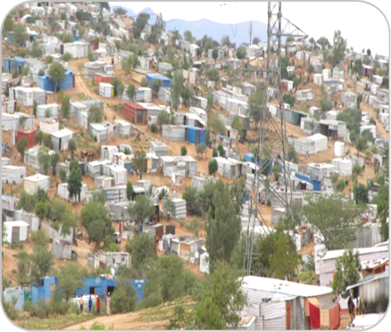


ALAN LAND AND HOUSING STRATEGIC SEMINAR
20-23 FEBRUARY 2023
NARRAVILLE COMMUNITY HALL
MRS BIANCA MIRIAM NGUAIKO
CEO
KAMANJAB VILLAGE COUNCIL

Slide 2
NAMIBIA RESIDENTIAL LAND AND HOUSING BACKLOG WAITING ROLL
ALAN /NAMIBIA RESIDENTIAL LAND AND HOUSING DEVELOPMENT FUND
COMMUNITY DRIVING STANDARD AND ACCEPTABLE HOUSING DEVELOPMENT
KAMANJAB SUSTAINABLE HOUSING AND RESIDENTIAL LAND APPROACH

Slide 3


EVERY CITIZEN WISH TO HAVE A PLACE CALL HOME
(Article 16 of the Namibian Constitution)
WHAT IS THE URBAN ( 57 LOCAL AUTHORITIES) BACKLOG OF RESIDENTIAL LAND AND HOUSING.
All income categories
All Ages from 21 Years to 54
All residential land owners but with no means to construct a dwelling
Or simple a citizen who resides in any
informal settlement,
backyard squatters,
reception area,
living with employer,
Employers staff accommodation
Living with parents
Rental accommodation

Slide 4

NATIONAL RESIDENTIAL LAND AND HOUSING BACKLOG (10 MINUTES)
176,365.00
LA SUBMITTED
31
LA THAT DIDN’T SUBMIT
26+2
DID NOT RESPOND ON CEO FORUM
REGIONAL COUNCIL PROCLAIMED SETTLEMENTS
14 REGIONAL COUNCILS
DID NOT REQUEST
MURD AND ALAN
OUTDATED WAITING LIST SOME SINCE 2015
MASS HOUSING LIST
IS NOT ON THE CEO FORUM
DIID NOT HAVE THE AUTHORITY TO REQUEST INFORMATION IN TERMS OF THE STATESTICS ACT
WAS NOT THE RIGHT TIME
DUE TO LACK OF RESOURCES AND CURRENT WAITING LISTT WHICH IS LONG

Slide 5

NATIONAL RESIDENTIAL LAND AND HOUSING BACKLOG (10 MINUTES)
176,365.00
50 000.00 CITY?
50 000 WB
59 644 LA AND RC SETTLMENTS
NATIONAL RESIDENTIAL LAND AND HOUSING BACKLOG
500 000 (2023-2030)

Slide 6

BACKLOG
500 000 (2023-2030)
MURD
FUNDING, ALIENATION, PROCLAMATION
ALAN
57 LOCAL AUTHORITIES +2
WAITING LIST STRATEGY
STEP 1
RESIDENTIAL ERVEN STOCK LIST
STEP 2
HOUSING OPTIONS
STEP 3
ARC
14 REGIONAL COUNCIL
SETTLEMENTS ?
HOUSING DEVELOPMENT FUND

Slide 7
Based on the preliminary waiting list information of which some is not updated since 2014 when all low Cost Houses Programme was suspended due to the new mass housing programme , the housing backlog increase and the primary is not less than 500 000. Local housing registers (otherwise known as ‘waiting lists’) serve an important administrative function, but they do not give us the full picture of how many people are in need of a home as we have been concentrating more on ultra low and low income bracket only while with middle and high income earners being served through private developer schemes and NHE . SDF is instrumental in ultra ultra low housing saving schemes Strategy.
The proposed objective is to have a national registration period across the country with the same starting date and same closing date to have a seven year master list.

Slide 8
Local Authorities | Residential Erven and or Housing Demand | Avalable unserviced erven | Available Partly Service with Water | Available Partly Service with water and Electricty | Available Partly Service with Water and Sewer | Available fully Service | Total available residential erven | actual backlog on redisential erven
Arandis Tiwn Council |  |  |  |  |  |  | 0 | 0
Aranos Town Council |  |  |  |  |  |  | 0 | 0
Aroeb Village Council | 17 |  |  |  |  |  | 0 | -17
Berseba Village Council |  |  |  |  |  |  | 0 | 0
Bethanie Village Council |  |  |  |  |  |  | 0 | 0
Bukkalo Vllage Council |  |  |  |  |  |  | 0 | 0
City of Windhoek |  |  |  |  |  |  | 0 | 0
Divundu Village Council | 2,500 |  |  |  |  |  | 0 | -2,500
Eenana Town Council |  |  |  |  |  |  | 0 | 0
Gibeon Village Council |  |  |  |  |  |  | 0 | 0
Gobabis Town Council | 7,000 |  |  |  |  |  | 0 | -7,000
Gochas Village Council |  |  |  |  |  |  | 0 | 0
Grootfontein Municipality |  |  |  |  |  |  | 0 | 0
Helao Nafindi Town Council |  |  |  |  |  |  | 0 | 0
Hentiesbaai Municipality | 3,500 |  |  |  |  |  | 0 | -3,500
Kalkrand Village Council |  |  |  |  |  |  | 0 | 0
Kamanjab Village Council | 1,029 | 71 | 414 | 327 |  | 217 | 1029 | 0
Kararasburg Town Council | 841 |  |  |  |  |  | 0 | -841
Karibib Town Council | 1,500 |  |  |  |  |  | 0 | -1,500
Katima Mulilo Town Council |  |  |  |  |  |  | 0 | 0
Keetmanshoop Municipality |  |  |  |  |  |  | 0 | 0
Khorixas Town Council | 2,150 |  |  |  |  |  | 0 | -2,150
Khurenkuru Village Council | 3,999 |  |  |  |  |  | 0 | -3,999
Koes Vilage Council |  |  |  |  |  |  | 0 | 0
Leonardville Village Council | 1,300 |  |  |  |  |  | 0 | -1,300
Luderitz Town Council |  |  |  |  |  |  | 0 | 0

Slide 9
Local Authorities | Residential Erven and or Housing Demand |  | Avalable unserviced erven | Available Partly Service with Water | Available Partly Service with water and Electricty | Available Partly Service with Water and Sewer | Available fully Service | Total available residential erven | actual backlog on redisential erven
Maltahöhe Village Council |  |  |  |  |  |  |  | 0 | 0
Mariental Municipality | 8,000 |  |  |  |  |  |  | 0 | -8,000
Okahandja |  |  |  |  |  |  |  | 0 | 0
Okahao Town Council | 1,664 |  |  |  |  |  |  | 0 | -1,664
Okakarara Town Council | 1,550 |  |  |  |  |  |  | 0 | -1,550
Okongo Village Council |  |  |  |  |  |  |  | 0 | 0
Omaruru Municipality |  |  |  |  |  |  |  | 0 | 0
Omuthiya Town Council | 3,794 |  |  |  |  |  |  | 0 | -3,794
Ondangwa Town Council | 7200 |  |  |  |  |  |  | 0 | -7,200
Ongwediva Town Council | 4,855 |  |  |  |  |  |  | 0 | -4,855
Opuwo Town Council | 4,000 |  |  |  |  |  |  | 0 | -4,000
Oranjemund Town Council |  |  |  |  |  |  |  | 0 | 0
Oshakati Town Council | 12,771 |  | 5260 |  |  |  |  | 5260 | -7,511
Oshikuku Town Council |  |  |  |  |  |  |  | 0 | 0
Otavi Town Council | 4,500 |  |  |  |  |  |  | 0 | -4,500
Otjinene Village Council | 1,214 |  |  |  |  |  |  | 0 | -1,214
Otjiwarongo Muncipality | 4,702 |  |  |  |  |  |  | 0 | -4,702
Outapi Town Council | 3,511 |  |  |  |  |  |  | 0 | -3,511
Outjo Municipality | 5,470 |  |  |  |  |  |  | 0 | -5,470
Rehoboth Town Council | 8,500 |  |  |  |  |  |  | 0 | -8,500
Ruacana Town Council | 204 |  |  |  |  |  |  | 0 | -204
Rundu Town Council | 17,000 |  |  |  |  |  |  | 0 | -17,000
Stampriet Village Council |  |  |  |  |  |  |  | 0 | 0
Swakopmund Municipality | 22,000 |  |  |  |  |  |  | 0 | -22,000
Tsandi Village Counicil | 2,000 |  |  |  |  |  |  | 0 | -2,000
Tses Village Council | 100 |  |  |  |  |  |  | 0 | -100
Tsumeb Municipality | 3,485 |  |  |  |  |  |  | 0 | -3,485
Usakos Town Council |  |  |  |  |  |  |  | 0 | 0
Walvisbay Municipality | 36 000 |  |  |  |  |  |  | 0 | 0
Witvlei Village Council |  |  |  |  |  |  |  | 0 | 0
 |  |  |  |  |  |  |  | 0 | 0
 |  |  |  |  |  |  |  | 0 | 0
 | Khorixas Town Council | 2,150 |  |  |  |  |  | 0 | -2,150
 | Khurenkuru Village Council | 3,999 |  |  |  |  |  | 0 | -3,999
 | Koes Vilage Council |  |  |  |  |  |  | 0 | 0
 | Leonardville Village Council | 1,300 |  |  |  |  |  | 0 | -1,300
 | Luderitz Town Council |  |  |  |  |  |  | 0 | 0

Slide 10
OBJECTIVE
Transparency ,accountability , eliminating corruption, governance, funding
Local Authorities
Regional Council
National Planning Commission
Statistics Office
Rental
Private developers
Private builders
Decentralized build together
Shack dwellers federation
Self improvers
Town Planners
Building materials shops
Manufacturing of building material investors
Sourcing of grants
Financial institutions

Slide 11
TOTAL HOUSEHOLD INCOME // HOUSING AND RESIDENTIAL ERVEN NEED
(500 000 ESTIMATED UNCONFIRMED BACKLOG )
CATEGORY | TOTAL HOUSEHOLD INCOME | BASED ON THE ESTIMATE OF 500 000 HOUSING BACKLOG
 |  | %
Ultra-low Income earners | N$1,000.00-N$5,000.00 GROUP A | 62% 310 OOO
Low income earners | N$5001-N$10,000.00 GROUP B | 25% 125 OOO
Middle Income earners | N$10,001.00 – N$20 000.00 GROUP C | 10% 50,000
High Income earners | N$20,001.00 –N$40,0001.00 GROUP D | 2% 10,000
Super-Higher Income Earners | N$40,001.00-N$ 60,000.00 GROUP E | 1% 5000

Slide 12
Adaption of the National Housing Policy threshold as basic of land and housing funding and alienation
Use your waiting list
TOTAL HOUSEHOLD INCOME | BASED ON THE ESTIMATE OF 500 000 HOUSING BACKLOG
 | %
N$1,000.00-N$5,000.00 GROUP A | 62% 310 OOO
N$5001-N$10,000.00 GROUP B | 25% 125 OOO
N$10,001.00 – N$20 000.00 GROUP C | 10% 50,000
N$20,001.00 –N$40,0001.00 GROUP D | 2% 10,000
N$40,001.00-N$ 60,000.00 GROUP E | 1% 5000

Slide 13
OBJECTIVE
Transparency ,accountability , eliminating corruption, governance, funding
Local Authorities
Regional Council
National Planning Commission
Statistics Office
Rental
Private developers
Private builders
Decentralized build together
Shack dwellers federation
Self improvers
Town Planners
Building materials shops
Manufacturing of building material investors
Sourcing of grants
Financial institutions

Slide 14
NATIONAL LAND & HOUSING MASTER ROLL
2023-2030
with interim only to be call if 80% of the backlog is achieved before 2030
REGION | CONSTITUENCY | TOWN /SETTLEMENT | Previous waiting list number | NHDF REF NO | Date of application | SURNAME | NAME | ID NUMBER | INCOME CATEGORY | OWNER OF LAND NEED HOUSING | LAND AND DWELLING OPTION NEED | RECOMMENDED HOUSING OPTION | Employment status (refer to codes0
Kunene | Kamanjab | Kamanjab |  | 000001 |  | Nakashole | Miriam | 0000000 | C | yes | no | C | CE

Slide 15
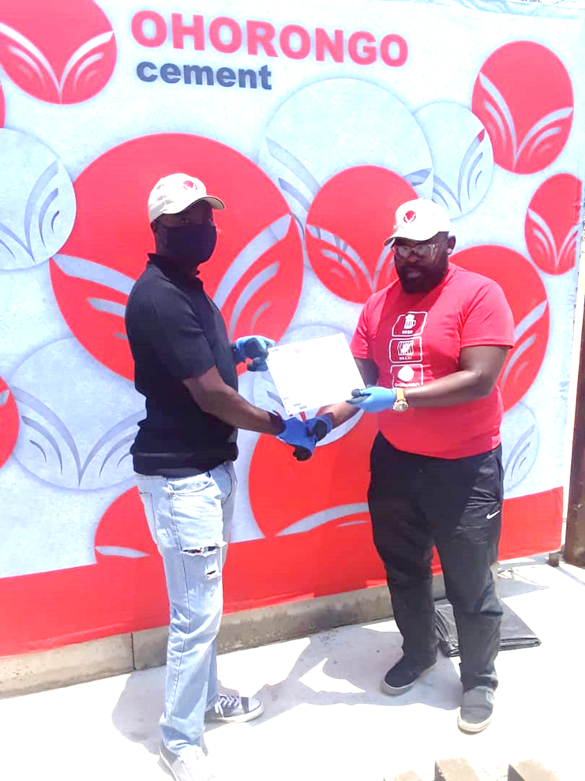
Thank you

