Slide 1

SHACK DWELLERS FEDERATION OF NAMIBIA(SDFN) NAMIBIA HOUSING ACTION GROUP(NHAG) TRUST
ALAN
LAND AND HOUSING STRATEGY SEMINAR
Community based housing strategies and partnership with LAs in Namibia
20-22 March 2023

Slide 2
Background to Housing (as per current housing policy revision)
The Namibian housing crisis is characterised by high housing costs due to
slow and costly delivery of serviced land and
negligible affordable formal housing production,
in a context of high un- and underemployment, and extremely low levels of household income.
2009 policy emphasis on homeownership as economic driver
Mass Housing Development Programme (MHDP) predominantly focus on credit-linked housing during the pilot phase as the houses remained unaffordable to the majority.

Slide 3
Social Context of Housing
Majority of the population is excluded from accessing conventional credit-linked housing according to NSA statistics
62% earning below N$5,000 per month
25% earning between N$5,000 and N$10,000
Informal housing is dominating our urban landscapes.
The data collected by communities indicated that 216,000 shacks accommodate about 950,000 people in 285 informal settlements with About 40% of the urban population (Community Land Information Program-CLIP)
Access to land: Security of tenure is denied – no development opportunities

Slide 4
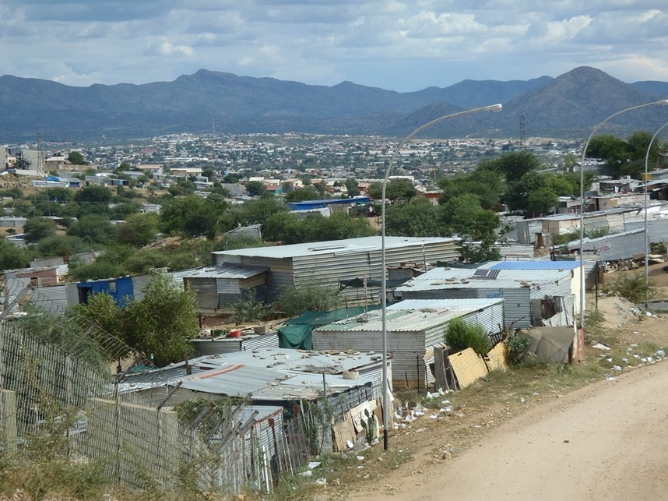

Slide 5
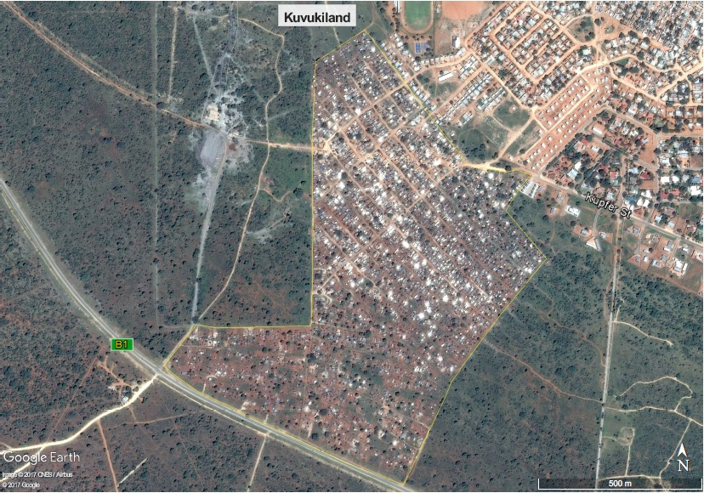

Slide 6
CURRENT DEVELOPMENT OPTIONS FOR SOCIAL INCLUSION, TARGETING THE LOW-INCOME HOUSEHOLDS (TWO FOCUSING ON COMMUNITY BASED INITIATIVES)
1 BUILD TOGETHER PROGRAM:
- Local Authorities manage the program.
Move away from owner-built and employ contractors
2. SAVING GROUPS DEVELOP THEIR OWN HOUSING SOLUTION
Independent saving groups financed by Built Together, Local Authorities
Shack Dwellers Federation of Namibia managing their own Poor Peoples Development Fund – Twahangana Fund supported by MURD, Private Sector and Communities to build their own houses and develop their own land
3. MURD/CoW/NHE informal settlement upgrading programme
- House construction on individual plots on credit-linked principles
4. PARTICIPATORY INFORMAL SETTLEMENT UPGRADING
Multi-partner approach to community driven informal settlement upgrading (enumerations, mapping, studio planning, reblocking and servicing) to open housing development opportunities – currently MURD funds channelled through Twahangana Fund
5. GREENFIELDS DEVELOPMENT
Local Authorities developing with mostly government funding new townships and plots for sale
Development Workshop develop greenfields plots of land

Slide 7
SAVING GROUPS DEVELOP THEIR OWN HOUSING AND LAND SOLUTION
SHACK DWELLERS FEDERATION OF NAMIBIA (SDFN)
A Social Movement on National Level of 1,016 Saving Groups, Comprised of 31,197 households - aim to improve the living conditions by working together as saving groups and supporting informal settlement communities according to their needs.
Supported by
NAMIBIA HOUSING ACTION GROUP (NHAG) TRUST, an NGO with 10 employees support the SDFN and informal settlement communities financially, technically, linking the community to the formal sector and administering their Poor People’s Fund (to meet land, service and housing needs)

Slide 8
SOCIAL ASPECTS OF COMMUNITY BASED INITIATIVES
PARTICIPATION: The Federation activities empowers saving group members and informal settlement communities to participate in their own development.
INFORMATION: knowledge about ourselves, help us to develop ourselves - and the Community Land Information Program support us and LA.s to make development decisions
SAVINGS is not only bringing small money together but people sharing their needs and planning for their development
EXCHANGES - Learning from each other while practicing thereby Building capacity by learning from each other on good practices.

Slide 9
SDFN
Social movement built on daily savings, regular learning exchanges, and managing their own construction and fund – built 7,453 houses
According to the quarterly data submitted for the 2nd National Land Conference report – supplying 79% of the low-income housing in Namibia – mainly financed through multi-sector (government and Private, community repayments) - channelled through the Twahangana Fund

Slide 10
Namibia Progress on housing delivery
Summary from Progress report on Implementation of the resolutions of the 2nd National Land Conference
Urban Land Resolution 22 |  | Build 300 000 housing units/opportunities over the next 7 years. This is a National emergency
Report | 2021/2022 |  |  |  | 2020/2021 | 2019/2020 | total statistics |  | For low-income group: +- less than NAD 8,000 monthly income
stakeholders | Quarter 1 | Quarter 2 | Quarter 3 | Total 9 months |  |  | Total for 2.75 years
 |  |  |  |  |  |  | number | % | number | %
MHDP (Mass Housing Development Program) |  |  |  |  |  | 222 | 222 | 6.0
Private Developers | 135 | 93 |  | 228 | 138 | 283 | 649 | 17.6
PPP |  | 26 | 12 | 38 |  |  | 38 | 1.0
SDFN | 298 | 79 | 86 | 463 | 787 | 585 | 1835 | 49.8 | 1,835 | 75.14
Decentralised BTP | 38 | 28 |  | 66 | 44 | 102 | 212 | 5.7 | 212 | 8.68
Otweya Decongestion Walvis 13 | 13 | 40 |  | 53 |  |  | 53 | 1.4 |  | 0.00
ISSUP MURD/WHK Council/NHE | 131 | 4 | 65 | 200 | 74 |  | 274 | 7.4 | 274 | 11.22
Council Funding |  |  |  | 0 | 44 |  | 44 | 1.2 |  | 0.00
BTP Trust/Council | 6 |  | 115 | 121 |  |  | 121 | 3.3 | 121 | 4.95
NHE | 15 | 98 |  | 113 | 92 | 257 | 462 | 12.5 |  | 0.00
total | 636 | 368 | 278 | 1,282.00 | 1,179.00 | 1,227.00 | 3,688.00 | 100.0 | 2,442.00 | 100.00

Slide 11
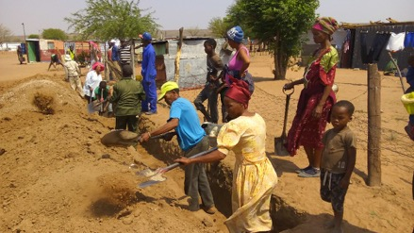
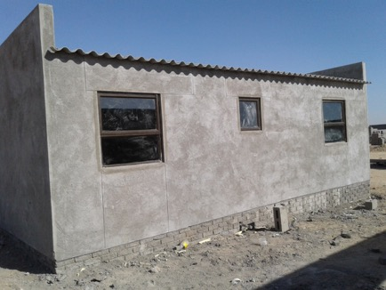
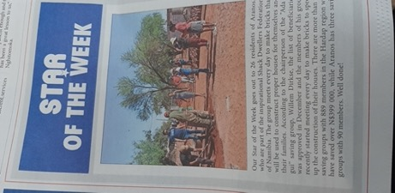
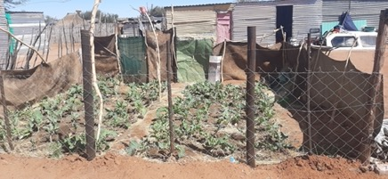
Communities reducing housing and servicing cost through own contributions - savings, brick making and managing their construction

Slide 12
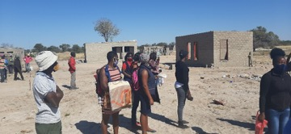
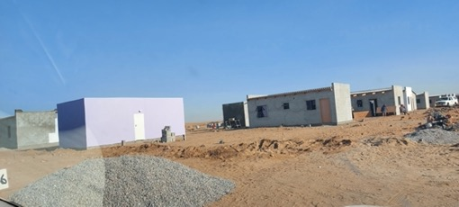
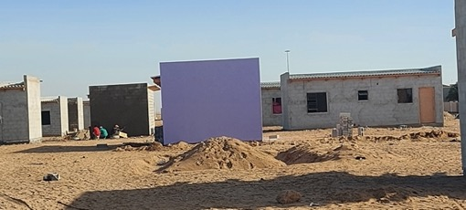
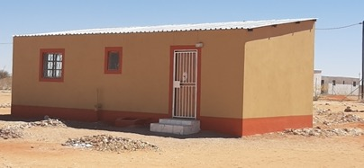
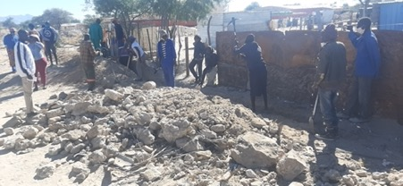
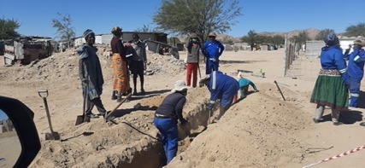
+7,000 Houses constructed by SDFN

Slide 13
BUILDING PARTNERSHIPS TO FINANCE AFFORDABLE HOUSING Government, Community and Private Sector contribute to the Twahangana Fund
Twahangana Fund as the Poor People’s Development Fund provide finances for servicing land and building of houses. It was established in 1995
The saving groups approved the loans, and do the bookkeeping, manage the loan repayment while NHAG administer the books
The fund channelled N$291,6 million to the housing groups for members to build houses, install services and improve income which include the following:
30.3% (N$88.4 million) member repayments from loan
5.4% (N$15.7 million) PPF member contribution
36.6 % (N$106.8million) of the funds came from the Ministry of Urban and Rural Development (Government of Namibia) and is also revolving, N$2.4 million used for capacity building and technical support
4.8% (N$ 14.2 million) channeling Decentralised Build Together loans
14.6% (N$42.5 million) of the funds came from the Private Sector donation: including
Standard Bank Buy-a-Brick Donations -
Three Partners: Ohorongo Cement, FNB and Pupkewitz Foundation (Building Material suppliers) donations
B2Gold
Office of the First Lady
MTC Knock out competition
Osino Mining
ABC Fishing Shares
8.3% (N$24.2 million) is from external funders

Slide 14
Twahangana Fund

Slide 15
A SHORT STUDY ON COMMUNITY FINANCING MECHANISMS FOR
AFFORDABLE HOUSING PRODUCTION IN AFRICA
“Transparency seems to be one of the main principles of the Twahangana Fund. The fund is managed by the communities themselves. With NHAG and SDFN, these communities have demonstrated their ability to directly manage donor and government funding, thanks to several years of experience and strong monitoring systems (Namibia). “
CAHF, Urban-Monde, UrbanSEN

Slide 16
INCREMENTAL INFORMAL SETTLEMENT UPGRADING TOWARDS SOCIAL AND ECONOMIC INCLUSIVE URBAN DEVELOPMENT A partnership approach to scaling up security of tenure and housing opportunities through co-production between organised communities, local and regional authorities, central government, universities, private sector and other stakeholders

Slide 17
NO | OUTCOMES | ACTIVITIES
1 | Identification of implementation/ sites based on the commitment of both LA and community | Consult communities and Local/Regional/National Authorities to start with profiling (if not already done) Identify the demand-driven location (agreement with Authorities and communities to implement the process, availability of bulk services) Establish a team from the Local Authority and community and other stakeholders to facilitate the process
2 | Information for development decisions | Undertake Community Land Information Program (CLIP) based on the boundaries of the settlements determined by the LA and communities, as well as backyard shacks, tenants and second households (overcrowded extended families) in existing formal housing Register households not covered by CLIP in the informal settlements and saving groups, at relevant LA property division Assess of existing bulk infrastructure services Identify potential for investments based on Local Authority budgets, central government finance and local community contributions
3 | Locally driven settlement plans | Feedback on settlement data/information with discussion forums to identify priority needs and future planning Facilitate city-wide planning sessions with all stakeholders Conduct studio sessions on Informal Settlement Upgrading and/or Green Fields Development based on city-wide planning and priority needs identified Draw up settlement and greenfield layouts, agreed upon by community and Authorities Develop service plans with all stakeholders Submit plans to Local Authority for approval for development rights and/or Flexible Land Tenure registration
4 | Secure tenure and basic services to enable housing development | Establish an enabling body/technical team between the Local, and Regional Authorities, NHAG/or relevant technical supporter, and community and for the installation of basic services (water, sanitation) Survey larger block erven (land surveyor) and individual plots (technician) Start re-blocking process with community Install basic service reticulation with community and as part of learning-by-doing approach Approve occupation and development rights certification (Local Authority) while Flexible Land Tenure application is processed
5 | Improved shelter | Facilitate households to use/access: (a) their own financial resources; (b) Build Together loans as individuals or independent saving groups; or (c) the Twahangana Fund to construct permanent houses

Slide 18
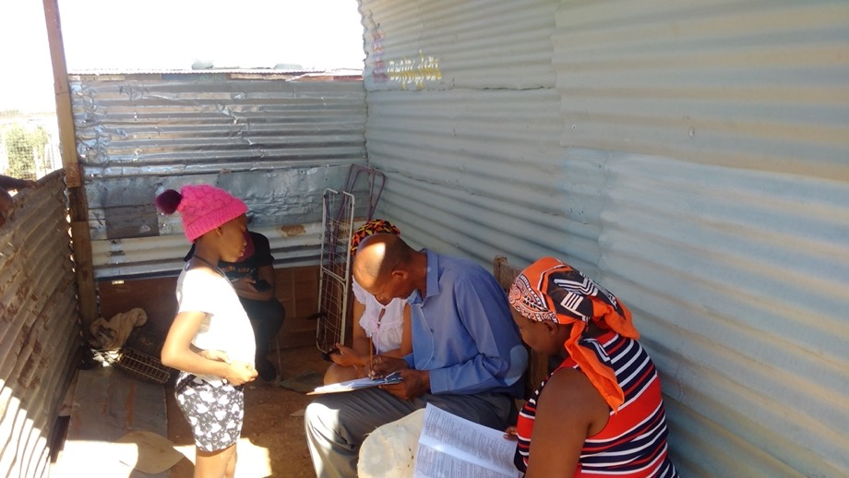
Enumerations - mapping structures and socio-economic data through the Community Land Information Program

Slide 19
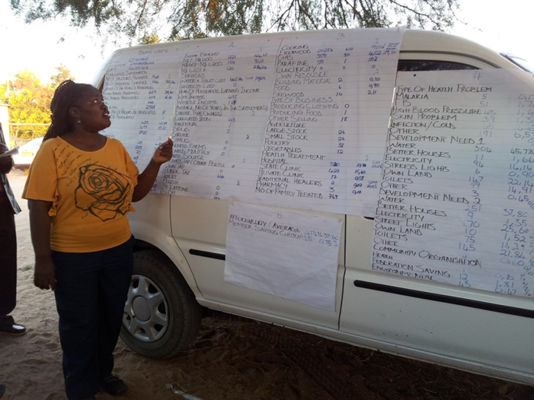
Feedback of results to community and Local Authority
Who are we, what can we afford, and what do we need?

Slide 20
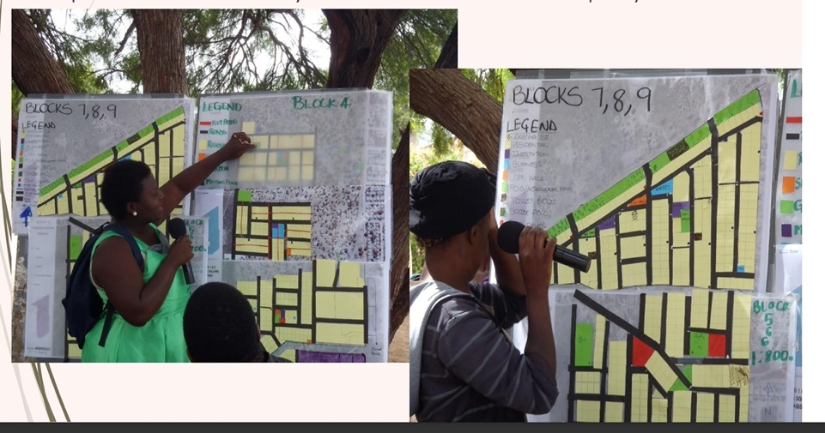
Layout plans prepared by community during planning studios with students and professionals
What do we want?

Slide 21
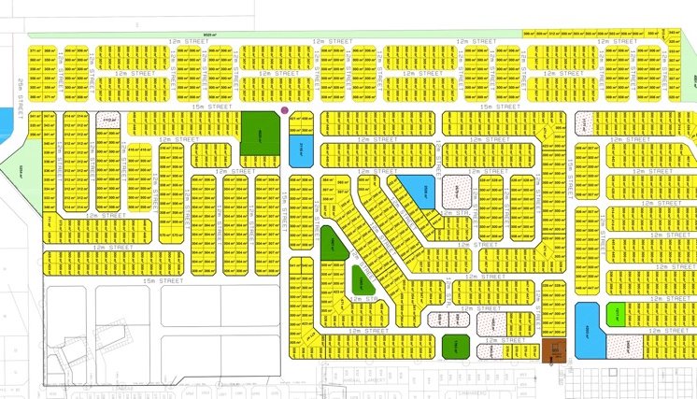
DRAFT LAYOUT FROM THE COMMUNITY STUDIO
Draft layout plan for Local Authority approval–
Can our dream become a reality?

Slide 22
Reblocking:
Survey blocks – moving into sites

Slide 23
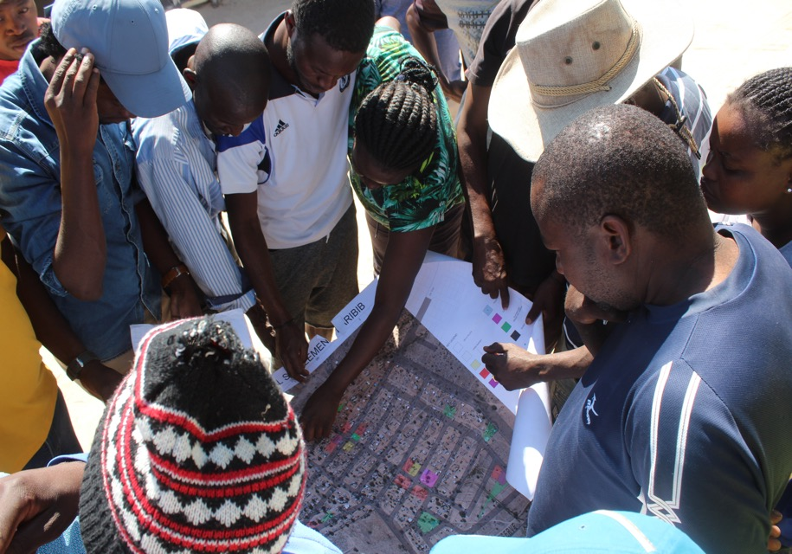

Slide 24
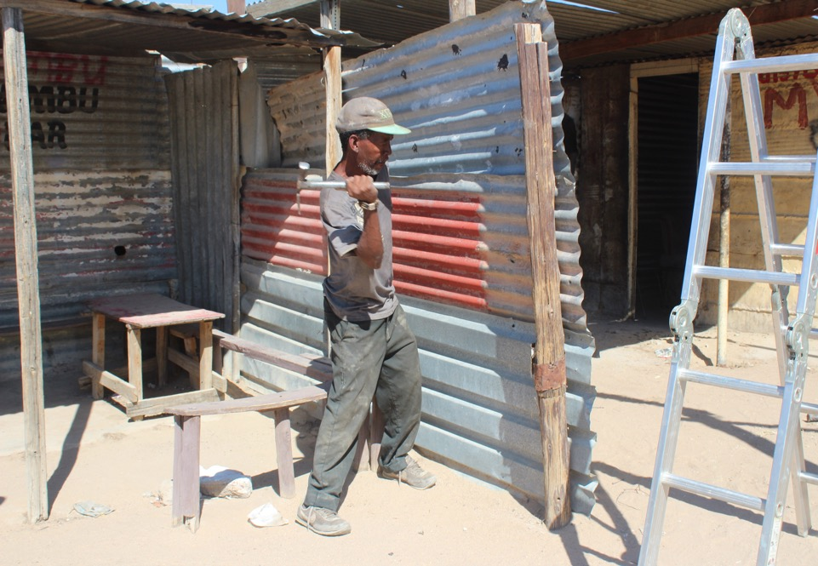

Slide 25
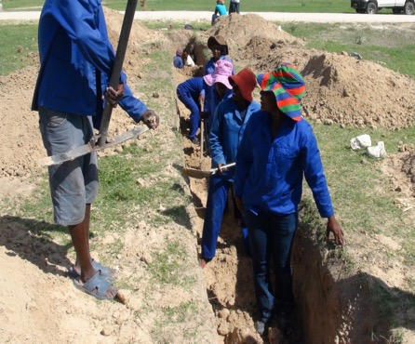
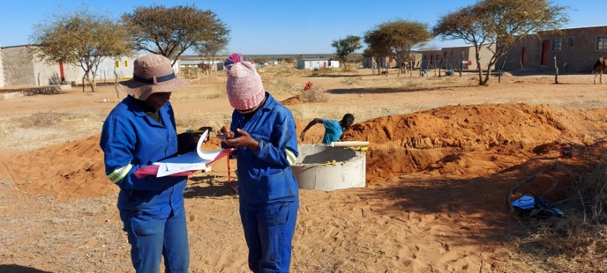
Thank you
Servicing of land

Slide 26
Informal Settlement Upgrading in Partnership with Local Authorities

Slide 27
IMPACT OF COMMUNITY DRIVEN UPGRADING WORK
Gobabis Freedom Square the first pilot resulted in 1,115 households occupying developable land with water and sanitation for less thatn N$10,000 per plot (conventional development in Gobabis is N$80,000)
Received flexible land tenure titles
Start constructing housing from Twahangana Fund and with own initiatives
Another 23 Local Authorities are active in upgrading work – in 34 Informal settlement with 27,000 households
1,400 households in Karibib and Helao Nafidi informal settlements have access to water, marked plots and are installing sewer

Slide 28
SOCIAL IMPACT OF ENABLING COMMUNITIES TO PARTICIPATE IN THE HOUSING AND LAND PROCESS
Meeting the need for a “home” on scale with less per capital costs (N$35,000 to N$40,000 per house), while communities and technical support add more than double that value on the capital invested
ownership on local level
Enabling social capital and shared knowledge
Building capacity of the “excluded” especially women and low-income earners
Broader community (Local Authorities, private sector, individuals) contribute to the process – broadening the principle of partnership

Slide 29
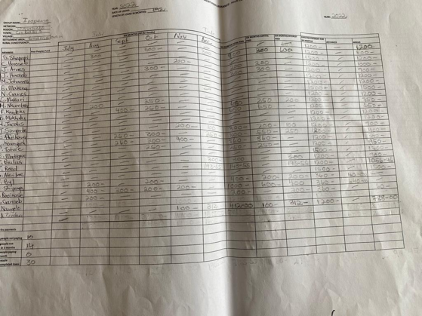
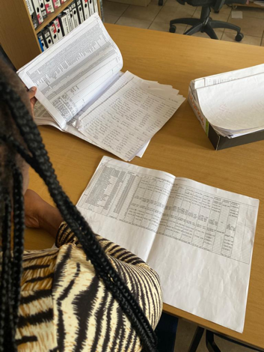
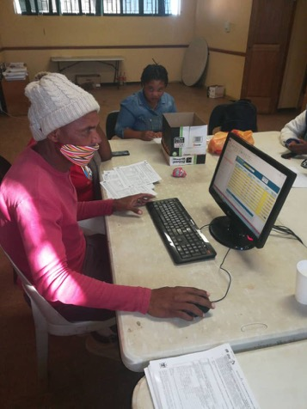
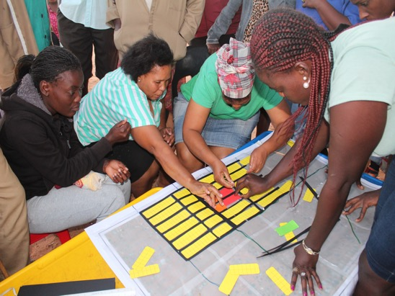

Slide 30
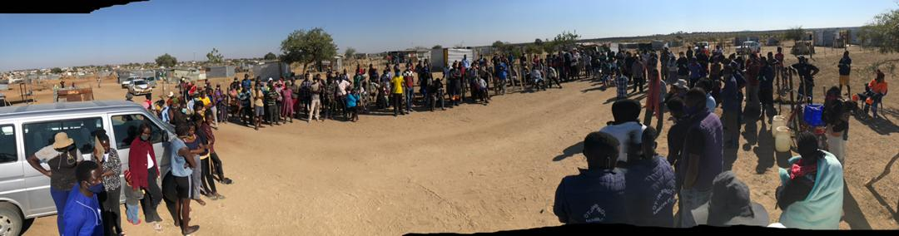
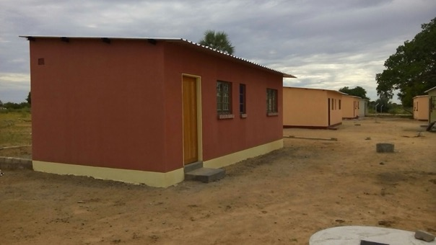
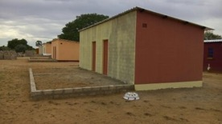
Thank you
Thank you

